Slide 1

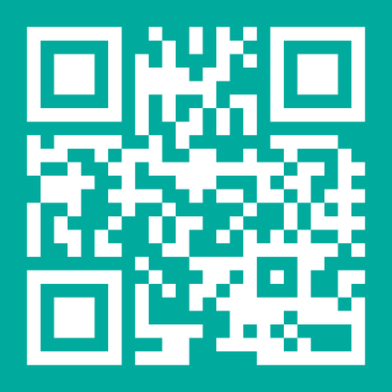

Slide 2

Aims
Practical approaches to supporting patient mental health and staff wellbeing in primary care:
Supporting Patients
Supporting Ourselves
Accessing Support

Slide 3
Supporting Patients
Pharmacy technicians may notice:
Changes in presentation or behaviour
Can you think of a difficult patient you have encountered recently?
Frequent visits or increased reassurance seeking
Low mood, anxiety, overwhelm, frustration
Social isolation or caring pressures
Medication adherence concerns
Notes:
“What signs might tell us someone is struggling emotionally, even if they don’t say it directly?”

Slide 4
Supporting Ourselves
Repeated exposure to distress can lead to:
Compassion fatigue
Stress / Burnout
What aspects of your role do you find most emotionally draining?​
Reduced empathy
How do you deal with these?
Feeling overwhelmed
Carrying conversations home mentally
Notes:
“What helps you reset after a difficult interaction?”

Slide 5
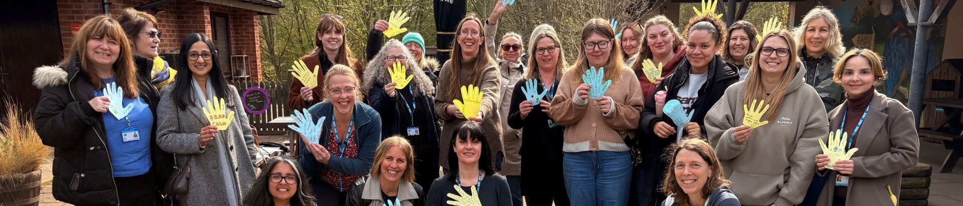

Burnout, stress and unsupported teams are driving experienced colleagues out of our system, just as we cant afford to lose them. Our health and wellbeing offer is a structured response to this reality, providing accessible support that treats workforce wellbeing as a core issue.

Slide 6
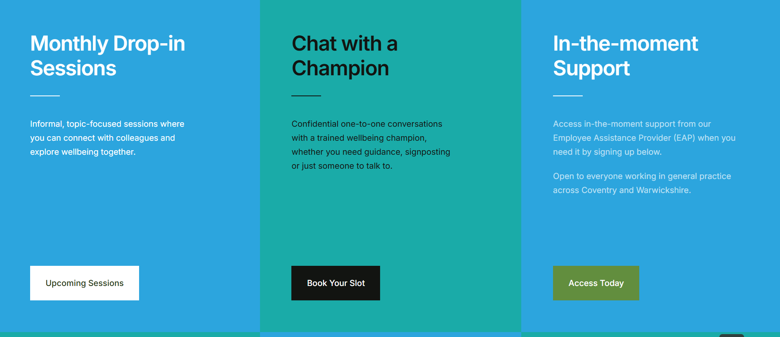
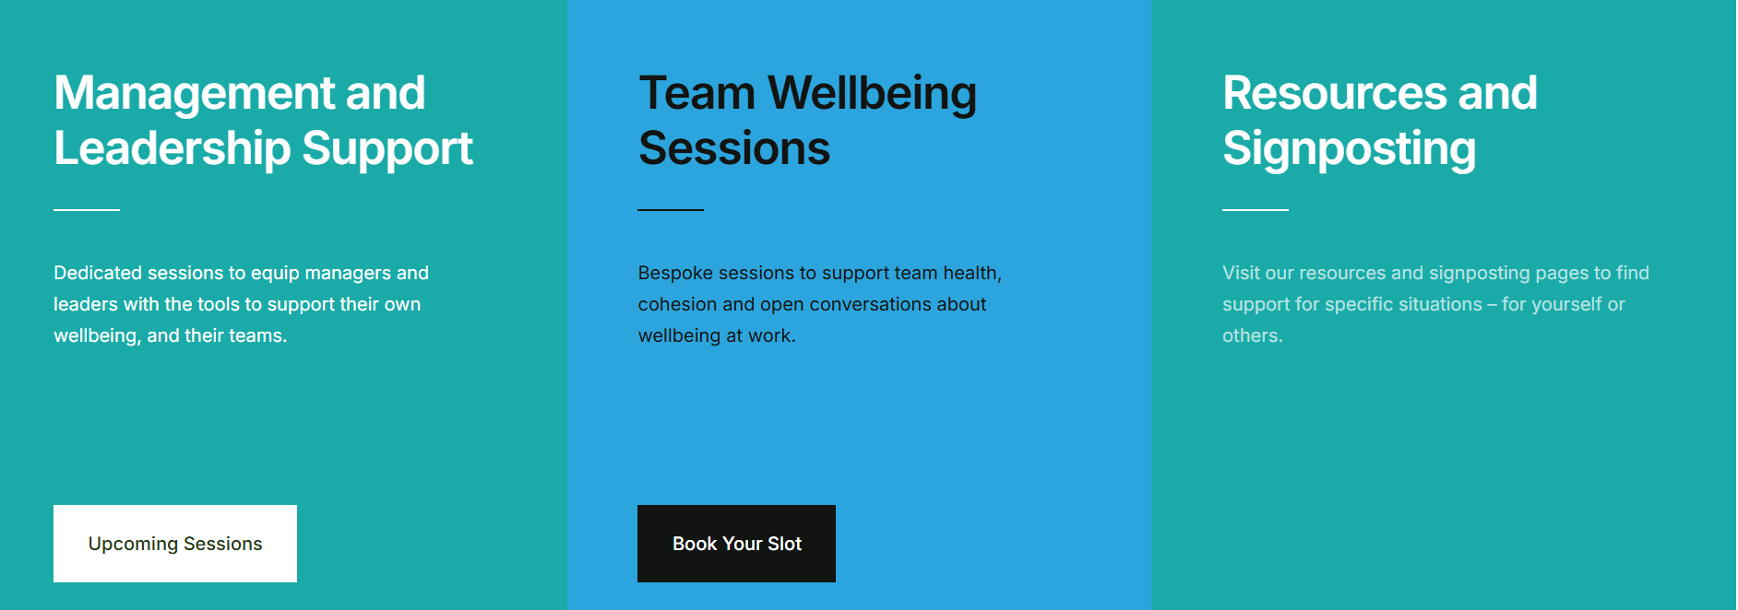
Notes:
Website lay out - How to access a Champion and support for self, teams and managers/leaders

Slide 7
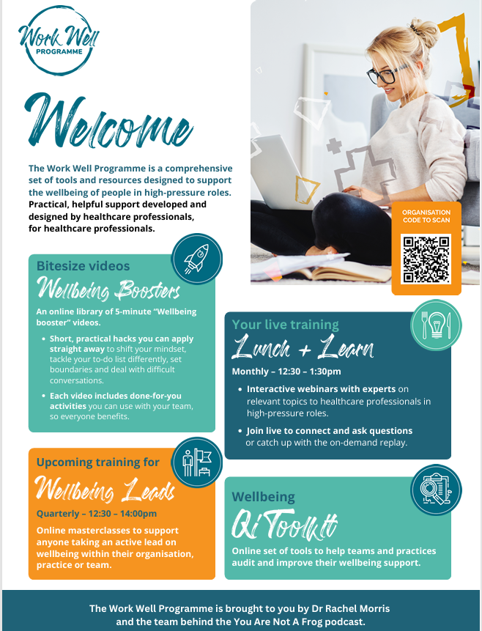

Please get in touch:
Wellbeing Helping Hub www.cwthwellbeing.com
cw.traininghub@nhs.net
Notes:
Work well programme – Dr Rachel Morris support

Slide 8
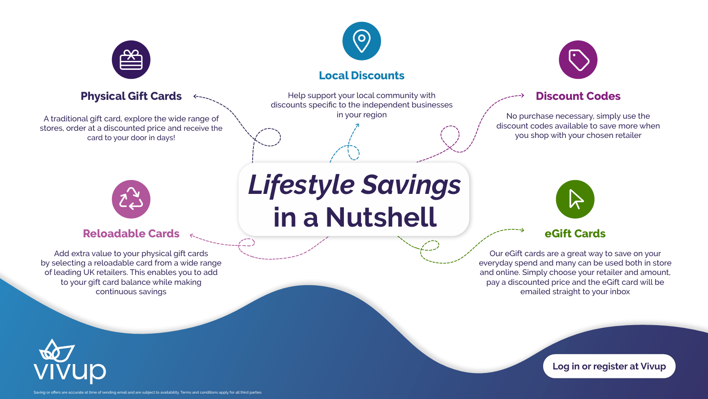
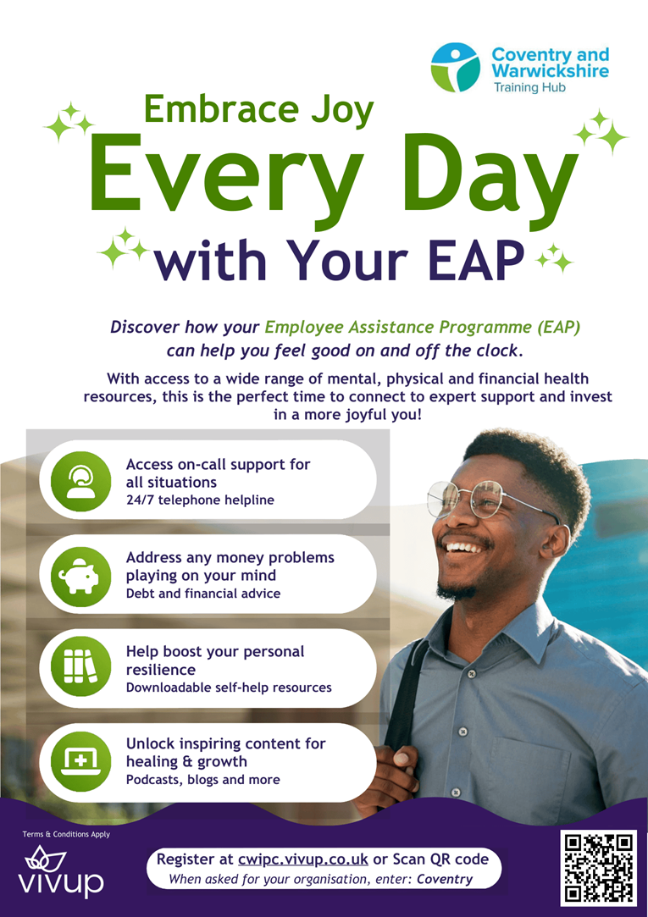

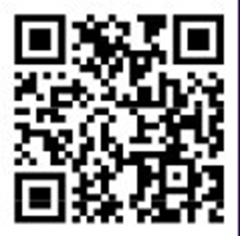
Notes:
VIVUP – EAP and lifestyle savings

Slide 9
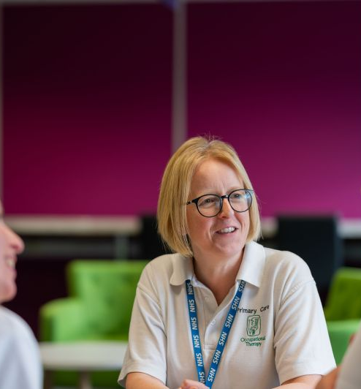
MDT & Community support options
GP/practice teams
Social prescribers
Health coaches
Mental health practitioners
Carer support services
Local voluntary/community groups
NHS talking therapies
Crisis pathways where appropriate
Notes:
“We are not expected to manage complex mental health needs alone - knowing where to signpost is part of good care.”

Slide 10
Questions
A chance for you to ask any questions you may have in a safe open environment.

Slide 11
Thank you
Small compassionate interactions matter.
We don’t need to have all the answers…
being present
listening
and connecting people with support
…can make a real difference.
What is one thing you might try differently after today?
Notes:
“What helps you reset after a difficult interaction?”

