Slide 1
Depression
Symptom, Diagnosis &Treatment
June 2026
Tracy Ewing
Clinical Governance Pharmacist, CWPT

Slide 2
Objectives
Awareness and understanding of the:
  Symptoms of depression
  Diagnosis of depression
  Medicines used to depression
  Switching antidepressant treatment
  Discontinuation symptoms
  Hyperbolic tapering

Slide 3
Symptoms & Diagnosis of Depression
Symptoms can be divided into four main categories:
Psychological (affecting mood & perception)
  Low mood
  Anhedonia (reduced ability to experience pleasure or a total lack of interest in engaging in previously enjoyable activities)
Physical
  Sleep disturbances
  Weight change
Cognitive
  Difficulty in concentrating
  Poor memory
Behavioural
  Agitation
  Psychomotor retardation
  Self neglect

Slide 4
Symptoms & Diagnosis of Depression
Depression should always be considered a possible diagnosis in someone who has:
  • previous episodes of depression
  • experienced recent life events, e.g., a birth, a death, marriage, redundancy, divorce, pregnancy, termination or miscarriage
  • had coronary heart disease: post-myocardial infarction – depression is recognised as an independent risk factor for CHD and MI
  • a family history of depressive illness
  • a chronic disease state
  • a history of stroke

Slide 5
Symptoms & Diagnosis of Depression
The two core features of depression are:
  a persistent low mood
  an inability to take an interest in or pleasure from normal activities (called anhedonia)

Slide 6
Symptoms & Diagnosis of Depression
Screening & Rating Scales in Depression:
Both the British Association of Psychopharmacology (BAP 2015) and NICE (NG222 2022 & CG91 2009) recommend the following questions to detect depression:
  During the past month, have you often been bothered by feeling down, depressed or hopeless?
  During the past month, have you often been bothered by little interest or please in doing things?
“Yes” to either question is a positive result, “no” to both questions means depression is highly unlikely
“Yes” to both questions give 96-96% sensitivity at identifying depression
Sometimes called Whooley questions¹
1. Whooley et al. J. Gen Intern. Med. 1997 12 426-445

Slide 7
Treatment
Goals of Antidepressant treatment:
Effective treatment must be provided early to reduce mortality and risk
The aim is to return the patient to an asymptomatic or premorbid state
To restore normal functioning
To prevent or reduce the risk of recurrence
To reduce social isolation
Efficacy of antidepressants depends on two conditions being met:
minimum effective dose
Effective dose continues for an adequate period

Slide 8
Treatment
Treatment split into 3 phases:
Acute phase:
Achieving effective minimal dose and maintain for 6 weeks
Antidepressants start to work within 1-2 weeks
NICE 222 recommends if there is no or limited response after 4 weeks, either dose is increased or antidepressant changed (maybe increase in side effects
Continuation Phase:
Effective dose continued for at least 6 months
Increased risk of relapse
NICE recommend 12 months
Prophylactic Phase:
If history of recurrent episodes, aim is to prevent further episodes
During long term treatment – physical health must be monitored

Slide 9
Treatment
Antidepressant Classes:
  Tricyclic Antidepressants (TCAs)
  Selective Serotonin Reuptake Inhibitors (SSRIs)
  Monoamine Oxidase Inhibitors (MAOIs)
  Serotonin & Noradrenaline Reuptake Inhibitors (SRNIs)

Slide 10
Treatment
Tricyclic Antidepressants (TCAs)
TCAs licensed in UK:
Amitriptyline
Clomipramine
Dosulepin
Doxepin
Imipramine
Lofepramine
Nortriptyline
Trimipramine

Slide 11
Treatment
Tricyclic Antidepressants (TCAs) – Safety
Toxicity in overdose
Cardiac toxicity – impair electrical conduction in heart (prolonged PR,QRS &QT intervals on ECG) can result in arrythmias & heart block
Behavioural toxicity – sedation, concentration difficulties & postural hypotension
Hepatotoxicity – metabolised by liver and therefore should be avoided in severe hepatic impairment
Proconvulsant effect – lower convulsive threshold so should be avoided in epilepsy
Use in the elderly – due behavioural and cardiac toxicity use should be avoided
Drug interactions
Side Effects:
Dry mouth – try sugar free chewing gum or artificial saliva spray
Sedation – take all at night if possible
Constipation – stimulant laxative may be needed in long term
Weight gain – dietary & exercise

Slide 12
Treatment
Selective Serotonin Reuptake Inhibitors (SSRIs)
SSRIs in the UK include:
Citalopram
Escitalopram
Fluoxetine
Paroxetine (specialist advice before prescribing)
Sertraline
All very similar in efficacy, toxicity, side effects

Slide 13
Treatment
Selective Serotonin Reuptake Inhibitors (SSRIs) – Side effects
Nausea & diarrhoea – usually transient
Bleeding disorders – following injury, serotonin is released to promote platelet aggregation. SSRIs block serotonin transport molecules on platelets therefore depleting platelet serotonin stores – increasing the risk of bruising, purpura & nose bleeds. Also increased risk of perioperative bleeding & cerebral haemorrhage. In older population GI risk and people co-prescribed aspirin or NSAIDs (NICE CG91 – if unavoidable PPI to be prescribed)
Hyponatremia – especially in elderly – look out for drowsiness, confusion, fatigue, muscle cramps or sleep problems
Sexual dysfunction – erectile difficulties common – patients should be made aware before starting therapy
Loss of libido – occurs in both sexes, common in depression but if still persistent when all other symptoms have lifted more likely to be medication induced. May also raise prolactin
Motor symptoms – Parkinsonian side effects
Nocturnal teeth grinding - often presents with a dull persistent headache in the morning and the patient may complain of jaw pain
Anxiety – exacerbation of anxiety, especially in early days of treatment

Slide 14
Treatment
Selective Serotonin Reuptake Inhibitors (SSRIs) – Safety
Serotonin Syndrome:
Potential risk with any medicine which increases serotonergic transmission, especially high dose SSRIs, and when antidepressants are used in combination with lithium
If mild can be managed by dosage reduction or medication withdrawal plus benzodiazepines
If severe, patient will require major supportive measures and can result in multiple organ failure and death
Symptoms include:
  Agitation, restlessness
  Sweating, fever
  Diarrhoea, nausea, vomiting
  Poor coordination, confusion, hypermania
  Hypertension
  Tachycardia
  Convulsions
Onset usually within a few hours of medication/dose changes and usually resolves within 24 hours after withdrawal

Slide 15
Treatment
Selective Serotonin Reuptake Inhibitors (SSRIs) – Safety
Reduced Bone Density: SSRIs associated with bone density reduction and increased risk of fractures
QT interval prolongation: Citalopram & escitalopram associated with clinically relevant prolongation of QT interval which led to changes in licensing:
  Max dose for citalopram reduced to 40mg (20mg in older adults & reduced hepatic function)
  Max dose escitalopram for 65 years+ is 10mg OD
  Contraindicated in congenital/known QT prolongation syndrome
  Contraindicated with other medicines known to prolong QT interval

Slide 16
Treatment
Monoamine Oxidase Inhibitors (MOAIs)
Specialist only
Not first line
Similar side effect profile to TCAs
Life threatening interaction with tyrosine & tyramine containing foods (aged/mature cheeses, cured or aged meats, fermented or pickled food, yeast & meat extracts) – ‘Cheese Syndrome’
Patient should carry a warning card
Reversible Inhibitor of Monoamine Oxidase-A (RIMA)
Moclobemide

Slide 17
Treatment
Serotonin and Noradrenaline Reuptake Inhibitors (SNRI)
Venlafaxine:
shown to increase blood pressure and heart rate – caution in patients with established cardiac disease (e.g. recent myocardial infarction)
Periodic blood pressure monitoring recommended. If BP increased sustained – reduce dose or discontinue
Duloxetine:
Optimal dose 60mg OD
Can increase BP so monitoring required in patients with hypertension or other cardiac disease
Other Antidepressants:
Trazodone:
Trazodone has a low incidence of anticholinergic side effects but is associated with nausea and vomiting and anorexia as well as postural hypotension.
Trazodone is regarded as safe in the elderly, appears not particularly cardiotoxic and has not been associated with reducing platelet serotonin content.
Agomelatine:
Contraindicated in hepatic impairment. LFTs recommended for all patients

Slide 18
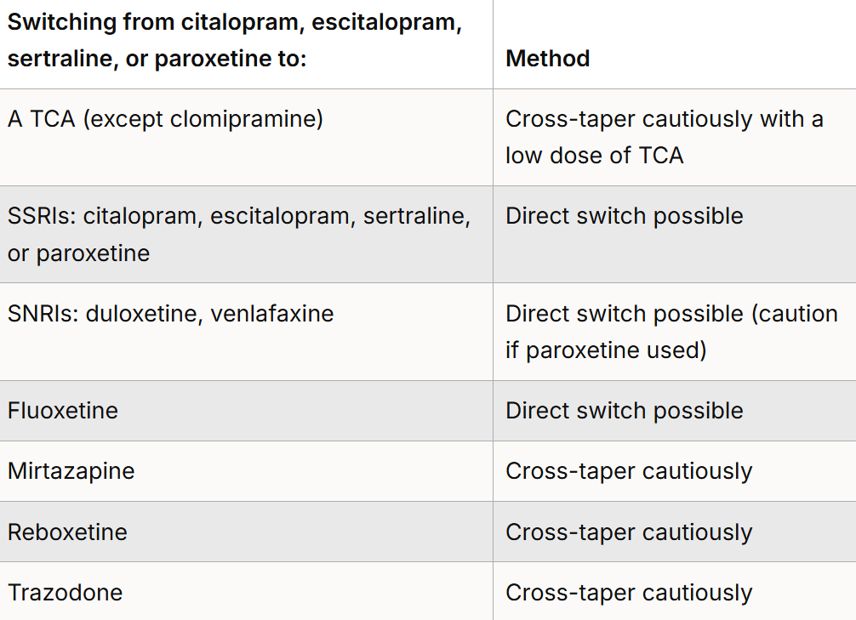
Switching Antidepressants
NICE provides guidance on switching:

Slide 19
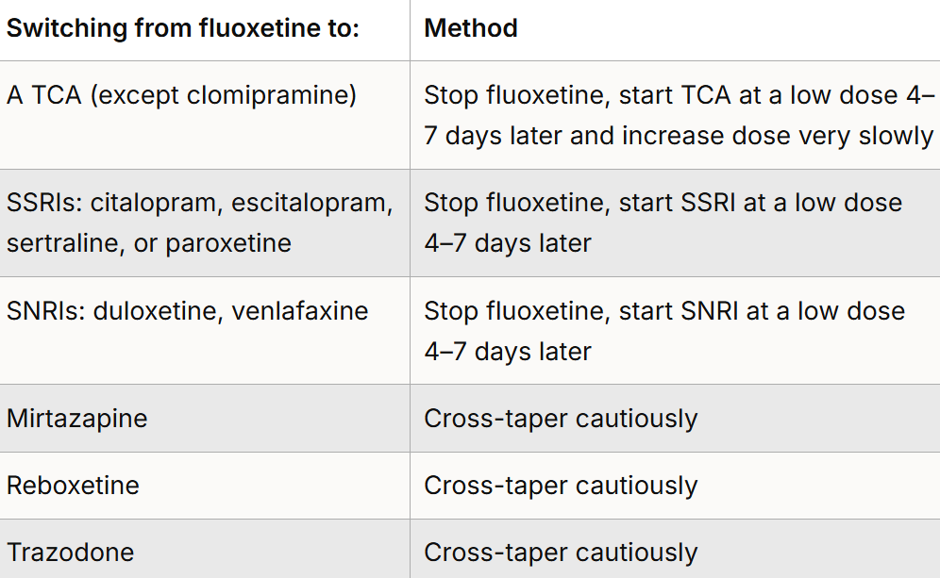
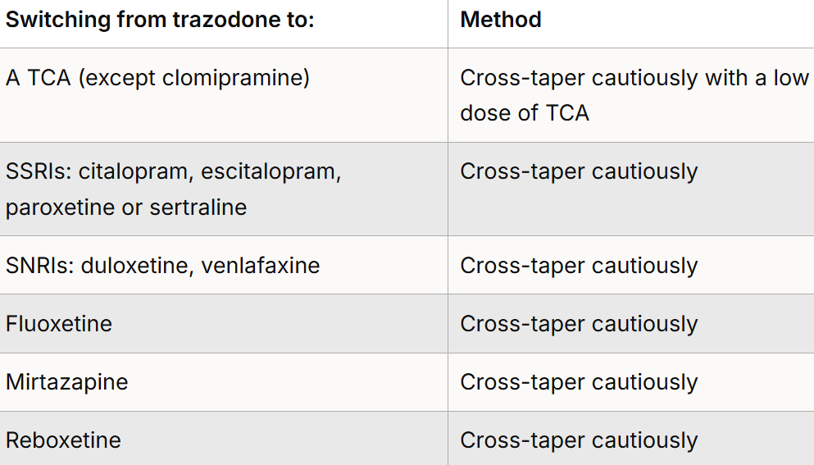
Switching Antidepressants
:

Slide 20
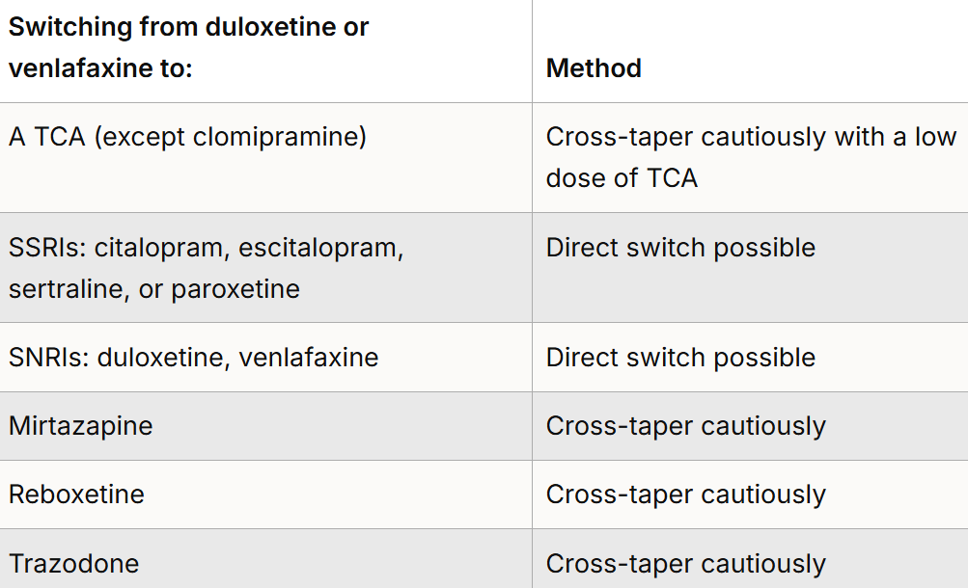
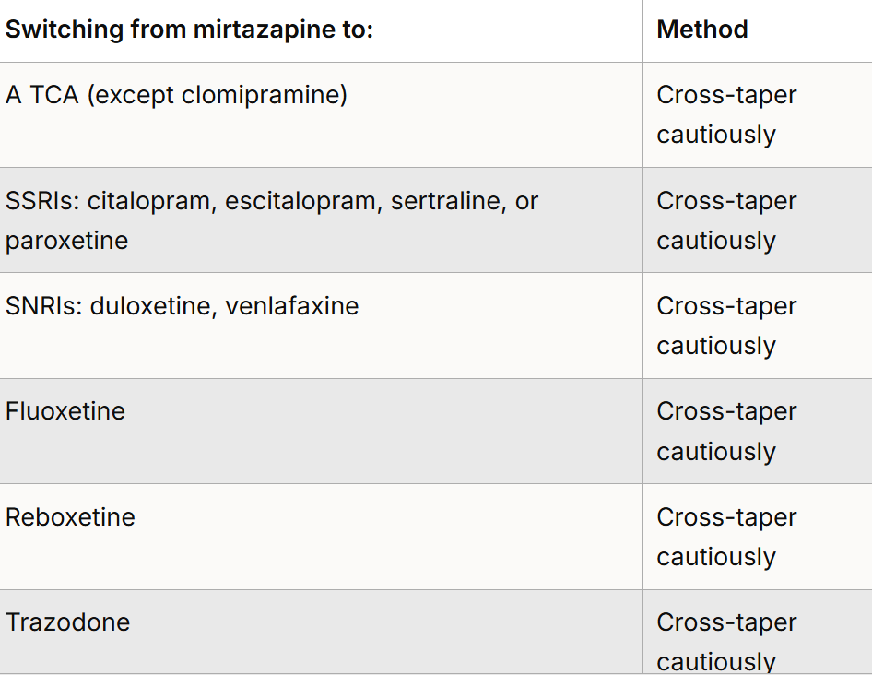
Switching Antidepressants
:

Slide 21
Discontinuing Antidepressants
Antidepressants can cause problems not only at initiation and during the maintenance phase but also when they are stopped suddenly, or when doses are missed or reduced too quickly.
Patients may be concerned that antidepressants are addictive
While discontinuation (or withdrawal) phenomena are associated with almost all antidepressants and these can result in very unpleasant and prolonged effects they do not fulfil the criteria for drug dependence
The discontinuation reaction seems to be a consequence of an abrupt drop in transmitter levels in central and perhaps also peripheral synapses
Consequences of discontinuation symptoms:
May impair a patient’s quality of life
Misinterpretation as a relapse of depression may result in an unnecessary extension of treatment
Unnecessary clinical investigations may be ordered
Unnecessary treatments for the symptoms may be prescribed
They may have a negative influence on compliance – possibly adding to patient fears that antidepressants are addictive
NICE NG222: withdrawal effects and concerns about stopping medication should be discussed with a person when starting on antidepressant medication

Slide 22
Discontinuing Antidepressants
Recognition of discontinuation symptoms
Usually occur with 72 hours of abrupt discontinuation or rapid dose reduction
All classes of antidepressants have potential to cause discontinuation symptoms but are more common with shorter elimination half lives
Tapered withdrawal not necessary if been taken for less than 4 weeks
Characteristic symptom profiles.
Discontinuation symptoms with TCAs
Gastrointestinal complaints
Abdominal pain, nausea, diarrhoea
Flu-like symptoms
Fatigue
Anxiety and agitation
Sleep disturbances including nightmares

Slide 23
Discontinuing Antidepressants
Discontinuation symptoms with SSRIs
Dizziness, light headedness, vertigo, ataxia
Nausea, vomiting, diarrhoea
Lethargy, headache, tremor, sweating, anorexia
Paraesthesia, numbness, “electric shock” – like sensations
Irritability, anxiety, agitation, low mood
Discontinuation symptoms with other antidepressants
Abrupt withdrawal of MAOIs has been associated with seizures, delirium, psychosis and rapid relapse
Tapered withdrawal is recommended for both venlafaxine and duloxetine. Discontinuation symptoms with venlafaxine are likely if it is stopped abruptly due to its short half-life and a longer tapering is recommended than for duloxetine
The SPC states that agomelatine can be withdrawn abruptly, with no need for tapering.
Vortioxetine SPC states that it can be withdrawn abruptly.

Slide 24
Discontinuing Antidepressants
Managing Antidepressant Discontinuation
Advise patient to talk to their prescriber if they wish to stop their antidepressant and they should not stop abruptly. The dose should be reduced gradually over time
Many patients who experience discontinuation symptoms require no more than an explanation and reassurance that mild symptoms usually only last a few weeks
Although many cases of discontinuation symptoms are mild, transient and self-remitting, to reduce the risk of the patient experiencing these symptoms, most antidepressants should be withdrawn gradually once treatment is completed, over a minimum of 4 weeks

Slide 25
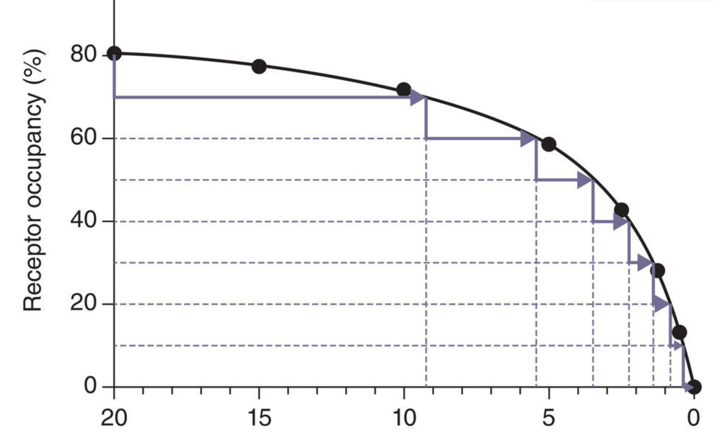
Discontinuing Antidepressants
Hyperbolic (gradual) Tapering
Reducing medications in progressively smaller increments as the dose decreases rather than fixed amounts
Based on the non-linear relationship between medicine dose and its effect on target receptors
Allowing for smaller reductions at lower doses minimise discontinuation/withdrawal symptoms
Reducing the dose by 10-20% of the previous dose
Each dose should be taken for 1-2 weeks (minimum) to monitor patient’s response
Can take months or years to completely discontinue a medicine
Relies on the availability of appropriate formulations tablets/capsules/ liquids

Slide 26
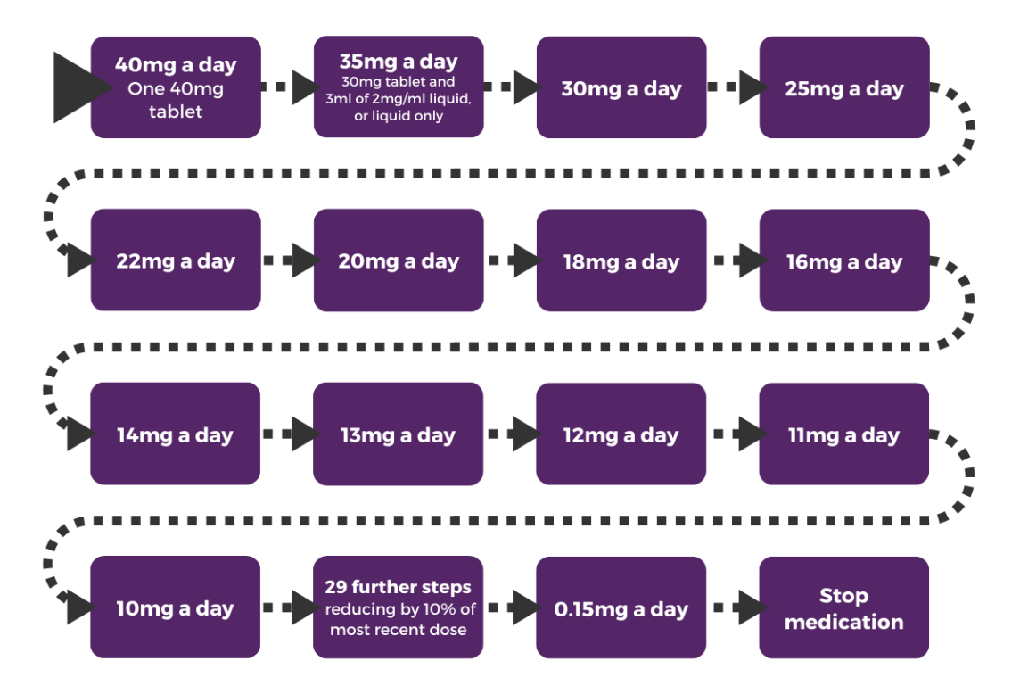
Discontinuing Antidepressants
Hyperbolic (gradual) Tapering: reducing 5% every 2-4 weeks

Slide 27
Resources
Patient information Leaflets
NICE Guidance NG222, CSK
Maudsley’s Deprescribing Guidance
Psychotropic Drug Directory : Stephen Bazaire
Coventry &Warwickshire APC documents
Stopping Antidepressants – Royal College of Psychiatrists
BAP Guidelines (British Association for Psychopharmacology

