Slide 1
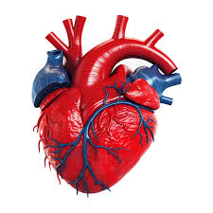
Cardiovascular Disease Prevention:
The importance of Pharmacists in GP
Dr Sarah Geissler
GP Partner Dunchurch Surgery
GP lead for CVD C&W ICB
26.11.25

Slide 2
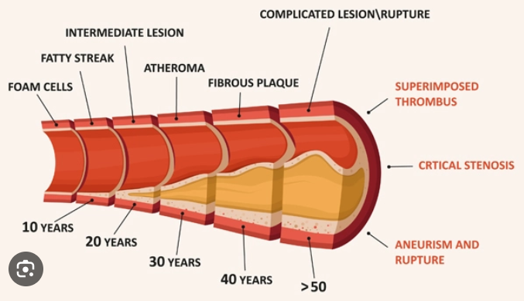
CVD is second highest cause of premature death in England and a major driver of health inequalities .
Much health education for patients only comes primary care until they have an event – if we make the effort to inform and encourage, our impact can be life changing.
Clinical Pharmacists have a significant window to recognise an individual’s risk and make a difference

Slide 3
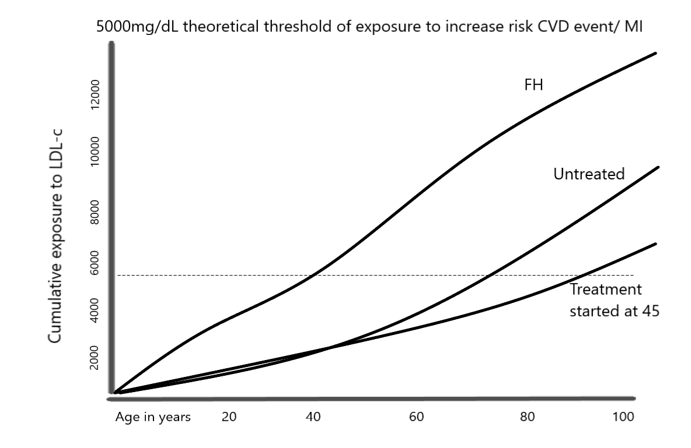
LDL-cholesterol – Magnitude and duration
Biological effect of LDL on risk depends on both the magnitude and duration of exposure i.e. area under the curve
Risk is modulated by the time course of area accumulation.
Specifically, that area accumulated early confers greater risk than when the same area is accumulated later.
Underscores the importance of optimal LDL-C early in life, because lower LDL-C later, even when low enough to result in the same area at a landmark age, does not fully reverse risk acquired earlier.
Lowering levels of LDL-C can delay the age at which mature atherosclerotic plaques develop, substantially reduces the lifetime risk of ASCVD events.

Slide 4
NICE guidance
“If the 10-year QRISK3 score is less than 10%, do not rule out statin treatment if the person has an informed preference for taking it or if there is concern that CVD risk may be underestimated*.”
* Autoimmune/ inflammatory disorders, steroid use, antipsychotics, mental health issues, HIV treatment…

Slide 5

Primary prevention of CVD –
Lipids: Aim to drop non HDL-c by 40% in patients with Qrisk >10% (NICE) or FOLLOW C&W LIPID PATHWAY.
BP: BIGGEST modifiable risk factor – silent and medication for individuals not always easy due to SE / electrolytes etc. Home readings should be <135/85.
HbA1c: Pre-diabetes or diabetes show metabolic imbalance with insulin resistance . Laying down of excess fats throughout the body, damaging blood vessels leaving them vulnerable – offer referrals ++
Lifestyle: This is where we need government action and public health intervention!!! But we can always encourage – DIET, move more, low alcohol, no smoking, healthy weight

Slide 6
Secondary prevention – never too late!
Annual QOF reviews are a minimum standard. If “good” BPs and lipids, patient may not even be seen for TIA/stroke/CHD – automated systems reduce opportunity for discussion.
Unless someone is frail, encourage them to allow escalation of BP medication to optimise – biggest reduction in mortality and morbidity we can do medically
The lower the LDL after an event, the lower the chance of another- No evidence of harm or any negative for reducing LDL - No lower limit!
Exercise on referral if available; Mediterranean diet, Freshwell low carb programme
Contracts and QOF do not stop us giving our patients good quality information and encouragement to achieve tough targets.

Slide 7
Summary of the most useful things to help your GP and patient:
Document that you have counselled the patient fully on any new medication
That you have set up the repeat bloods along with anything you spot is needed (TSH/HbA1c)
GP will always be distracted and pulled in multiple different direction in one consultation. eg mental health, the skin lesion, the knee pain, abnormal results... “whilst I’m here can you just…”
You have an opportunity to do the medication review properly.
Then task the GP – I have counselled this patient on Nustendi / ezetimibe / ramipril etc and advised bloods/ follow up, pt happy with plan – please do the prescription to usual chemist.
Please feel that you are right to do so and will be backed up. We can improve patient outcomes if the work is done on the ground at patient -facing level and that is increasingly you!

Slide 8
Thank you for listening!

