Slide 1
CVD Prevention – A focus on lipid management
Dr. Sheraz Nazir – Consultant Cardiologist, UHCW
Niharika Duggal – Specialist Pharmacist - Cardiology, UHCW

Slide 2
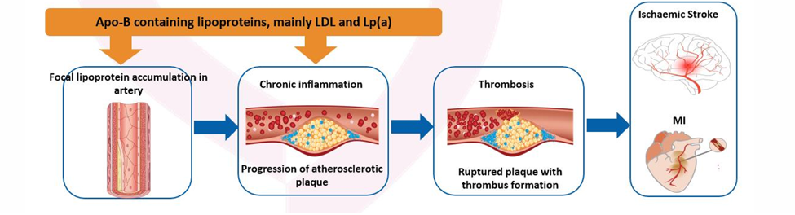
What is ASCVD?
A chronic, progressive disease
Characterised by the accumulation of lipids, inflammatory cells and fibres in focal areas of arteries that results in the formation of atherosclerotic plaques.
As plaques build up and rupture, they can cause partial or complete obstruction to blood flow
Notes:
Lipoprotiens in plasma transport lipids to parts of the body that require it for energy, steroid hormone production, bile acid formation. There are six major lipoproteins, one of which is LDL-C. LDL-C is a type of ApoB containing lipoprotein, which can cross the endothelial barrier, cause endothelial dysfunction and oxidative stress and lead to the build up of fatty plaques (atheroma).

Slide 3
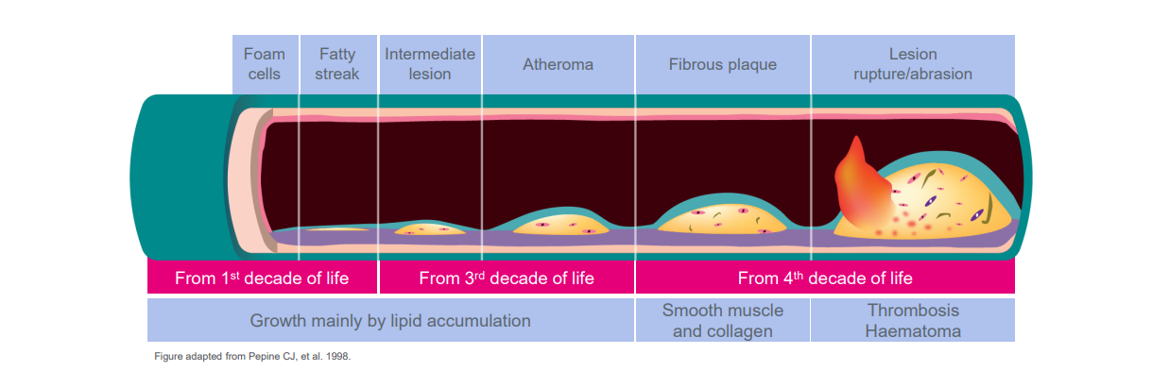
Unstable or ruptured plaques block blood flow and increase the risk of CV events; early and robust treatment may reduce the risk of CV events²
CV: cardiovascular. 1. Fleg JL, et al. JACC Cardiovasc Imaging 2012;5:941–955; 2. 2019 ESC/EAS Guidelines for the management of dyslipidaemias. Mach F, et al. Eur Heart J 2020;41:111–188; 3. Pepine CJ. Am J Cardiol. 1998;82:23S-27S.
Notes:
Atherosclerosis is the build up of fatty material (atheroma) inside your arteries. It is a progressive, multifactorial inflammatory and dyslipidemic disease, responsible for the majority of CVD. Growth of lesions is predominantly via lipid accumulation, which increases more in the third and fourth decade of life. Unstable or unptured plaque blocks blood flow, increasing the risk of cardiovascular events such as MI.
Build up of plaque occurs predominantly throughout your second and third decade of life (30s and 40s) – therefore it can be imperative to catch patients deemed at high risk to help prevent the burden of an event.

Slide 4
Interpretation of lipids
Test | Target Reference Range (secondary prevention)
LDL-C | Target <2mmol/L (<1.4 as per ESC)
HDL | >1mmol/L (for men) >1.2mmol/L (for women)
Triglycerides | <2 mmol/L
Lp(a) | <90nmol/L
Total Cholesterol | <4mmol/L
Non HDL-C | <2.5mmol/L
Growth of atherosclerotic plaque is proportional to the amount of circulating LDL-C.
An increased level of HDL is linked with being cardioprotective.
Raised Triglycerides are associated with an increased risk of CVD.
Lp(a) is an independent risk factor for CVD.
Notes:
ND - Many components to a lipid profile, hence taking just a total cholesterol reading is not enough – difficult to know what to target
Lipid profiles do not need to be fasting anymore when taken (though it will be more accurate). If raised TG, then to consider repeat lipid profile. If still raised, then can look to action.
If TG >10mmol/L, at risk of acute pancreatitis
Always need baseline HbA1c, TFTs, liver profile before interpreting lipid profile – helps exclude any secondary causes and manage any other factors affecting lipids.
If TG >4.5, a lab will not be able to tell you LDL (Friedewald Equation - LDL-C = TC – HDL – TG/5) . Newer equation available called Sampson equation – where you can calculate LDL-C when TG are up to 9.

Slide 5
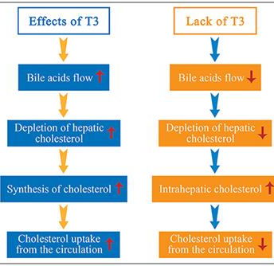
Secondary causes of hyperlipidaemia
Nephrotic Syndrome – chol ++ TG (+)
Hypothyroidism – chol ++ TG +
Biliary Obstruction – chol + TG (+)
Pregnancy – chol +
Myeloma – chol +
Steroids – chol + TG +
Obesity – chol + TG +
Diabetes Mellitus – chol + TG +
Renal Failure TG +
Excess Alcohol Intake TG ++
Beta blockers TG +
Thiazide diuretics – TG + chol +
Oral contraceptives – TG +
List not exhaustive!
Notes:
Some which are more easily managed – highlighted in red. Lipid profile will get better once risk factors managed.
Nephrotic syndrome – usually need to manage underlying issues e.g. fluid retention, proteinuria etc…
Patients with hypothyroidism for an extended period of time, will tend to have a higher cholesterol level.
Those with hypothyroid have a higher risk of side effects from statin as well (sometimes will see HIS more cautiously because of this).

Slide 6
Future Focus → Taking a holistic approach
Breaking down the silos encourages a more holistic management of these conditions.
Atrial Fibrillation
Blood Pressure
Cholesterol
CVD Prevention
Weight Management
Exercise
Diet
Smoking cessation
Lipid Control
Blood pressure control
Blood glucose control
Coronary Heart
Disease
Post Stroke/TIA
Kidney Disease
Peripheral arterial disease (PAD)
Diabetes
Notes:
ND

Slide 7
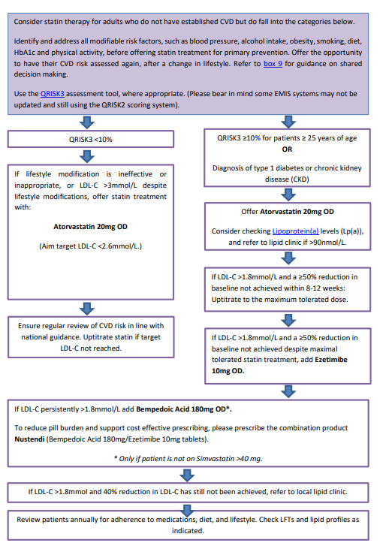
Primary Prevention
Notes:
Local guideline (on GP Gateway an APC)
NICE guidance is to reduce non-HDL to at least 40% from baseline for primary prevention. Non-HDLC can a good indicator, as it incorporates both LDL-C and trigs (so can be a good indicator of overall residual CVD risk) - however where possible request a full lipid profile to obtain an LDL-C reading. We know that LDL-C is directly linked to for plaque progression, so this can give an indicator of how best to uptitrate therapies

Slide 8
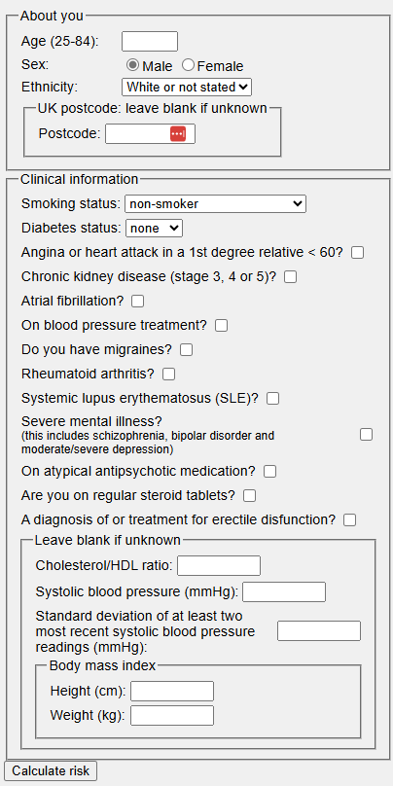
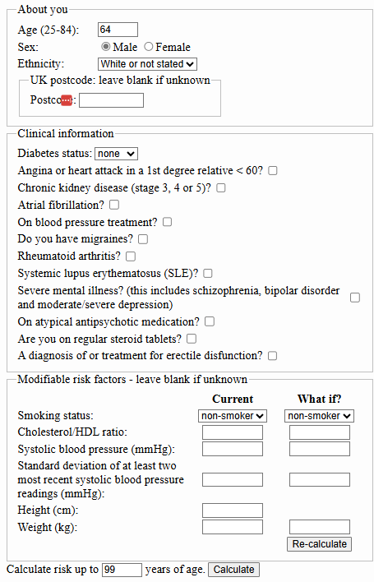
What tools exist for calculating CV risk?
QRISK3*¹
estimates the probability of an individual developing CVD over a 10-year time frame
QRISK-lifetime*²
Estimates an individual’s risk of getting CVD over their lifetime and compares it with their risk with good control of the following risk factors:
smoking
body mass index
cholesterol/HDL ratio
systolic blood pressure
    CV risk is underestimated in those with BMI >40 kg/m², hypertriglyceridaemia (fasting triglyceride 4.5–9.9 mmol/L) and recent risk factor change (e.g. quit smoking, blood pressure or lipid treatment)³

Slide 9

Please join

Slide 10
Calculate your QRISK3 vs QRISK Lifetime
Notes:
MENTI

Slide 11
Hidden risk factors not in QRISK3
COPD
IBD
PCOS
Menopause
Prediabetes
HIV
Triglycerides >1.7
Sleep disorders
Medications (e.g. Antipsychotics)

Slide 12
Considerations in females
Women of childbearing potential
  If planning for pregnancy, stop lipid lowering therapy at least 3 months prior to trying for conception
Pregnancy
  Remain off lipid lowering therapy for duration of pregnancy
  Bile acid sequestrants can be used in some patients – however seek A&G from lipid clinic
    Can impact absorption of folic acid and fat-soluble vitamins
Breast feeding
  Lipid lowering therapies not for use during breast feeding
Monitoring
  Do not routinely check lipid profiles during pregnancy

Slide 13
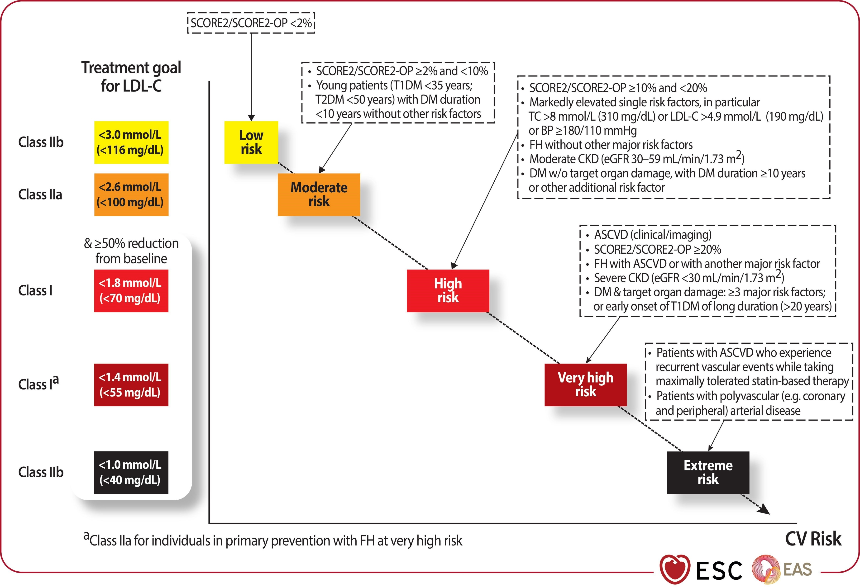
Targets for LDL-C
https://academic.oup.com/eurheartj/advance-article/doi/10.1093/eurheartj/ehaf190/8234482?login=false
Notes:
ND

Slide 14
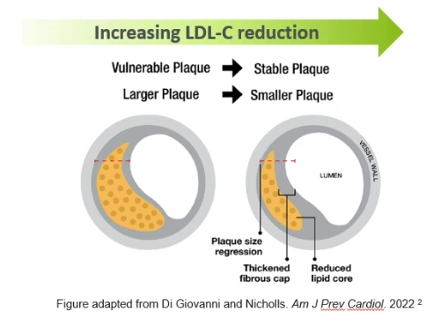
Reduction of LDL-C levels below 1.8mmol/L are associated with plaque regression and a reduction in atheroma volume
Notes:
ND

Slide 15
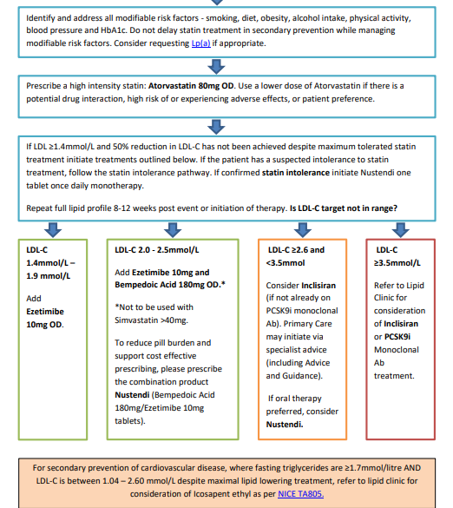
Secondary
Prevention
Notes:
ND

Slide 16
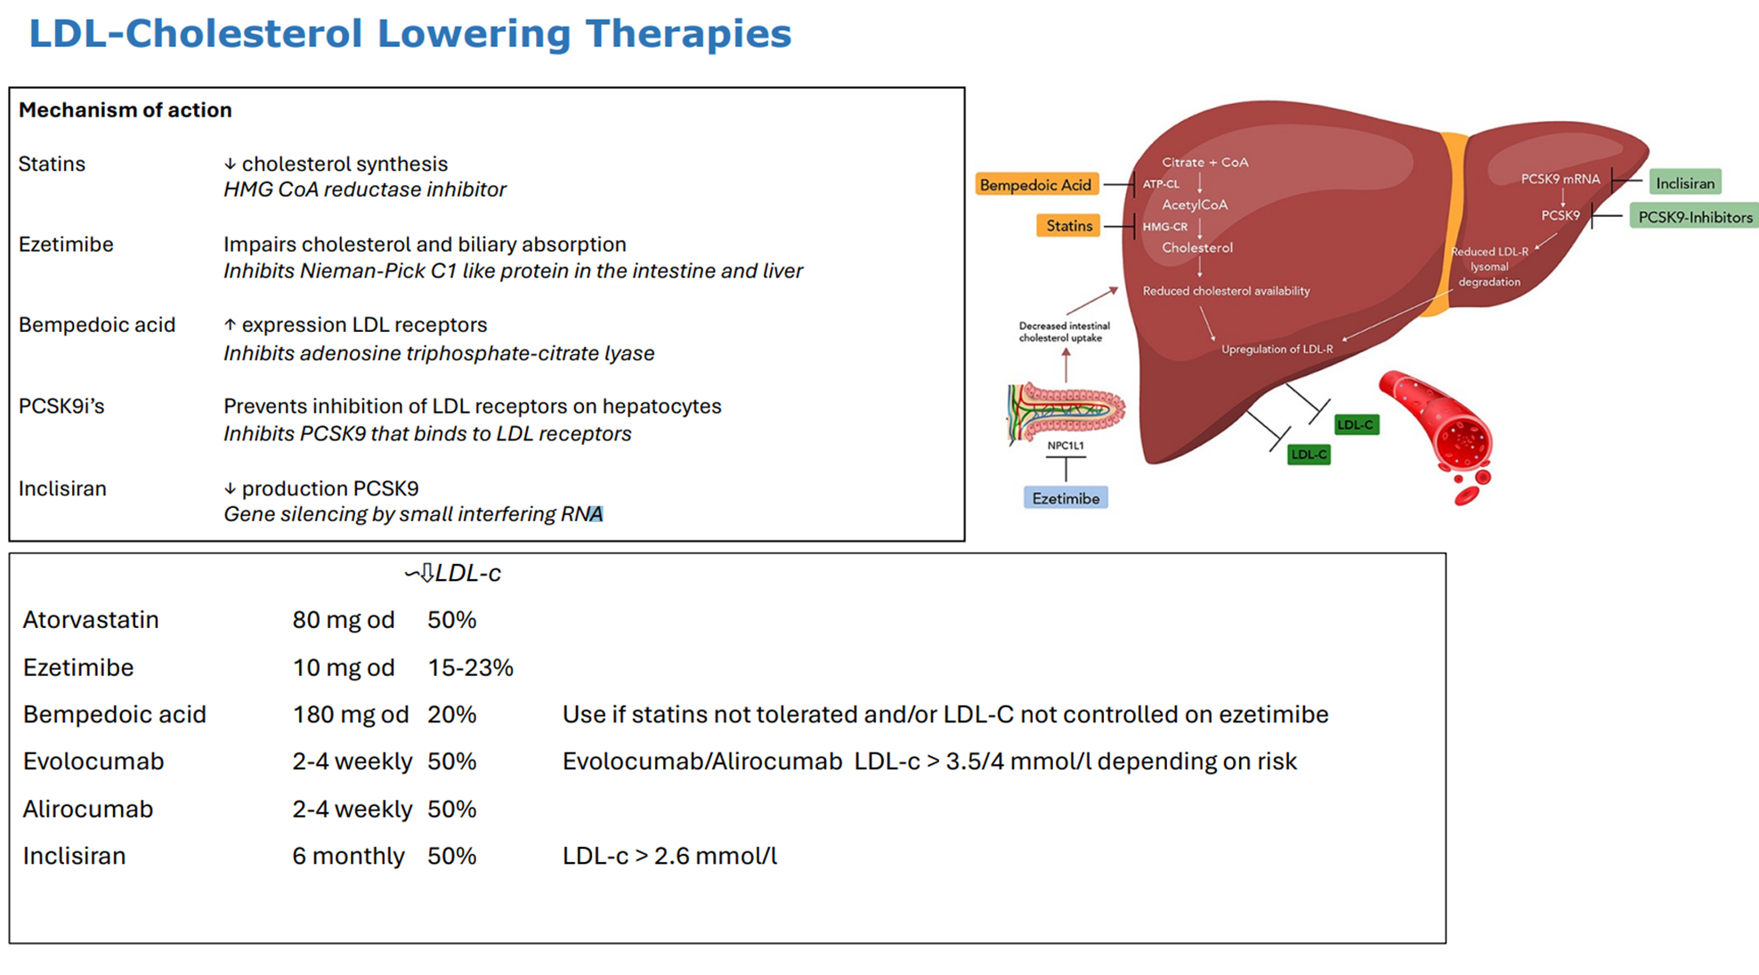
Mechanism of action
Notes:
ND

Slide 17
Drug Class | Formulary status | NICE approved indication | Administration | LDL-C lowering efficacy | CV outcomes | Safety data
Statins | GP can initiate | Primary prevention, Secondary prevention, FH | Oral tablet, once daily | High intensity statins can lower LDL-C by 40-55%. Doubling the dose of statin can only offer ~7% reduction in LDL=C | Multiple outcome studies confirming CV outcomes benefit. For every 10,000 people treated for 5 years: Secondary preventions, 1000 heart attacks, strokes or deaths avoided. Primary prevention: 500 heart attacks, strokes or deaths avoided. | Long term safety data has been well established over 3- years. For every 10,000 people treated for 5 years: 5 cases of myopathy 5-10 haemorrhagic strokes 50-100 new cases of diabetes SAMSON trial – nocebo effect
Ezetimibe | GP can initiate | Primary prevention, Secondary prevention and FH where statins are contraindicated, not tolerated or ineffective. | Oral tablet, once daily | Up to an additional 24% reduction in LDL-C in combination with as statin. | Two CV outcome studies in secondary prevention when used in conjunction with statins. (IMPROVE IT). For every 10,000 people treated for 2.5 years: approximately 150 major CV events avoided. | Long term safety data well established over 20 years. Side effects are usually mild and transient.
PCSK9i | Specialist only (subject to bluteq) | Secondary prevention and FH patients who meet eligibility criteria (NICE TA393, NICE TA394). | Subcutaneous injection, fortnightly or monthly | An additional LDL-C reduction of approximately 50% (range 25-70%) alone or in combination with statins. | Two CV outcome studies in secondary prevention on top of statins. For every 10,000 people treated for 2.5 years: Approximately 130 major CV events avoided. | Safety data established for over 6 years.
Inclisiran | Specialist advised | Secondary prevention in patients with patients who have LDL-C >2.6mmol/L despite maximal oral therapy. | Subcutaneous injection every 6 months after loading period. | An additional LDL-C reduction of approximately 50% (range 48-52%) alone or in combination with statins or ezetimibe | No CV outcome data; expected to be reported in 2026. | Short term safety data from trials of up to 2 years. Black triangle to be removed soon.
Icosapent ethyl | Specialist initiated | Secondary prevention- only if TG ≥1.7mmol/L and LDL-C between 1.04 and 2.6mmol/L | Oral capsule, twice a day | An 18% reduction in TG levels when added to statin therapy | One CV outcome study when given in addition to statin therapy. For every 10,000 people treated for 4.9 years approximately 370 major CV events would be avoided | Safety data established in a trial over 5 years. Small increase in hospitalisation with atrial fibrillation / flutter (NNH =- 100) and increased bleeding (NNH = 167)

Slide 18
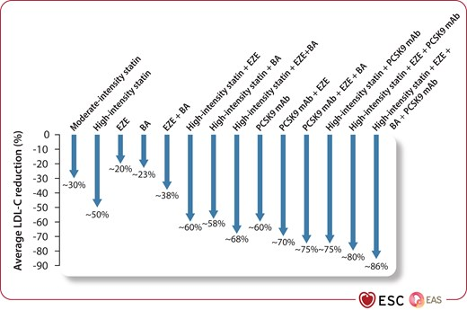
2025 Focused Update of the 2019 ESC/EAS Guidelines for the management of dyslipidaemias
Notes:
International guidance

Slide 19
Monitoring
Full lipid profile (including LDL-C) 4-12 weeks after any change in lipid lowering therapy
LFTs 3 months and 12 months after initiation or up-titration of a statin
Where muscle pain is a concern for patients, use the statin intolerance pathway
  Consider vitamin D, bone profile
  Consider CK if symptomatic after initiation of statin, bilateral pain in large muscle groups, worsening on exercise
Notes:
YP

Slide 20
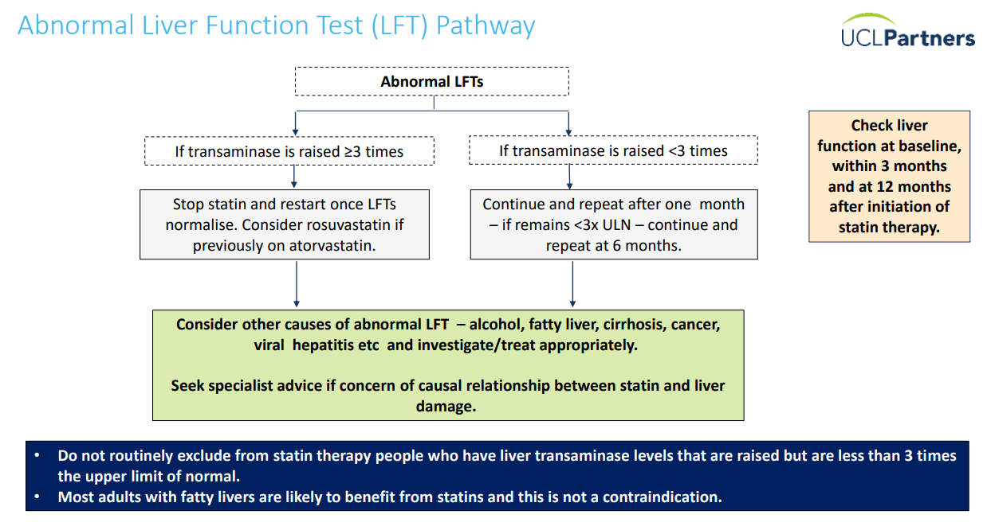
UCL Partners Cholesterol Framework 2024 UCLPartners Proactive Care Framework: Lipid Management including Familial Hypercholesterolaemia

Slide 21
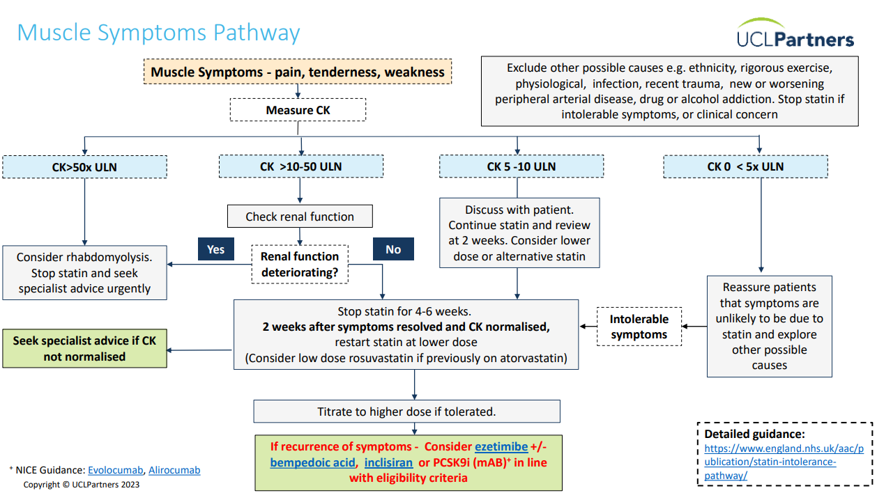
UCL Partners Cholesterol Framework 2024 UCLPartners Proactive Care Framework: Lipid Management including Familial Hypercholesterolaemia
Notes:
Y

Slide 22
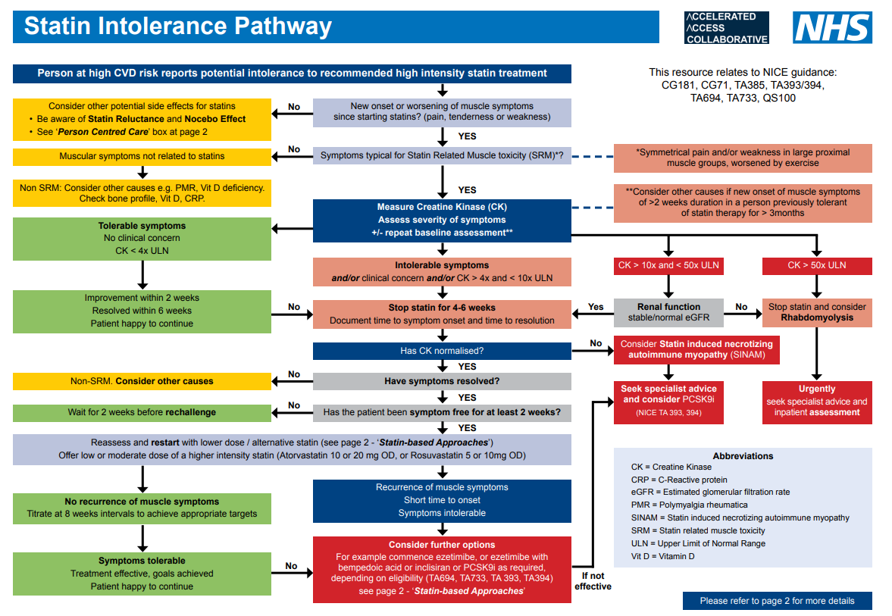
NHS Accelerated Access Collaborative » Statin intolerance pathway

Slide 23

Lipid lowering therapy in CKD
Refer to renal drug database
Atorvastatin is the safe to use in CKD and renal transplant
Rosuvastatin: 5-10mg if GFR <30ml/min
Ezetimibe safe to use in CKD and RRT. If GFR <30ml/min, there is a 1.5 increase in AUC, but no dose adjustment required.
Bempedoic acid can be used safely down to CrCl 30ml/min; use with caution in patients outside of this remit or on renal replacement therapy (limited evidence)
PCSK9i – no dose adjustment required.
Inclisiran – manufacturer advises caution in severe renal impairment due to lack of data. HD should not be performed for at least 72 hours post dose. <GFR 30mL/min

Slide 24

Lipid lowering therapy in the elderly
Statin therapy produces significant reductions in major vascular events, irrespective of age, but there is less evidence of benefit for primary prevention in people over the age of 75.
Consider potential benefits from lifestyle changes and the persons preferences (NICE 2023). Consider the presence of any comorbidities, whether they are on multiple medications, whether they are frail, and their life expectancy.
Consider people aged 85 or older to be at increased risk of CVD because of age alone, particularly in those who smoke or have raised blood pressure (NICE 2023).
  Older patients have been under-represented in clinical trials, despite having a high risk.
Notes:
ND

Slide 25
Landmark clinical trials
Therapy / Drug class | Trial name | Population | Key endpoint(s) | Follow-up | Risk-reduction (HR, RR, etc) | Key findings / notes
Statin (HMG-CoA reductase inhibitor) | 4S (Scandinavian Simvastatin Survival Study) | 4,444 patients with coronary heart disease (angina or prior MI) and raised cholesterol. | Primary: all-cause mortality; Secondary: major coronary events, revascularization. | Median ~5.4 years | Relative risk of all-cause death: ~0.70 (30% RRR) Major coronary events: RR ~0.66. | Simvastatin significantly improved survival in CHD; showed long-term safety; among the first “hard outcome” cholesterol-lowering RCTs.
Statin in primary prevention | JUPITER (Justification for the Use of Statins in Prevention: An Intervention Trial Evaluating Rosuvastatin) | 17,802 apparently healthy individuals (no prior CVD) but with elevated hs-CRP (≥ 2 mg/L) and moderate LDL. | Composite: nonfatal MI, nonfatal stroke, unstable angina, arterial revascularisation, cardiovascular death. | Median 1.9 years (stopped early) | HR for primary endpoint: 0.56 (95% CI 0.46–0.69), ~44% RRR. Absolute risk reduction ~1.2% over follow-up. | Showed benefit of statin therapy in people without high LDL but with systemic inflammation (hs-CRP).
Ezetimibe | IMPROVE-IT (IMProved Reduction of Outcomes: Vytorin Efficacy International Trial) | 18,144 patients stabilized after acute coronary syndrome (ACS) on simvastatin therapy. | Composite: CV death, nonfatal MI, stroke, rehospitalization for unstable angina, coronary revascularization (≥ 30 days) | Median ~6 years (some up to ~8.5 years) | HR for primary composite endpoint: ~0.94 (intention-to-treat), ~6.4% relative risk reduction. On-treatment analysis: HR 0.92 (95% CI 0.87–0.98). | Demonstrated that adding ezetimibe to a statin yields further CV benefit even when LDL is already relatively low. Also showed safety of very low LDL levels in long-term therapy.
PCSK9 inhibitor | FOURIER (Further Cardiovascular Outcomes Research With PCSK9 Inhibition in Subjects With Elevated Risk) – Evolocumab | ~27,564 patients with stable atherosclerotic cardiovascular disease, already on statins. | Primary MACE: CV death, MI, stroke, coronary revascularization, unstable angina | Median 2.2 years | HR ~0.82 for primary endpoint (i.e., ~18% relative reduction) | Evolocumab significantly reduced first and subsequent cardiovascular events, supporting the benefit of very aggressive LDL lowering.
ACL-inhibitor / Bempedoic acid | CLEAR Outcomes (Cholesterol Lowering via Bempedoic Acid, an ACL-Inhibiting Regimen) | 13,970 patients, statin-intolerant or unable to take maximally tolerated statins, at high CV risk. | Primary: 4-component MACE (CV death, nonfatal MI, nonfatal stroke, coronary revascularization) | Median ~3.4 years | HR for primary MACE: ~0.87 (95% CI 0.79–0.96), ~13% relative risk reduction. | Provides evidence that an oral non-statin therapy (bempedoic acid) reduces cardiovascular events in statin-intolerant/high-risk patients.

Slide 26
QoF
Streamlined indicators and focus on CVD prevention to reduce premature mortality from heart disease and stroke by 25% within a decade
Rationale for inclusion includes the following:
• The QOF 2025/26 highlights that high cholesterol is one of the most significant risk factors for cardiovascular disease
• Globally, a third of ischaemic heart disease is attributable to high cholesterol
• High cholesterol is estimated to account for 7.1% of deaths and 3.7% of disability-adjusted life years (DALYS) in England

Slide 27
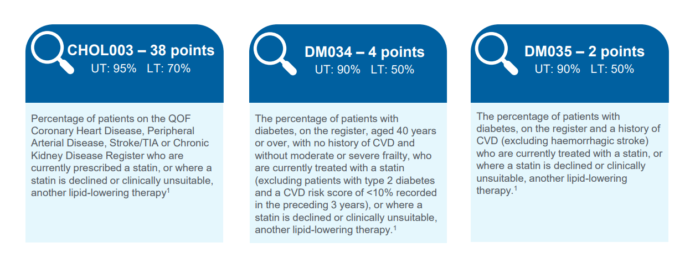
Who to target with lipid lowering therapy?

Slide 28
Case studies
Niharika Duggal – Specialist Pharmacist - Cardiology, UHCW

Slide 29
Please join

Slide 30

Case Study 1
PMHx Hypertension
Background: Non-smoker, 163cm, 65kg
Observations: BP 138/82 mmHg
DHx: Ramipril 5mg OD
Family history: Father had MI with two stents at 68, Mother has dementia
Biochemistry:
HbA1c: 39
U&E, FBC, LFT – NAD
TC 5.4 mmol/L, LDL-C 3.8 mmol/L HDL-C 1.6 mmol/L, TG 1.6 mmol/L, Chol:HDL ratio: 3.3
Mrs. T. H., 55-year-old receptionist
Notes:
What are your next steps?
NICE recommends atorvastatin 20 mg daily for primary prevention if QRISK ≥10%.
Discuss shared decision-making and lifestyle modification before and alongside treatment.
Consider follow-up lipids at 3 months aiming for ≥40% LDL-C reduction.
Address adherence, alcohol intake, and OTC product interactions.
She is concerned about his risk of dementia with taking statins

Slide 31
Myth busting
Statin and Dementia
I don’t get along with statins
For patients concerned about risk of dementia: ‘The brain produces most of the cholesterol required for its processes ‘in-house’. Analysis of 36 combined studies show that statins reduce the risk of dementia by 20%. A lifelong approach to good health is the best way to lower your risk of dementia; this includes managing cholesterol.
For patients concerned about trialing a statin again: ‘80-92% of patients rechallenged with a statin have not had aches and pains upon reinitiation’. Work with the patient to start on a dose they are comfortable with (including intermittent dosing) and build up to a maximal tolerated dose.

Slide 32
Linked guidelines
Guideline name | Information | Link
EAS/ESC Guidelines for the Management of Dyslipidaemias (2025) | Up-to date information on management of dyslipidaemias, including primary and secondary prevention. Targets for LDL-C outlined (matching local guidance) | 2025 Focused Update of the 2019 ESC/EAS Guidelines for the management of dyslipidaemias
NICE Lipid Modification | National guidelines on lipid modification. | Scenario: Secondary prevention of CVD | Management | Lipid modification - CVD prevention | CKS | NICE
Coventry and Warwickshire Lipid Management for Primary and Secondary Prevention of Cardiovascular Disease | Local guidelines on GP Gateway and APC for management of dyslipidaemias. | Coventry and Warwickshire Lipid Management for Primary and Secondary Prevention of Cardiovascular Disease (CVD) Guidance

Slide 33

Case Study 2
PMHx: Hypothyroidism, STEMI October 2025, HFmrEF (EF 45%) Pre-diabetic
Background: ex-smoker, <10 units alcohol per week, on cardiac rehab
DHx: Atorvastatin 80 mg OD, Bisoprolol 5 mg OD, Ramipril 10 mg OD, Aspirin 75 mg OD, Ticagrelor 90 mg BD, Levothyroxine 75microgram OD, GTN PRN
Family Hx: Mother MI aged 50
Biochemistry:
HbA1c 44
TC 4.2 mmol/L, LDL-C 2.2 mmol/L
TFT, FBC, U&E – NAD
LFTs – Isolated ALT of 68
Mr. JP, 55-year-old engineer
Notes:
Secondary prevention
What is her target LDL? Whats her target BP?
She is complaining of muscle aches and pains – how do you manage this?
What additional tests may you consider?
What lifestyle advice would you give?

Slide 34
Myth busting
Statin Diabetes Risk
Muscle Pain Concerns
Medication Burden
When patients worry about HbA1c rising on statins, explain: "About 1 in 200 patients may develop diabetes with statin therapy, but the cardiovascular benefits typically outweigh this risk. We'll monitor your blood glucose regularly."
For patients worried about myalgia:
"If you experience muscle pain, we can try rosuvastatin 2-3 times weekly / acid instead of daily or other agents. This often reduces side effects while maintaining most benefits."
When patients say, "I'm on too many medications," consider: "Adding bempedoic acid to ezetimibe may help reach targets without additional pills.
Some medications may be reduced after the first year post-MI."

Slide 35
Linked Information
Guideline name | Information | Link
EAS/ESC Guidelines for the Management of Dyslipidaemias (2025) | Up-to date information on management of dyslipidaemias, including primary and secondary prevention. Targets for LDL-C outlined (matching local guidance) | 2025 Focused Update of the 2019 ESC/EAS Guidelines for the management of dyslipidaemias
NICE Lipid Modification | National guidelines on lipid modification. | Scenario: Secondary prevention of CVD | Management | Lipid modification - CVD prevention | CKS | NICE
Coventry and Warwickshire Lipid Management for Primary and Secondary Prevention of Cardiovascular Disease | Local guidelines on GP Gateway and APC for management of dyslipidaemias. | Coventry and Warwickshire Lipid Management for Primary and Secondary Prevention of Cardiovascular Disease (CVD) Guidance
ESC Guidelines for the management of acute coronary syndromes | Up-to-date guidance on management of ACS in acute settings and longer term secondary prevention | 2023 ESC Guidelines for the management of acute coronary syndromes

Slide 36

Case Study 3
PMHx: Hypertension
Background: Non-smoker, nil alcohol consumption, runs twice a week
DHx: Amlodipine 10 mg OD, Losartan 100 mg OD, Indapamide 2.5 mg OD
FHx: Father has type 2 diabetes
Biochemistry:
eGFR 45 mL/min, Na+ 145mmol/L, K+ 4.8mmol/L
TC: 4.2mmol/L, LDL-C: 2.1mmol/L, TG: 2.3mmol/L, HDL: 0.9mmol/L
HbA1c: 41mmol/mol
Presents today for blood pressure review:
156/88 mmHg (clinic), 150/85 mmHg (home)
Dr. L.S 50-year-old cardiologist
Notes:
Lifestyle? high salt intake -→ what impact does this have on BP?
Check adherence
Next steps – Spiro with close monitoring of U&E
Consider uACR and SGLT2i for CKD if signs of proteinurea

Slide 37
Linked information
Resource | Information | Link
NICE Hypertension in adults: diagnosis and management (NG136) | Treatment of primary hypertension in people aged 18 or over (NG133 for hypertension management in pregnant patients) | Overview | Hypertension in adults: diagnosis and management | Guidance | NICE
British and Irish Hypertension Society | Clinical guidelines, education and resources for healthcare professionals | British & Irish Hypertension Society

Slide 38

Case Study 4
PMHx: Heart Failure with reduced ejection fraction (EF 32%), NYHA II
Background: non-smoker, nil alcohol intake, limited mobility at home
DHx: Bisoprolol 5mg OD, Ramipril 10mg OD, Furosemide 40mg OD
Biochemistry/recent review:
HbA1c 37
TFT, FBC, U&E – NAD, eGFR 50ml/min
LFTs – ALP of 200
TC: 3.1, non-HDL 1.8
Vital signs on review – 124/79mmHg, Heart rate 70
Mrs. S. W. 74-year-old retired librarian
Notes:
Raised ALP can be a sign of congestion
uACR to be requested
SGLT2i
Consider change of ramipril to Entresto (SI – discuss with HF team). Consider introduction of MRA as BP tolerates. Check for signs of worsening HF ?uptitration of furosemide for a short course
Cardiac rehabilitation

Slide 39
Linked information
Guideline name | Information | Link
Coventry and Warwickshire Management of Chronic Heart Failure guidance | Short and long version available on GP Gateway and APC website for management of all subtypes of heart failure. | CG047-CW Management of Chronic Heart Failure guidance short version.pdf
NICE Chronic heart failure in adults NG106 (last updated September 2025) | National guidance for diagnosis and management of heart failure | Overview | Chronic heart failure in adults: diagnosis and management | Guidance | NICE
ESC Guidelines for the diagnosis and treatment of acute and chronic heart failure: Developed | European guidelines for diagnosis and management of heart failure | 2023 Focused Update of the 2021 ESC Guidelines for the diagnosis and treatment of acute and chronic heart failure | European Heart Journal | Oxford Academic
Pumping Marvellous | Information for patients in an easy format around heart failure | Pumping Marvellous | The UK's Heart Failure Charity

Slide 40

Case Study 5
Background: No CVD history, fit and well
Social: Nonsmoker, <12 units per week alcohol intake, goes swimming three times a week
Family history: Father had MI at 46, sister on lipid-lowering therapy
Biochemistry :
U&E, LFT, TFT and HbA1c – NAD
TC: 11.2 mmol/L,
TG: 0.9mmol/L,
HDL: 1.9mmol/L
LDL-C 7.6 mmol/L
Miss F.H, 33-year-old physiotherapist

Slide 41
Linked information
Guideline name | Information | Link
NICE Familial Hypercholesterolaemia (NG71) | National guidance for FH identification and management | Overview | Familial hypercholesterolaemia: identification and management | Guidance | NICE
West Midlands Familial Hypercholesterolaemia Service | GP Gateway link for referral form for FH | WM Familial Hypercholesterolaemia Service – GP Gateway
Welsh Familial Hypercholesterolemia | Genetic testing assistant, LDL-C estimator for patients who already are taking a lipid lowering therapy | FH Web Tools

