Slide 1

What do we mean by brief dietary advice & healthy lifestyles in CVD prevention?
Kelly Slater
Dietitian Ambassador
Specialist Senior Dietitian

Slide 2

Learning objectives
Identify current evidence of nutrition and prevention of cardiovascular disease
Implement nutrition science into sustainable and practical strategies

Slide 3
Quiz
Mentimeter
Do fats make you fat? - Mentimeter

Slide 4
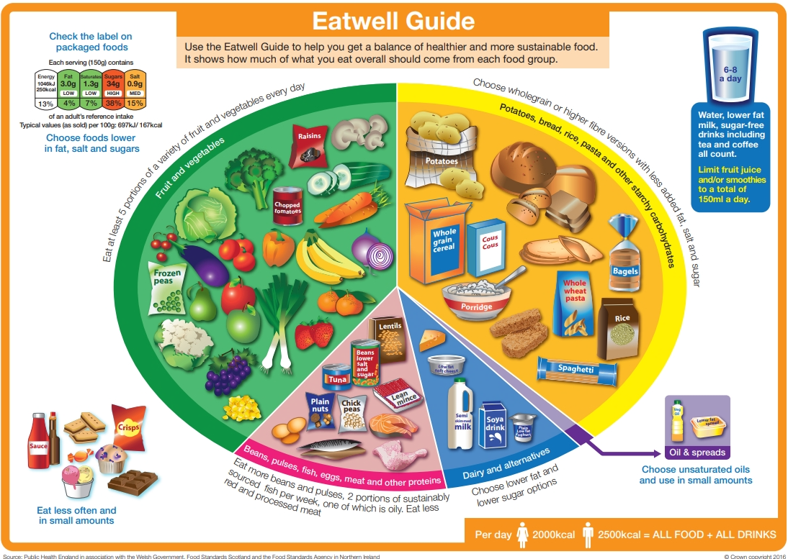

Slide 5
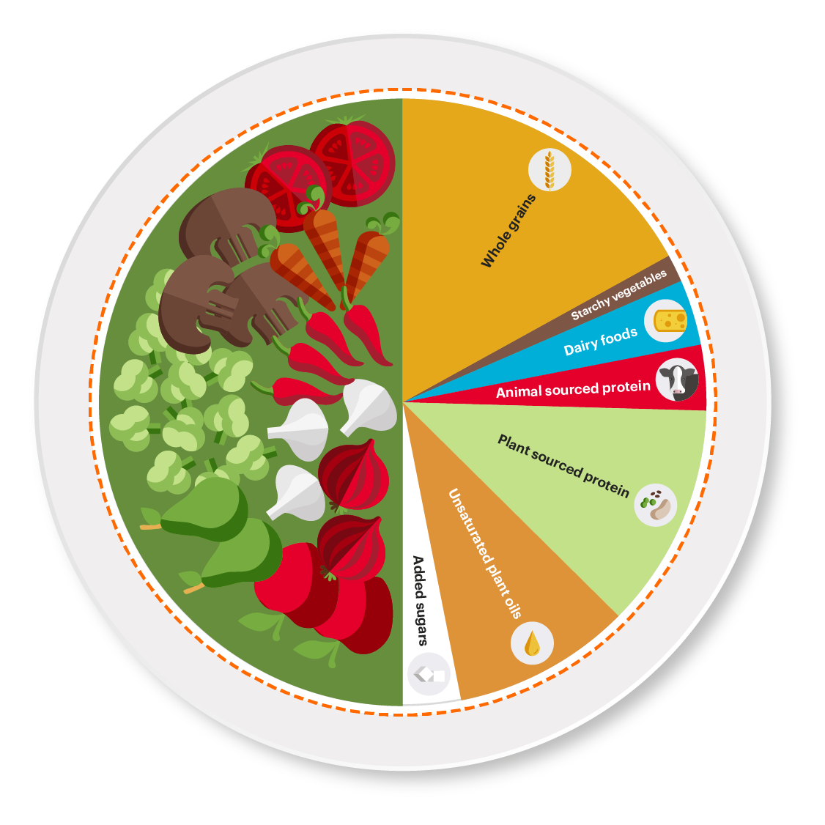
EAT-Lancet Planetary
Health Diet ²

Slide 6
Current nutritional guidelines to prevent and management cardiovascular disease
According to NICE ³ there are five modifiable risk factors:
Healthy diet:
Daily total fat up to 30% of energy intake. Saturated fatty acids (SFA) <7% of total energy intake & should be replaced by monounsaturated & polyunsaturated fatty acids (MUFA; PUFA) such as olive/rapeseed oil. Avoid or minimise trans-fat intake.
At least 5 fruit and vegetables per day
Not exceed 6 g salt (1 teaspoon) per day
Not exceed 30 g refined sugars (2 tablespoons) per day
Aim for 30 g per day
Aim 2 portions fish per week, one being oily fish
2) Physical activity: 150 minutes per week moderate intensity
3) Smoking cessation
4) Weight management
5) Alcohol consumption: no more than 14 units per week

Slide 7
Mediterranean diet
Diet with plenty of fruits, vegetables, nuts, seeds, beans, pulses, wholegrains, and olive oil.
Some dairy and lean proteins like chicken, eggs, and fish to be consumed in moderation.
Red and processed meats are consumed in much smaller amounts.
A Cochrane review ⁴ of 15 studies with over 56,000 adult participants suggested that reducing SFA and replacing it with PUFA (oily fish, walnuts, flaxseeds, rapeseed) intake for a minimum of two years leads to a reduction in cardiovascular events. The greater reduction in SFA caused greater reductions in cardiovascular events. However, the effects of replacement with MUFA (olive oil, nuts, avocado) remain unclear.

Slide 8
Reducing cholesterol level
Fat
Eat less saturated fat: butter, ghee, cream, full fat dairy, biscuits, cakes, visible fat on meat, pastries, coconut oil, palm oil)
Replace with unsaturated fat: vegetable oils (olive, rapeseed and sunflower oil), nuts, seeds, avocado and oily fish
Fibre
High fibre diet can reduce risk of heart disease
Aim for five portions of fruit and vegetables per day
Switch to wholegrain varieties of bread, cereals, pasta and rice
Choose other high fibre foods such as pulses (lentils, beans, chickpeas), oats, unsalted nuts and seeds
Salt
Reduce salt slowly to adjust taste buds. Add herbs, spices, lemon juice for flavour

Slide 9
Common dietary queries
Dietary cholesterol
Dietary cholesterol does not impact cholesterol in blood for most people. Examples of these foods are eggs, some shellfish such as prawns & crab & offal such as liver/pate & kidney
Plant stanols and sterols
Some foods are fortified with plant stanols or sterols, in combination with a healthy diet, could see a reduction in cholesterol. They are not a substitute for healthy diet or a replacement for cholesterol lowering medication
Mediterranean diet is thought to be the ‘gold standard’
Other traditional diets can also be important for health and nutrition.
Traditional African, Arabic, Asian and Caribbean diets, are more similar (in terms of food groups and principles) than they are different. It is important to translate and adapt findings of dietary patterns from nutrition research into practical guidance that is culturally sensitive and inclusive to everyone.

Slide 10
Does dietary changes prevent CVD risk
Yes! Lots of evidence to show this
Example in primary care:
Dietetic Input in Primary Care can Decrease Risk of CVD: Hypercholesterolemia Patient Audit 2024 ⁵
Diet and lifestyle can have a significant impact on this, although this is not the only factor. This audit demonstrated that more than 54% of patients had a significant improvement in patients’ total cholesterol after seeing a first contact dietitian in primary care and 18% stabilised their total cholesterol levels.

Slide 11
Barriers of communicating the facts to patients
Barriers
Lack of time
Information overload & complex scientific language
Personal expectations
Cultural beliefs
Social media influence
The public and social media, tend to be all or nothing on food trends
Change takes time: don’t expect immediate shifts in behaviour or perspective. Revisiting the topic many times with patience is often needed.

Slide 12
Communicating with patients
First listen to the patient’s understanding of nutrition and health.
Move away from labelling ‘bad’ foods, fear-based, restrictive messaging. Instead, highlight variety, quality and enjoyment within evidence-based guidelines.
Motivational prompts: ‘would you try one small swap this week?’
‘what do you like about butter & what worries you?’
Visual tools: Show suitable portions of fats.
Quick tips: small swaps, reducing saturated fats slowly to aid taste changes, consider budget (use store-brand oils, tinned fish, frozen vegetables).

Slide 13
Final comments
Translate science into everyday practice. Patients will feel empowered and not overwhelmed
Celebrate small wins
Healthy eating isn’t about perfection, it’s about patterns
Any questions???

Slide 14
References
1) The Eatwell Guide and Resources | Food Standards Agency
2) The Planetary Health Diet – EAT
3) The National Institute for Health and Care Excellence (NICE). 2023. Cardiovascular disease: risk assessment and reduction, including lipid modification [NICE guideline No. 238] https://www.nice.org.uk/guidance/ng238
4) Hooper L, Martin N, Jimoh OF, Kirk C, Foster E, Abdelhamid AS. Reduction in saturated fat intake for cardiovascular disease. Cochrane Database of Systematic Reviews 2020, Issue 8. Art. No.: CD011737. DOI: 10.1002/14651858.CD011737.pub3. Accessed 19 January 2024. https://pubmed.ncbi.nlm.nih.gov/32428300/
5) Dietetic Input in Primary Care Can Decrease Risk of CVD - BDA
Home - British Dietetic Association (BDA)
Recipe finder - BHF

