Slide 1


CVD Prevention – focus on hypertension
Francesco P Cappuccio, MD MSc DSc FRCP FFPH FBIHS FAOP FAHA FESC
Professor of Cardiovascular Medicine & Epidemiology, University of Warwick
Consultant Physician, UHCW NHS Trust, Coventry
Past-President: British and Irish Hypertension Society (2017-19)
NO CONFLICT OF INTEREST TO DECLARE
GP Gateway: Hypertension
https://www.coventryrugbygpgateway.nhs.uk/pages/hypertension/

Slide 2
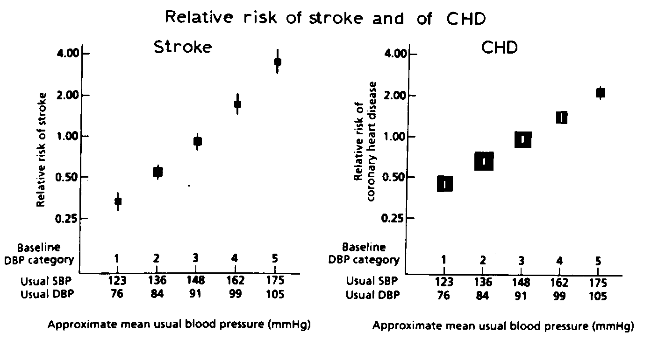
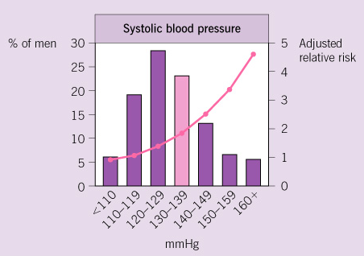
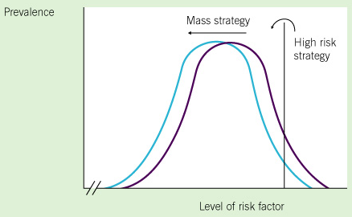
Definition of hypertension
Blood pressure (BP) normally distributed in the population (bell-shaped curve).
The higher the BP the greater the risk of CV events (strokes and MI).
BP lowering causes a reduction in the risk of CV events.
Hypertension …. a blood pressure level above which investigation and treatment do more good than harm (G Rose 1971)
Definition changes with time and between countries.
Drug v non-drug therapy: ‘high-risk’ v ‘population’ approach

Slide 3
Why bother?
3/5 deaths in the UK are from vascular disease
blood pressure predicts risk of vascular disease
risks of high blood pressure can be reversed by treatment

Slide 4
Long term consequences of uncontrolled
high blood pressure
Myocardial Infarction; Arrhythmias; Atrial Fibrillation; Heart Failure; Cardiomyopathy.
Stroke (Ischaemic, Haemorrhagic)
Kidney Failure
Retinopathy
Peripheral Vascular Disease
Notes:
Hypertension may damage all blood vessels of the body, large, medium and small, and therefore, the subsequent reduction in blood flow and oxygen supply will damage all organs provided by such vessels. Target organs, therefore, are typically the heart, the brain, the kidneys, the eye and the other large vessels outside these organs.

Slide 5
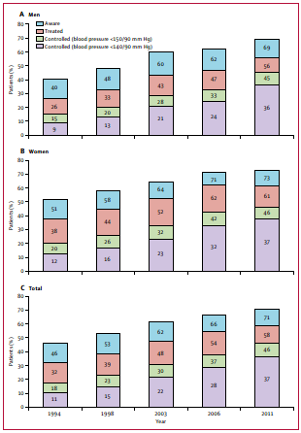
Hypertension management in England from 1994 to 2011
In the period 1991 to 2011:
the prevalence of hypertension remained at 30%
awareness improved from 46% to 71%
BP treatment increased from 32% to 58%
However, BP control improved from 11% to 37% to tight targets and from 18% to 46% to Audit targets
Still, more than half of hypertensives do not have BP controlled
Falaschetti E et al. Lancet 2014

Slide 6
Hypertension control in the UK
*self-reported in Biobank
**<140/90mmHg
Percentage
Tapela N, et al. OpenHeart 2021; 8: e001461
NCD-RisC. Lancet 2019; 394: 639-51

Slide 7
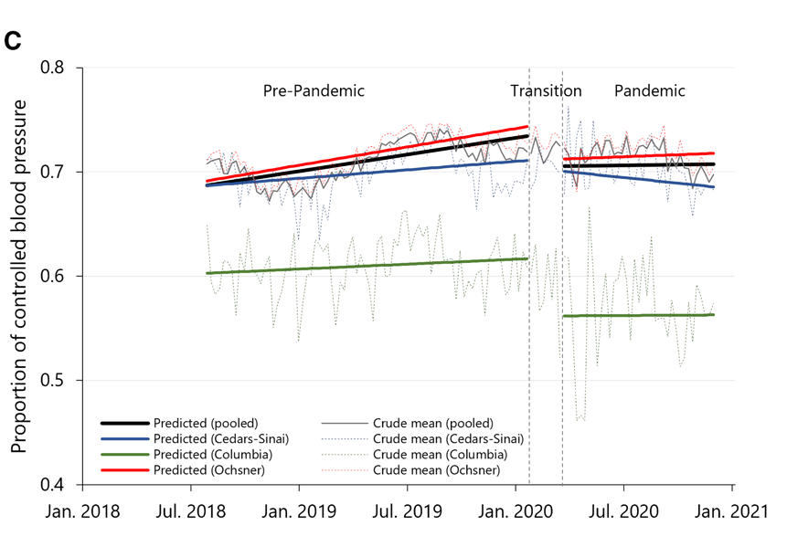
Impact of COVID-19 pandemic on hypertension control
Data from Electronic Records of 3 large US health care systems
N=137,593 adults with hypertension - interrupted time-series analysis
During the pandemic
% of controlled* HPT fell by 3.43%
SBP rose by 1.79mmHg
DBP rose by 1.30mmHg
Trend of increasing control flattened
*<140/90mmHg
Gotanda H, et al. Hypertension 2022; 79: 2733-42

Slide 8
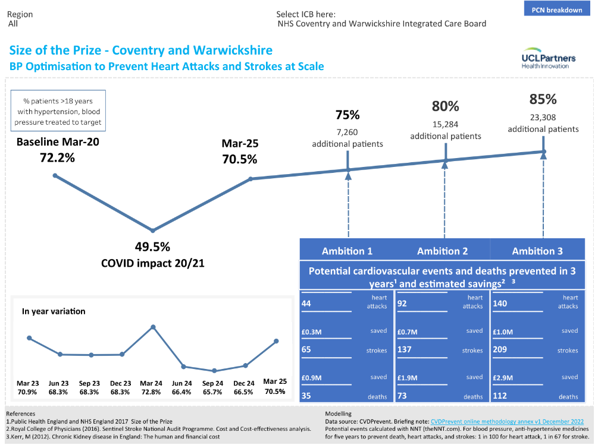
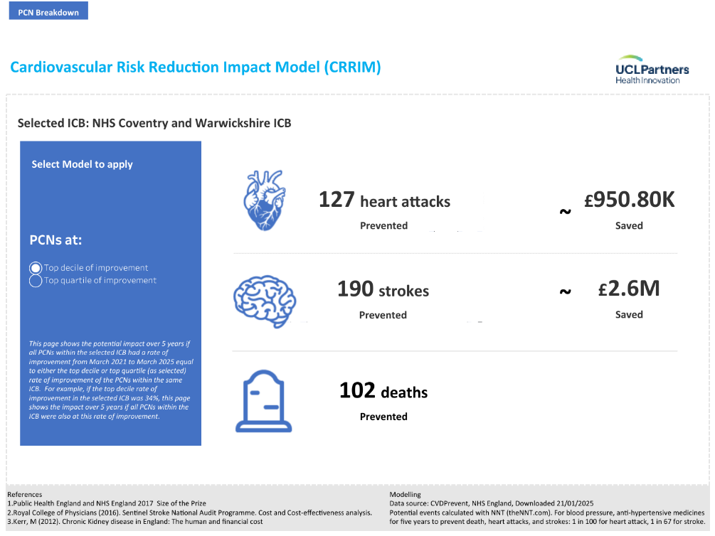
Coventry & Warwickshire ICB

Slide 9
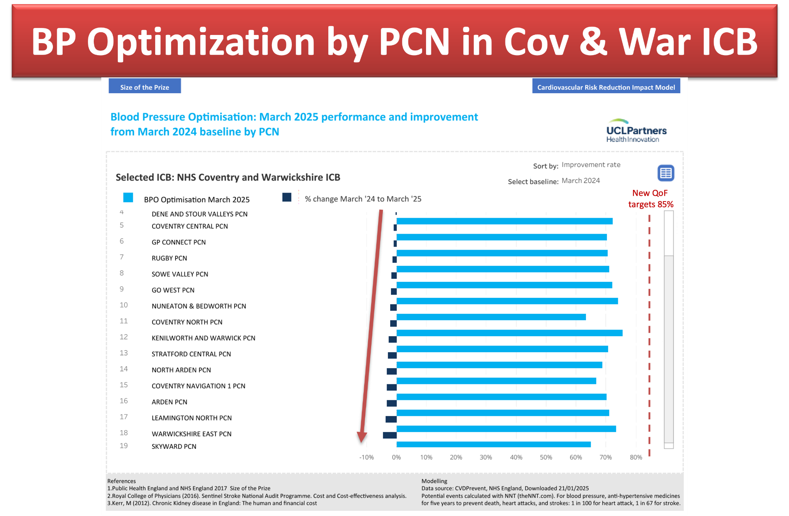

Slide 10
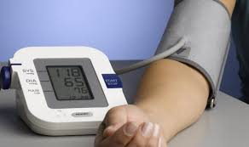
Synopsis
What is new or updated ?
diagnosing hypertension
starting antihypertensive drug treatment
monitoring treatment and blood pressure targets
choosing antihypertensive drug treatment (steps 1 to 4)
who to refer for same-day specialist review
What is unchanged ?
measuring blood pressure
assessing cardiovascular risk and target organ damage
lifestyle interventions

Slide 11
Important warning!
NG136, 2019 may not apply to adults with
  CKD
  Type 1 diabetes
  Pregnancy
  Pre-existing cardiovascular disease
Need to cross-referencing to specific NICE guidelines
  CKD in adults: assessment and management (CG182, 2014)
  Type 1 diabetes in adults: diagnosis and management (NG17, 2015)
  Hypertension in pregnancy: diagnosis and management (NG133, 2019)
  Multimorbidity: clinical assessment and management (NG56, 2016)

Slide 12
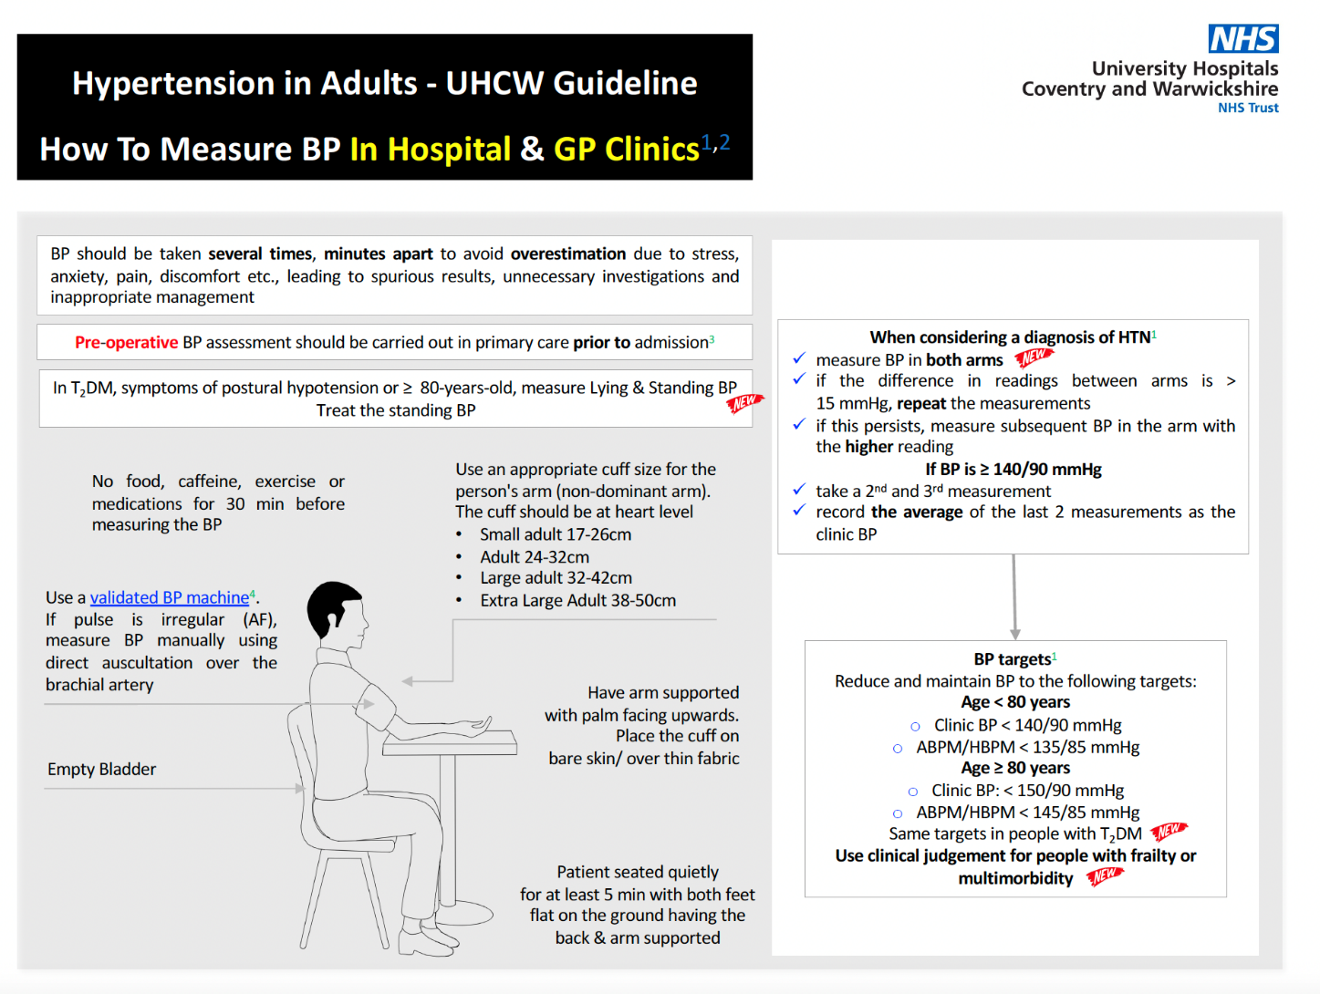

Diagnosing hypertension
Accurate BP measurement paramount!
Notes:
No food, coffee, exercise, Rx, cigarettes 30 min before BP
Empty bladder
Sit quietly for at least 5min – no chatting-talking
Sit with feet flat on ground, back and arm supported
Use validated devices and appropriate sized cuff on bare skin – no fabrics – palm up

Slide 13
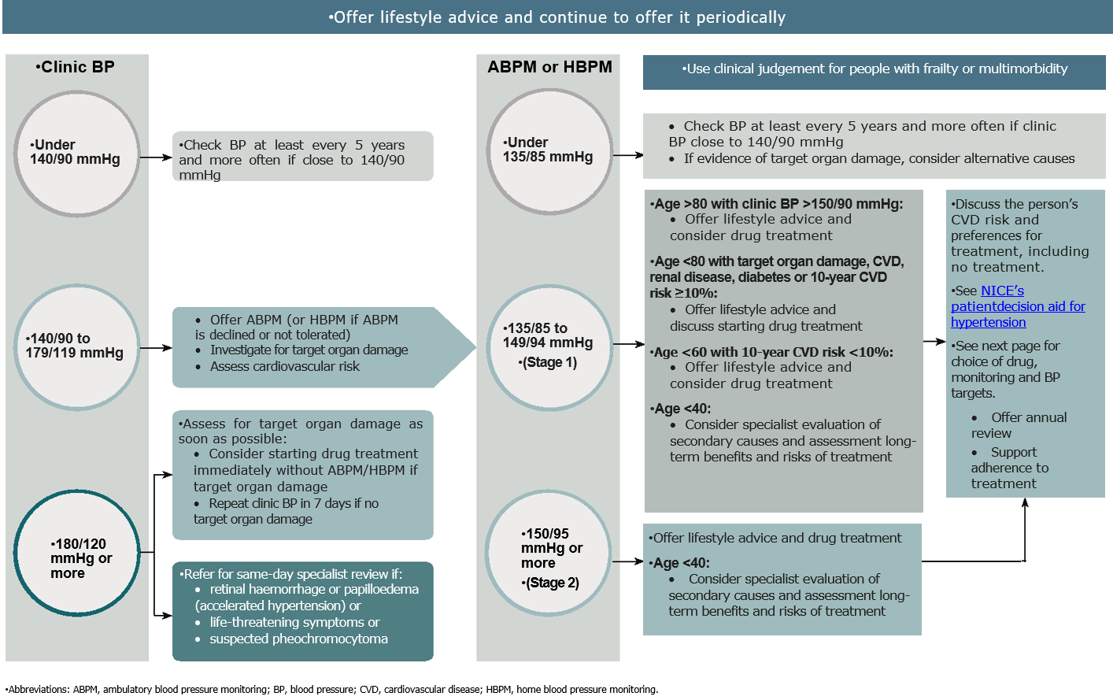
Diagnosing hypertension
 | Office BP (mmHg) | ABPM or HBPM (mmHg)
Normal | < 140/90 | < 135/85
Stage 1 | 140/90 to 159/99 | 135/85 to 149/94
Stage 2 | 160/100 to 179/119 | > 150/95
Stage 3 | SBP >180 or DBP >120 | -

Slide 14

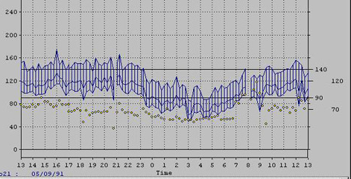
Hypertension
Hypertension
Morning rise
Hypertension
Nocturnal
dip

Slide 15
‘day-time’ Office BP vs ABPM
Hypertensive
Masked
White Coat
Normotensive

Slide 16
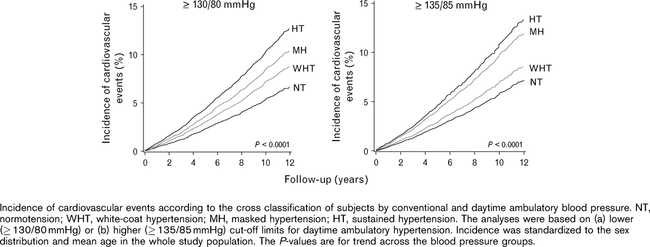
CVD risk by ABPM categories
Hypertension
Masked
White-coat
Normotensive
Follow-up (years)
Hansen TW et al. J Hypertens. 2007;25(8):1554-64.

Slide 17
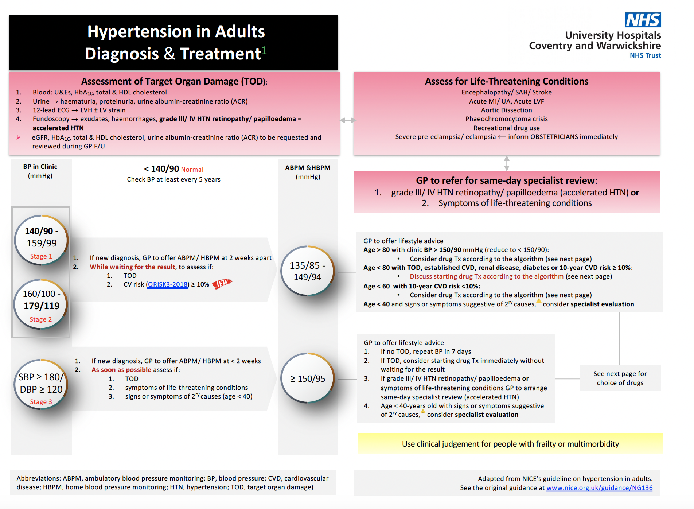
Diagnosing and treating hypertension

Slide 18
Starting antihypertensive drug treatment
Offer drug treatment
at any age in persistent Stage 2 hypertension
<80 years in persistent Stage 1 hypertension with one or more of the following:
  Target organ damage (e.g. LVH, proteinuria, fundi changes, high HbA1c, reduced eGFR etc)
  Renal disease or diabetes
  Established cardiovascular disease
  Estimate 10-y risk of CVD >10% (QRISK2)
  Use clinical judgement if frailty or multimorbidity

Slide 19
Starting antihypertensive drug treatment
Consider treatment
<60 years and Stage 1 hypertension with QRISK2 <10%
<80 years and Stage 1 hypertension if Office BP >150/90 mmHg
<40 years, consider seeking specialist advice
Consider the need for specialist investigations in people with signs and symptoms suggesting a secondary cause of hypertension.

Slide 20
Monitoring treatment
Use office BP measurements to monitor the response to Rx
Measure standing as well as seated BP in people with
  type 2 diabetes or
  symptoms of postural hypotension or
  aged 80 and over.
In people with postural drop or symptoms of postural hypotension, treat to a BP target based on standing BP
Consider ABPM or HBPM, in addition to office BP, for people identified as having a white-coat or masked hypertension
NG136, 2019 may not apply to adults with CKD, type 1 diabetes, pregnancy, pre-existing CVD (cross-referencing to specific NICE guidelines)

Slide 21


BP targets
Reduce office BP to
When using ABPM or HBPM use the average ‘day-time’ BP
Use clinical judgement for people with frailty or multimorbidity
same targets in people with type 2 diabetes
Age <80 years
<140/90
Age >80 years
<150/90
Age <80 years
<135/85
Age >80 years
<145/85
NG136, 2019 may not apply to adults with CKD, type 1 diabetes, pregnancy, pre-existing CVD (cross-referencing to specific NICE guidelines)

Slide 22
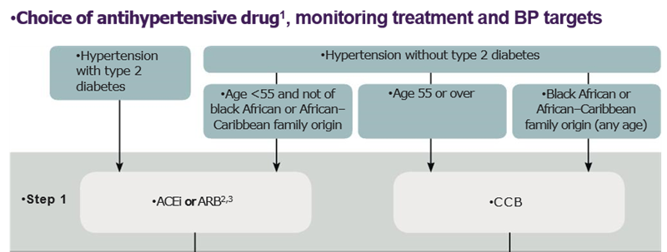
Choosing antihypertensive drug treatment
Choosing drugs for newly diagnosed patients: step 1
NICE Hypertension on adults NG136 (August 2019)

Slide 23
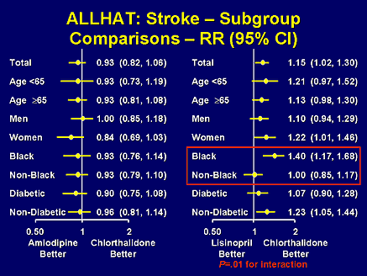
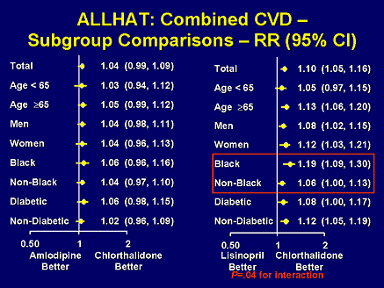

ALLHAT: effects of mono-therapy by ethnic background
CCB vs Diuretic
ACE-i vs Diuretic
CCB vs Diuretic
ACE-i vs Diuretic
Doxazosin monotherapy arm stopped early due to excess heart failure deaths!
ALLHAT. J.A.M.A. 2002; 288: 2981-97

Slide 24

Multiple agents are needed to reach BP goal
Trial (SBP achieved)
ASCOT-BPLA (136.9 mmHg)
ALLHAT (138 mmHg)
IDNT (138 mmHg)
RENAAL (141 mmHg)
UKPDS (144 mmHg)
ABCD (132 mmHg)
MDRD (132 mmHg)
HOT (138 mmHg)
AASK (128 mmHg)
1
2
3
4
Average no. of antihypertensive medications
Adapted from Bakris et al. Am J Med 2004;116(5A):30S–8
Dahlöf et al. Lancet 2005;366:895–906
Notes:
Major clinical trials have demonstrated that patients typically needed treatment with multiple antihypertensive agents to get to, and stay at, BP goal.
The number of antihypertensive agents required for BP control in many patients typically averages 2−4, with co-morbid conditions (such as kidney disease or diabetes mellitus) imposing greater drug requirement.¹
For example, in the Hypertension Optimal Treatment (HOT) study, an average of 3.3 drugs were required to attain a diastolic BP goal of <80 mmHg, and in the Anglo-Scandinavian Cardiac Outcomes Trial-Blood Pressure Lowering Arm (ASCOT-BPLA), most patients were taking at least two antihypertensive agents by the end of the trial.^{1,2}

Slide 25
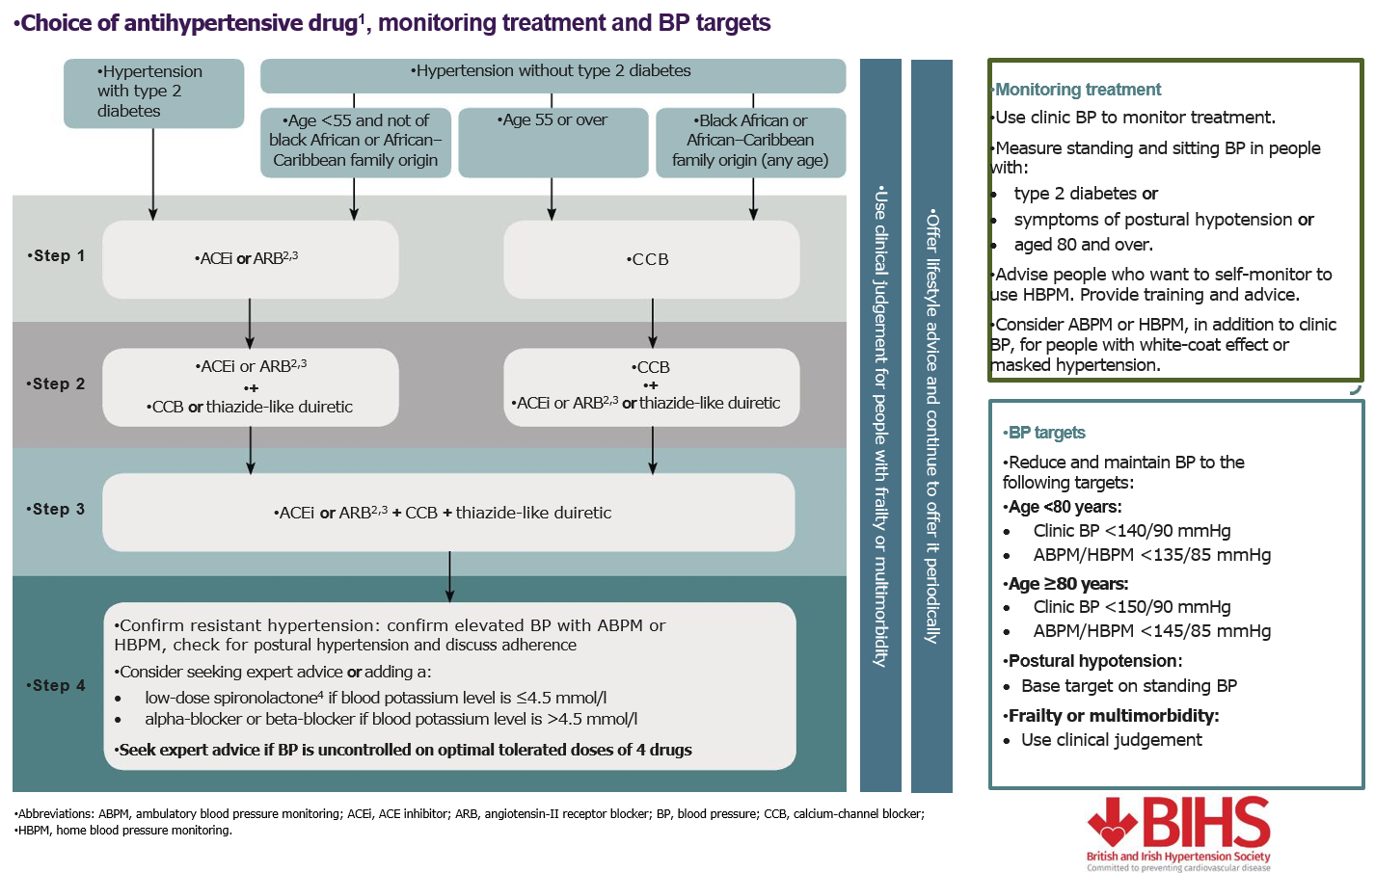
Choosing drugs for combination therapy: step 2
NICE Hypertension on adults NG136 (August 2019)

Slide 26
Choosing drugs for combination therapy: step 3
NICE Hypertension on adults NG136 (August 2019)

Slide 27
Choosing drugs for combination therapy: step 4
NICE Hypertension on adults NG136 (August 2019)

Slide 28
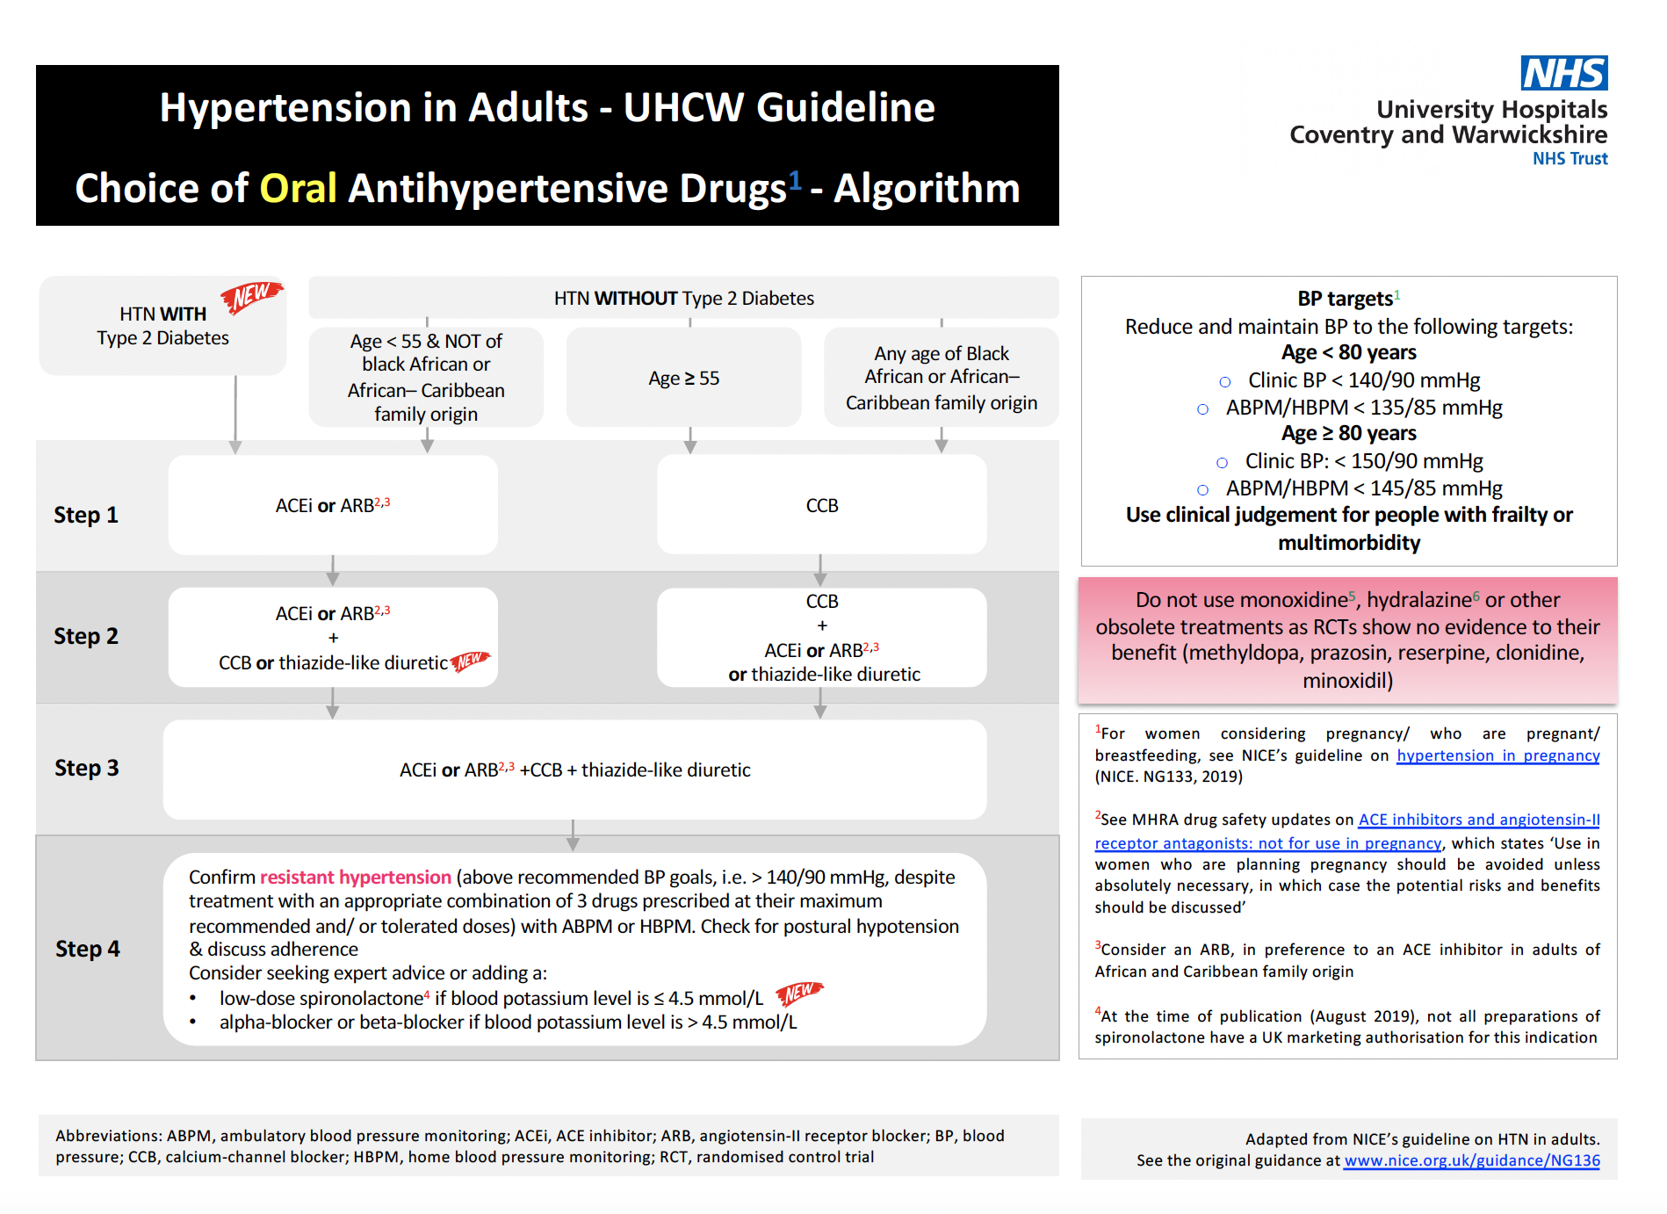

Slide 29
Started Rx after a single measurement.
No records of both arms’ BP
No records of either ABPM or HBPM
No records of TOD assessment
No records of QRISK
On Rx with obsolete Rx*
RED FLAGS
On short-acting options (e.g. captopril, nidefipine capsules, loop-diuretics)
On step 1: Diabetics not on ACEi/ARBs | mono-Rx with BB
On step 1: A/C pts on ACEi/ARBs or BB
On step 2: not on A+C | on BB
On step 3: not on A+C+D | on BB
For step 4: seek specialist advice
Pt on obsolete Rx*
*Obsolete Rx = moxonidine, hydralazine, clonidine, alpha-methyl-dopa, prazosin, minoxidil, reserpine, loop diuretics

Slide 30
Resistant hypertension: Definition & Estimates
“defined when a patient’s BP is not controlled to recommended BP goals, i.e. <140/90 mmHg, despite treatment with an appropriate combination of three drug therapies, i.e. A+C+D, prescribed at their maximum recommended and/or tolerated doses.”
Not synonymous with uncontrolled BP
Approx. 1.5m people in the UK are on 3+ BP-lowering drugs
55% of them remain uncontrolled (~825,000)
Estimated prevalence of resistant hypertension 0.5 – 1.0m
Most resistant hypertension is due to systolic hypertension

Slide 31
Resistant hypertension: Clinical assessment
BP appropriately measured? (pseudo-resistant)
Could the patient have white coat hypertension? (pseudo-resistant)
Is Rx optimal according to Step 3 of the NICE/BIHS algorithm?
Is the patient adhering to the treatment? (pseudo-resistant)
Is the patient taking other medications that may be contributing to their resistant hypertension? (e.g. OC, NSAIDs, steroids, excess liquorice, cyclosporine, erythropoietin, sympathomimetic agents,…)
Could the patient have a secondary cause of hypertension?
Myat A et al. BMJ 2012;345:e7473

Slide 32
Miss MLE (44 yrs)
1
2
1
2
3
1
2
3
4
1
2
3
4
5
1
2
3
4
5
6
1
2
3
1
2
3
4
1
2
3
10/2009
09/2010
11/2011
05/2012
01-09/2013
10/2014
DNA
DNA
mmHg
Direct observation
Admission
Admission
GTN
Admission
Admission
GTN
D1=Bendrofluazide; D2 = Spironolactone
C1 = Nifedipine m/r; C2 = Amlodipine; C3 = Verapamil SR
A = Olmesartan
X1 = Doxazosin

Slide 33
Mr IMV (43 yrs)
A1 15
C1 2.5
A1 20
C1 10
D1 12.5
B1 50
X1 6
A1 20
C1 10
D1 12.5
B1 100
X1 4
D2 50
X2 10
A2 20
C2 10
D1 12.5
B1 100
X1 4
D2 25
A2 20
C2 10
D2 25
A2 40
C2 10
D2 25
X1 8
D3 2.5
B2 10 x
A3 150 x
A2 40
C4 60 90
D2 100 50
X1 8
D3 2.5
mmHg
b/min
60 60 90 73 82 97 74 70 93
mmHg
D1=HCTZ; D2 = Spironolactone; D3 = Indapamide
C1 = Felodipine; C2 = Amlodipine; C3 = Verapamil SR; C4 = Nifedipine MR
A1 = Lisinopril; A2 = Olmesartan; A3 = Aliskiren
B1 = Atenolol; B2 = Carvedilol
X1 = Doxazosin; X2 = Minoxidil

Slide 34
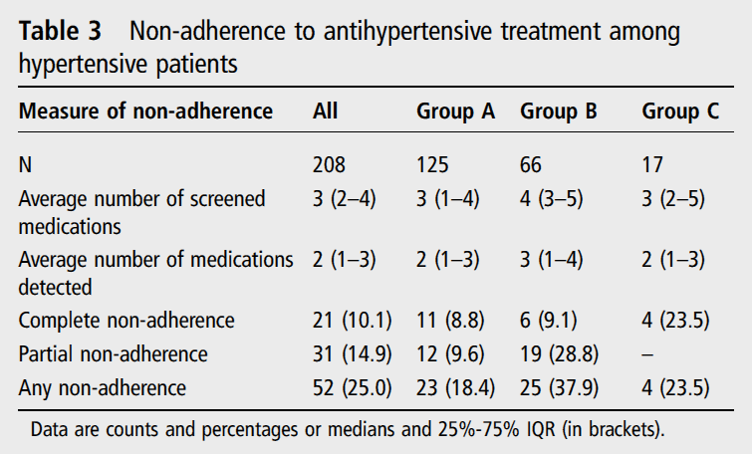
Patients may not take their tablets
Urine analysis by high-performance liquid chromatography-tandem mass spectrometry (HPLC-MS/MS)
Tomaszewski M et al. Heart 2014;100:855-61

Slide 35
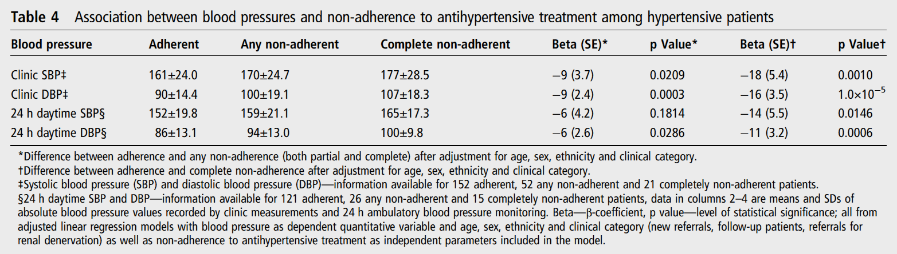
Non-adherence is associated with uncontrolled BP
Urine analysis by high-performance liquid chromatography-tandem mass spectrometry (HPLC-MS/MS)
Tomaszewski M et al. Heart 2014;100:855-61

Slide 36
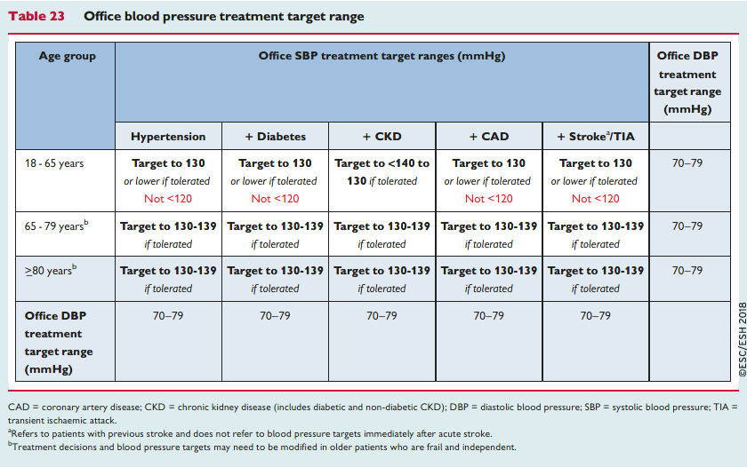
BP targets
NICE 2019
ESC/ESH 2018
NICE Hypertension on adults NG136 (August 2019).
Williams B et al. Eur Heart J 2018;39:3021-3104.
Notes:
So we should take that the NICE guidelines for the detection and management of hypertension in adults only refers (or applies) to people with hypertension with or without diabetes BUT without evidence of CVD, whereas the European Guidelines would cover also those patients with pre-existing CVD.
NEXT

Slide 37
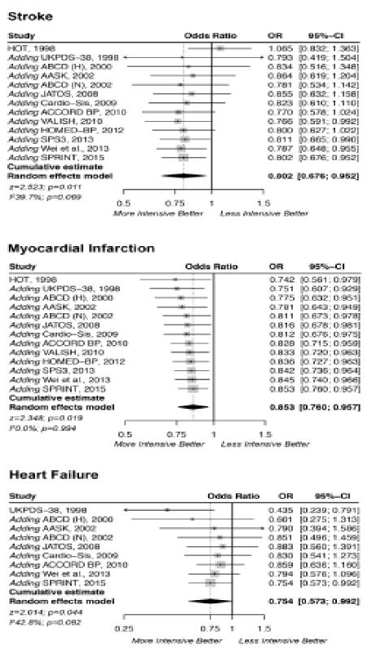
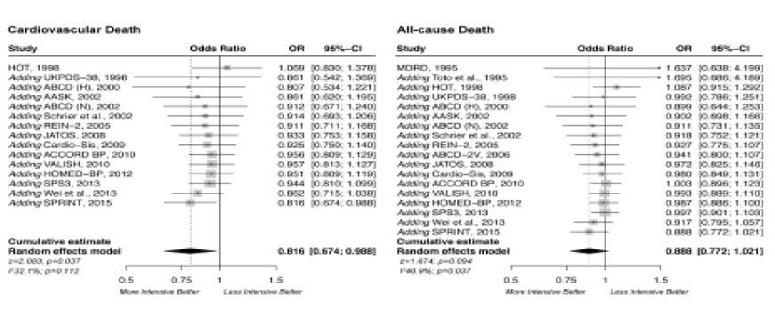
More vs Less Intensive Blood Pressure-Lowering
Additional benefits of lower BP targets
Stroke: -20%
Myocardial infarction: -15%
Heart failure: -25%
Cardiovascular death: -18%
All-cause mortality: -11%
Verdecchia P, et al. Hypertension 2016; 68: 642-53
Notes:
Based on their expertise and experience of current practice, […] there were both benefits and harms associated with a lower clinic systolic blood pressure target of 120 mmHg compared with 140 mmHg in people with primary hypertension without type 2 diabetes. Although the evidence suggested some benefit in reducing mortality and cardiovascular events, the lower blood pressure target was associated with a greater risk of harms, such as injury from falls and acute kidney injury. The committee agreed that the long-term implications of these adverse events were unclear and that further research is needed. This evidence came from the SPRINT trial.
Evidence from a smaller study also showed some benefit of lowering clinic systolic blood pressure targets to 130 mmHg. However, the committee noted that the study was based on people already receiving treatment and that it lacked information on adverse events.
In contrast with the reservations expressed, this slides clearly shows that in numerous RCTs more aggressive strategy of blood pressure control improves all vital outcomes.
NEXT

Slide 38
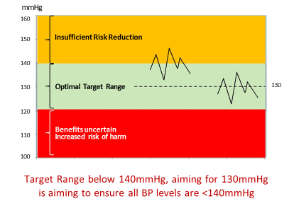
‘Aspirational’ vs ‘Practical’ targets:
the principle of a BP target range
B Williams. ESC Paris 2019 (personal communication)
Notes:
One indication from BIHS and other bodies has been to establish evidence-based (aspirational) blood pressure targets (let’s say SBP<130mmHg) and ‘practical’ targets (let’s say SBP<140mmHg). This approach – also applied to other areas like setting targets for salt reduction – is based on the principle of setting an optimal range. Aiming for a lower target will allow more individuals to achieve the higher target and to fall into the ‘optimal target range’.
NEXT

Slide 39
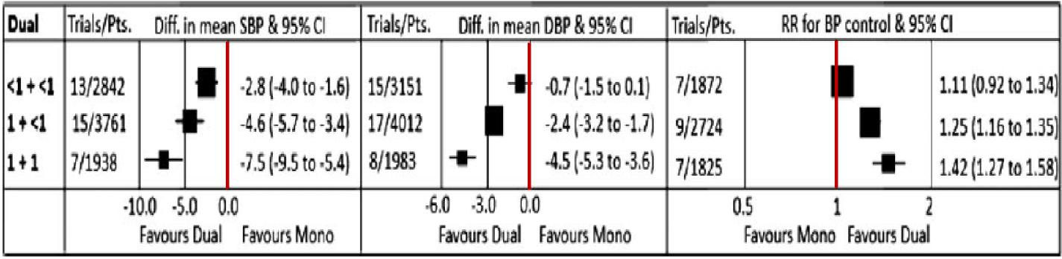
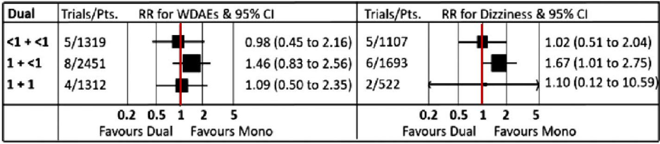

Efficacy and Safety of Dual Combination Therapy as Initial Treatment for Hypertension
33 trials, 13,095 participants, mean baseline mean BP 155/100mmHg
Compared low-standard dose dual combinations <1 + <1, 1 + <1, 1+1
Compared with standard-dose monotherapy, initiating treatment with low-standard-dose dual combination therapy is more efficacious without increasing withdrawals for adverse events
Salam A et al. J Hypertens 2019; 37: 1768-74
Notes:
This slides presents you the main results of a meta-analysis of the effect and safety of dual combination therapy as initial treatment for hypertension. This was published only a few months ago, but the individual trials had been available during the NICE assessment process.
The analysis shows – as predicted from the effects on blood pressure lowering – that starting with low-dose dual therapy is more efficacious in achieving blood pressure targets
PRESS without increasing adverse events
However, the NICE Committee said that (quote): “Some limited evidence from a single study showed that initial dual therapy may reduce cardiovascular events in people with hypertension and type 2 diabetes, but the committee members were disappointed that more comprehensive data were not available. In the absence of compelling new evidence on step 1 dual therapy, the committee agreed that the previous recommendations for step 1 treatment should be retained, because they were based on robust clinical and cost-effectiveness evidence”.
NEXT

Slide 40
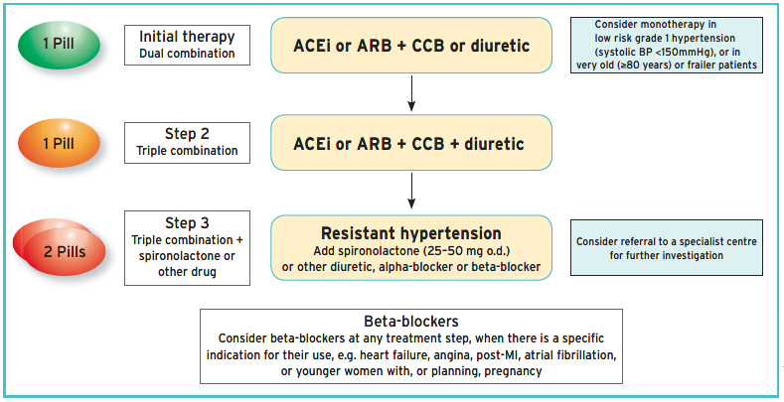
Core drug-treatment strategy for Hypertension
for uncomplicated hypertension and most patients with HMOD, cerebrovascular
disease, diabetes, or PAD
Notes:
These data support the European recommendations
NEXT

Slide 41
What is clinical and therapeutic inertia?
Clinical inertia. Failure of health-care providers to initiate or intensify therapy when indicated (therapeutic goals are not reached) and recognition of problem, but failure to act.¹
Therapeutic inertia. Failure of providers to begin new medications when an abnormal clinical parameter is recorded.²
Other terms. Patient’s inertia, Health Authorities inertia, Physician inertia, Clinical Myopia, Therapeutic momentum, Diagnostic inertia, […]³
¹Phillips LS, et al. Ann Intern Med 2001; 135: 825-34.
²Okonofua EC, et al. Hypertension 2006; 47: 345-51.
³Lebeau J-P, et al. BMC Fam Pract 2014; 15: 130.
Notes:
Clinical inertia was initially defined in 2001 by Phillips.
The term applies to the management of risk factors, when therapeutic targets are clearly defined and the benefits to reach those targets are well established.
Clinical inertia appears whenever the health-care provider does not initiate or intensify therapy appropriately when therapeutic goals are not reached.
With the exact same definition, Okonofua et al. introduced the terms “therapeutic inertia” in 2006.
Other terms have since been used to describe this fact. However, the recent use of these terms is imprecise, and conceptual models in theory and evidence have been proposed, as I shall describe soon.

Slide 42
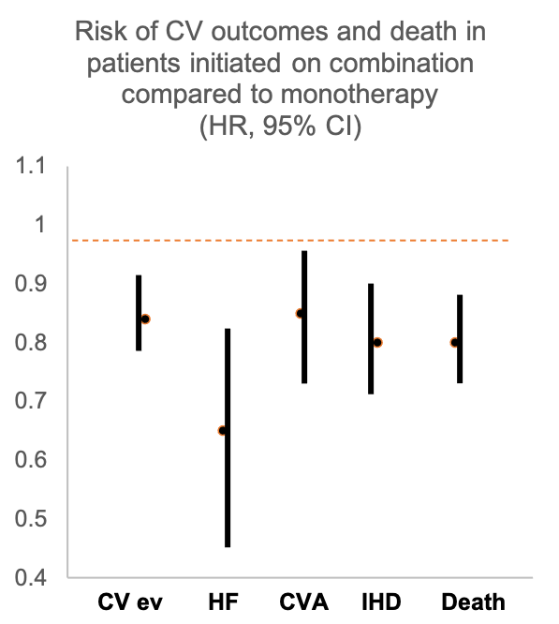
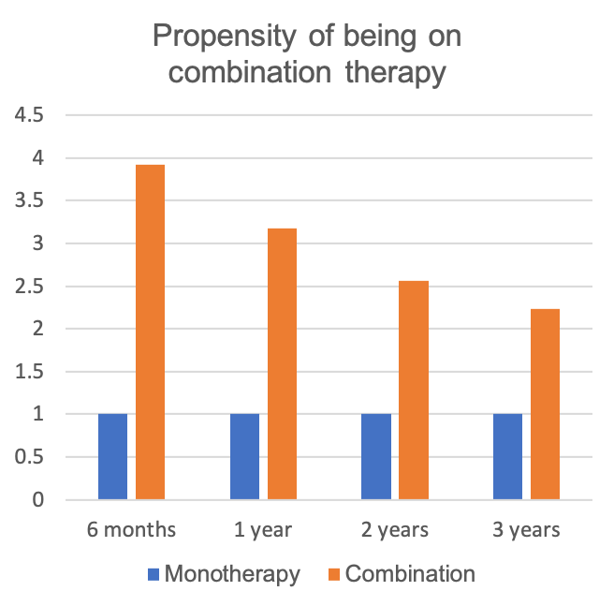
Why bother?
Rea F, et al. Hypertension 2018; 72: 846-53.
Notes:
In a prospective study carried out in 125,635 patients (40-85 yrs) in Northern Italy, therapeutic inertia as a contributor to failure to achieve BP control in hypertension was studied by comparing the proportion of BP control and the risk of death in two groups, one that started treatment with one drug (n=100,982) and one in whom a 2-drug fixed-dose or free combination was used (n=24,653). Follow-up was up to 3 years.
Patients on initial combination therapy showed a significant and marked increase in the propensity of being on combination treatment than patients under initial monotherapy, when allowing for confounders (left).
Compared to patients with initial monotherapy (right), patients prescribed an initial fixed-dose 2-drug combination (n=19 627) displayed a significant reduction in the risk of hospitalization for all considered outcomes. The risk reduction was largest for heart failure and smallest for cerebrovascular events, but for all events it was statistically significant.

Slide 43
Consequences of clinical inertia
Uncontrolled hypertension and progression to more severe one
Target organ damage (LVH, vascular stiffness, albuminuria)
CVD events (AMI, stroke, CHF, CKD)
Impaired cognitive function & dementia
Emergency hospital admissions
Disability (reduced QoL)
High healthcare costs
Loss of productivity

Slide 44
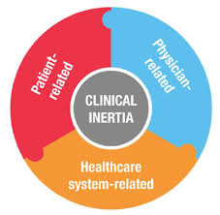
Possible solutions
Physician Factors | Patient Factors | Health System Factors
Improve communication with patients: risk, benefits, agree a strategy, | Self-monitoring of BP | Clear clinical guidelines
Use information material and counselling | Instructions and support for system-guided self-management | Disease registry
Empower patient (self BP monitoring) | Family, social or AHP support | Visit planning
Feedback of clinical improvements | Easy access and provision of prescribed drugs | Active patient outreach
Identify and address barriers | Group sessions | Decision support
Collaboration with other AHPs | Improve adherence and persistence | Team approach to care and care coordination
Simplify drug regime |  | Clear communication between physician and staff
Use single-pill combination |  | Reduced tariff for single-pill combination
Use long-acting drugs (once daily) |  | Remote monitoring systems
Address side effects/adverse reactions timely |  | Development of national databases shared across the whole health and social care system
Notes:
Clinical or therapeutic inertia is a complex multi-layered phenomenon, the cause of which reside in different domains of the doctor-patient interaction and not independent from the health-care systems and the organization in which such an interaction occurs.
I have only touched and illustrated some aspects, acknowledging that adherence and persistence are increasingly dominant aspects of some of the shortfalls detected in the quality of care for hypertension.
Some of the possible solutions are listed here. Most of these approaches clearly need to be combined in order to be effective, as they are part of different domains and therefore require a multisectoral interventions.

Slide 45
Therapy in resistant hypertension
Evidence-free zone (until recently!)
Seek specialist advice
Considered:
Alpha-blocker (doxazosin)
Further diuretic (spironolactone, amiloride)
Beta-blocker (atenolol, bisoprolol, carvedilol)
Invasive procedures (not for Primary Care!)
Non-effective: moxonidine; aliskiren
Obsolete: hydralazine; minoxidil; methyl-dopa; reserpine; clonidine (no evidence of benefits with RCTs)

Slide 46
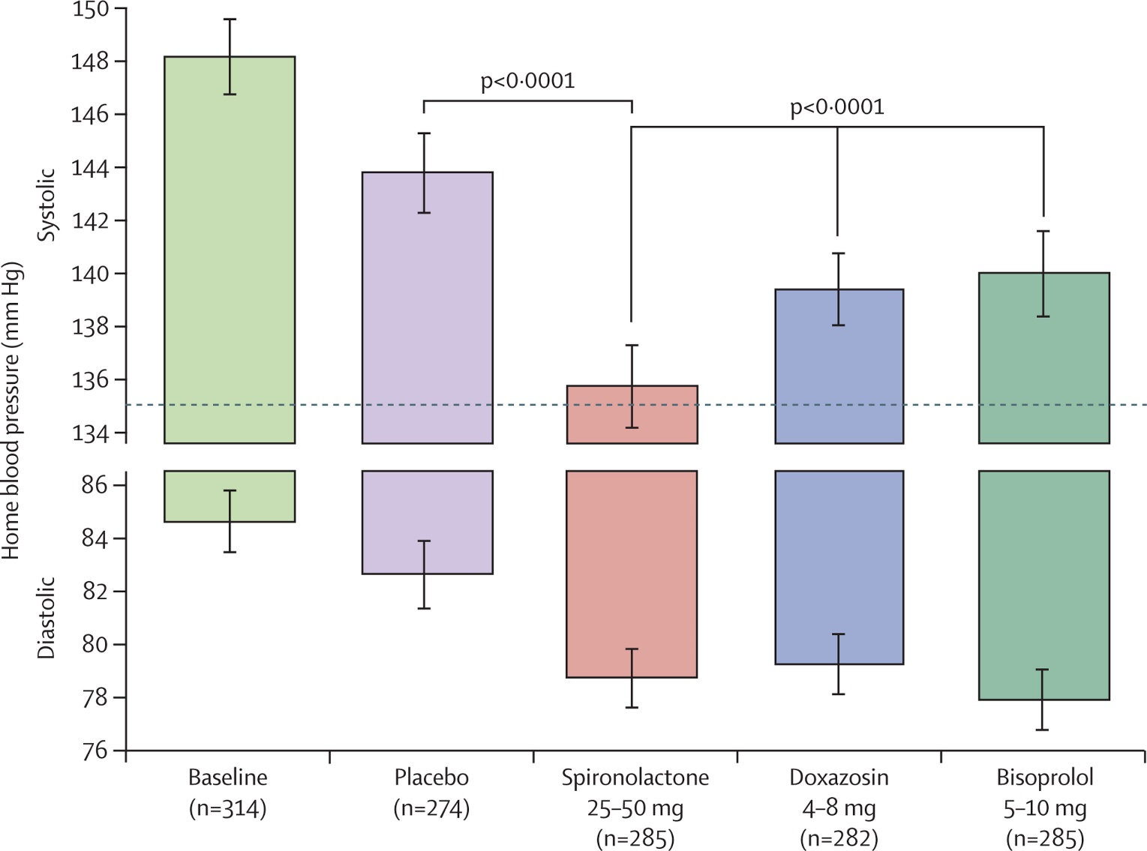
Figure 2
PATHWAY 2
Resistant hypertension
On 3 drugs
BP uncontrolled
18-79 yrs
N=335 randomized
N=230 complete all cycles
Williams B et al. Lancet 2015; 386: 2059-68
Notes:
Home systolic and diastolic blood pressures comparing spironolactone with each of the other cycles
The top and bottom of each column represents the unadjusted home systolic and diastolic blood pressures, respectively, averaged across the mid-cycle (low-dose) and end-of-cycle (high-dose) visits (6 weeks and 12 weeks) in which patients received the drug. Error bars represent 95% CI. Comparisons are as described under methods for the primary endpoint.

Slide 48
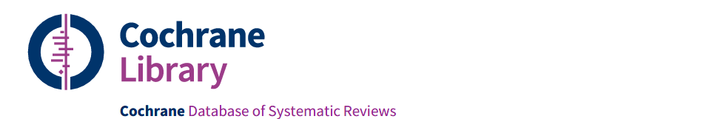
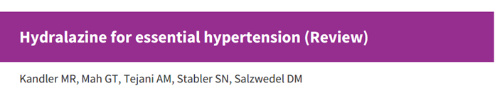
Hydralazine for essential hypertension?
No randomized controlled trials comparing hydralazine to placebo.
Uncertain the effects of hydralazine vs placebo on mortality, morbidity, withdrawals due to adverse effects, serious adverse events, systolic and diastolic BP.
Effects on BP based on before and after studies, not RCTs.
Uncertain effects on clinical outcomes.
Kandler MR et al. Cochrane Review 2011; 11: CD004934
Notes:
BNF Indications and dose
Moderate to severe hypertension (adjunct)
By mouth
For Adult
Initially 25 mg twice daily, increased if necessary up to 50 mg twice daily.
Heart failure (with long acting nitrate) (initiated in hospital or under specialist supervision)
By mouth
For Adult
Initially 25 mg 3–4 times a day, subsequent doses to be increased every 2 days if necessary; usual maintenance 50–75 mg 4 times a day.
Hypertensive emergencies (including during pregnancy),
Hypertension with renal complications
By intravenous infusion
For Adult
Initially 200–300 micrograms/minute; usual maintenance 50–150 micrograms/minute.
By slow intravenous injection
For Adult
5–10 mg, to be diluted with 10 mL sodium chloride 0.9%; dose may be repeated after 20–30 minutes.
Contra-indications
Acute porphyrias ; cor pulmonale; dissecting aortic aneurysm; high output heart failure; idiopathic systemic lupus erythematosus; myocardial insufficiency due to mechanical obstruction; severe tachycardia
Cautions
Cerebrovascular disease; coronary artery disease (may provoke angina, avoid after myocardial infarction until stabilised); occasionally blood pressure reduction too rapid even with low parenteral doses
Side-effects
Common or very common
Angina pectoris; diarrhoea; dizziness; flushing; gastrointestinal disorders; headache; hypotension; joint disorders; lupus-like syndrome (after long-term therapy with over 100 mg daily (or less in women and in slow acetylator individuals)); myalgia; nasal congestion; nausea; palpitations; tachycardia; vomiting
Rare or very rare
Acute kidney injury; agranulocytosis; anaemia; anxiety; appetite decreased; conjunctivitis; depression; dyspnoea; eosinophilia; eye disorders; fever; glomerulonephritis; haematuria; haemolytic anaemia; hallucination; heart failure; hepatic disorders; leucocytosis; leucopenia; lymphadenopathy; malaise; nerve disorders; neutropenia; oedema; pancytopenia; paradoxical pressor response; paraesthesia; pleuritic pain; proteinuria; skin reactions; splenomegaly; thrombocytopenia; urinary retention; vasculitis; weight decreased
Side-effects, further information
The incidence of side-effects is lower if the dose is kept below 100mg daily, but systemic lupus erythematosus should be suspected if there is unexplained weight loss, arthritis, or any other unexplained ill health.

Slide 49
Moxonidine for essential hypertension?
Centrally acting drug similar to clonidine.
Only as add-on therapy to further lower blood pressure if combination therapy with first- and second-line agents is insufficient or unsuitable. However, evidence limited¹.
Be ware of combination with beta-blockers (rebound hypertension)
The effect on cardiovascular morbidity and mortality has not been tested in clinical trials.
Do not prescribe in heart failure of any grade², bradycardia, arrhythmia, as it has been associated with increased mortality and adverse events.
Reduce the dose in renal impairment.
¹Chazova I & Schlaich MP. Int J Hypert 2013; 2013:541689
²Cohn JN, et al. Eur J Heart Fail 2003; 5: 659-67

Slide 50
Management of hypertensive crisis: BIHS Position document
Lack of robust data
Considerable heterogeneity and inconsistency in clinical practice
Non-adherence to antihypertensive medications
common (30%-50% of patients one year after
sub-optimal BP control
pseudo-resistance to medications
increased emergency hospital admissions, CVD risk, healthcare costs
Kulkami S et al. J Hum Hypert 2022; Nov 22

Slide 51

Who to refer for same-day specialist review
A hypertensive emergency is present when severe hypertension is associated with signs and symptoms of acute end-organ damage. Uncommon (1-2 per million per year)
Severe hypertension * >180/120
No symptoms or signs
Retinal haemorrhage or papilloedema
(Accelerated or malignant hypertension)
Life-threatening symptoms
(confusion, chest pain, HF, AKI)
Assess TOD
Suspected phaeo
(headache, palpitations, pallor, sweating etc)
*However, a BP pf >200/120mmHg is severe
Kulkami S et al. BIHS Position document J Hum Hypert 2022; Nov 22

Slide 52
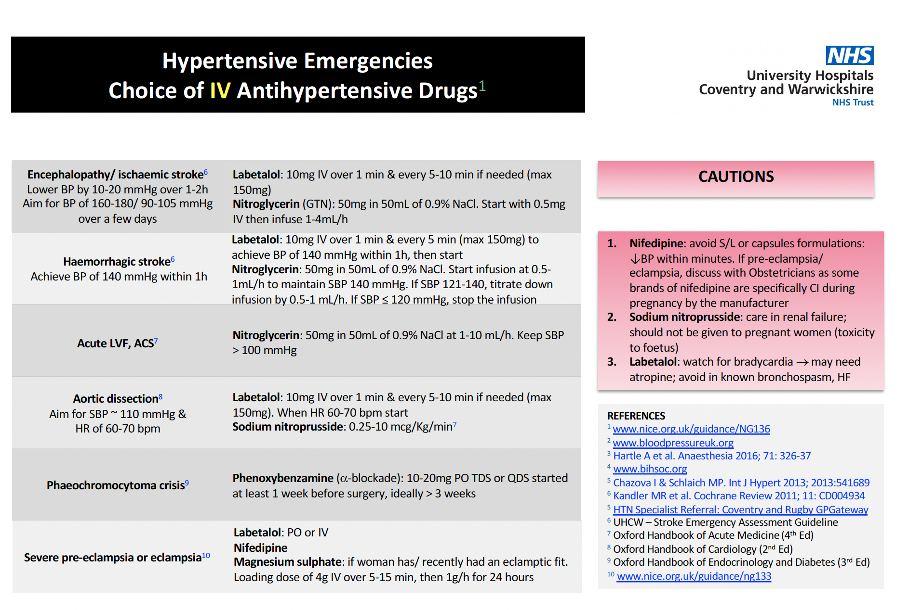

Slide 53


Thank you!
Any question?
Notes:
53

