Slide 1
Updates in Heart Failure Treatments
(Detect, Protect and Perfect)
Content created by HIWM Heart Failure Champions:
Joanne Lees Heart Failure Nurse Specialist, Sandwell and West Birmingham Hospitals NHS Trust​
Jacqui Hyland Heart Failure Nurse Specialist, UHCW​
Jacqui Elson Whittaker – Heart Failure Nurse Specialist, Dudley. ​

Slide 2
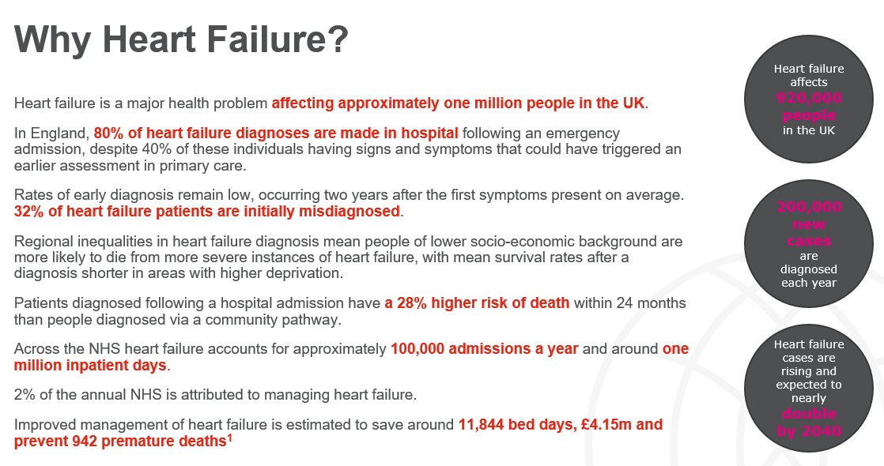
Notes:
Heart Failure is a big problem.
It affects approx. 1 million people in the UK
And despite people approaching primary care with symptoms, there is still evidence to suggest 80% diagnoses are made in hospital.
This is often 2 years after presenting with symptoms, with almost a third being misdiagnosed. Hence we need to tackle earlier detection.
This is because those being diagnosed following a hospital admission have a 28% risk of death within 2 years than those diagnosed via a community pathway.
There are approximately 100,000 HF admissions a year, costs the NHS a lot of money and accounts for many of our systems bed days.
If we tackle earlier diagnosis and improved management there are many system and financial savings to be had.

Slide 3
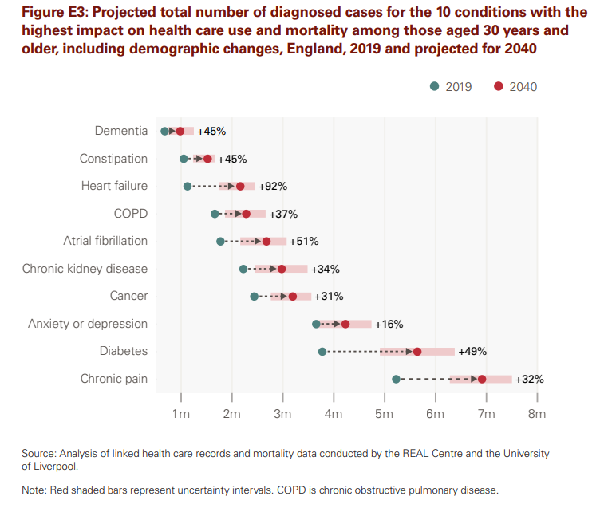

Notes:
This is not just a problem, this is an urgent problem. These projections from the Health Foundation report, show that there is going to be a 92% increase in heart failure diagnosis by 2040. So within 15 years there is going to be approx. 2 million people living with the condition.

Slide 4
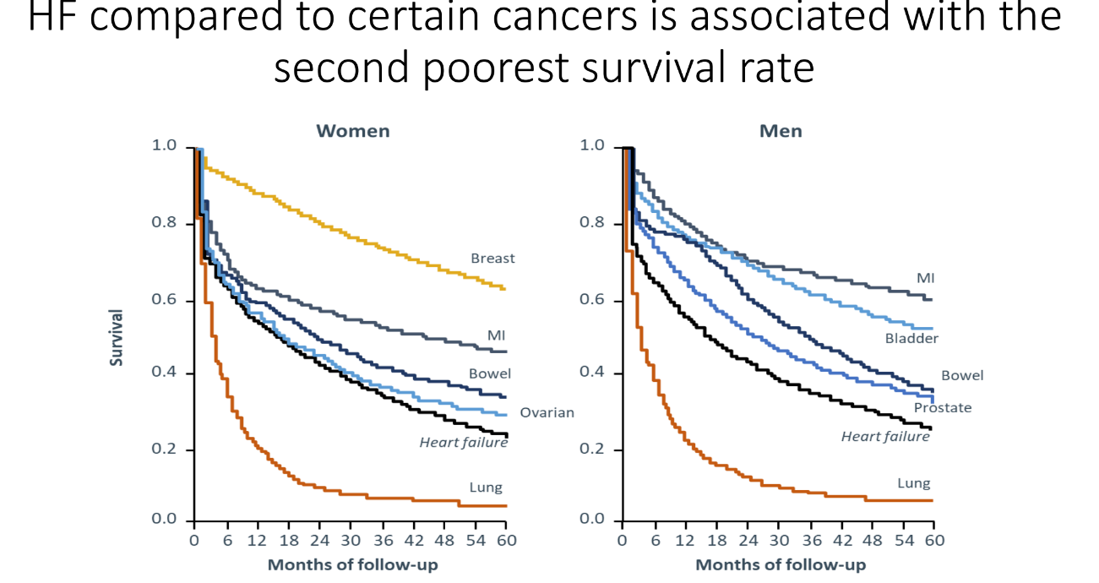
Notes:
Equally, it is not a good condition for people to have, as you can see here, survival rates in both men and women are lower than some of the common cancers within 5 years of diagnosis.

Slide 5
10 Year NHS Plan
‘chronic heart failure, thousands of lives could be saved by treating people earlier in the pathway’
‘Implementation of ‘Modern Service Frameworks’ in 2026, which are accessible and transparent to all. Early priorities will include CVD’
‘community pharmacy a bigger role in prevention by expanding their role in vaccine delivery and in screening for risk of cardiovascular disease and diabetes.’
‘Prevention is how we change this course. The possibilities are huge: around 70% of cardiovascular disease, 40% of cancers and 40% of dementia are preventable’
‘new ‘Prevention Accelerators’ will initially run in selected ICBs and will focus on community-led methods to tackle variation in uptake of high impact cardiovascular disease and diabetes interventions’
‘Advanced wearables, biomarkers and regenerative medicine will support our Plan for Change ambition to reduce premature cardiovascular disease mortality’
Notes:
For those of you that have read the new Ten Year NHS Plan, or skimmed it, you may think there has been very little written on cardiovascular disease, but actually, it is mentioned a lot.
It discusses about earlier diagnosis specifically in heart failure, but equally it suggests that systems should be looking at the workforce to tackle some of these conditions, such as community pharmacists,
There is a great emphasis on prevention of these conditions,
And how technological advancements will be really important to reduce mortality.

Slide 6
How the 10-year NHS Plan’s ‘three shifts’ relate to heart failure
From hospital to community
From sickness to prevention
From analogue to digital
The life expectancy of patients diagnosed at a late stage in the disease course is half that of patients diagnosed at the earliest. Patients admitted to hospital at the time of their diagnosis have worse survival rates than those not requiring hospital admission.
Earlier and timely diagnosis of heart failure in primary care and community settings, will help to support the recovery of the NHS backlog and alleviate pressure on ambulatory and emergency care.
Timely diagnosis in primary care requires recognition of the signs and symptoms of heart failure, both by patients and healthcare professionals.
Health care professionals having that awareness through education and upskilling will allow systems to proactively work towards the NHS ambition to identify/diagnose people with HF in a primary care setting and reduce the rates of hospitalisation.
Several digital applications are available to improve care for people living with heart failure, including:
AI-assisted echocardiograms to support diagnosis
Cardiac rehabilitation and self-management tools to empower patients
Remote monitoring solutions and virtual wards to enable clinicians to assess, monitor and care for patients outside clinical settings.
Notes:
And of course the main take aways of the new plan, have been the three shifts.
Hospital to Community
Sickness to prevention and
Analogue to Digital.
The condition of heart failure can fit into all of these boxes.
Earlier diagnosis of heart failure in community settings will help support the recovery of NHS backlogs and alleviate pressures in emergency care
Increasing awareness of the condition , to both health care professionals and patients can aid in the prevention work
And there are so many technologies such as point of care technologies, digital tools for rehab and remote monitoring self management that can really benefit heart failure patients.

Slide 7
Detect
Increase awareness of the signs and symptoms of heart failure
Protect
Improve health outcomes and patient experience
Perfect
Reduction in heart failure hospitalisations and/or redamissions
Notes:
So here at HIWM, we like to use the Detect, Protect, Perfect model.
Detect our HF patients early and out of hospital – we can do that by increasing awareness, such as teaching sessions like this, but also raising awareness to patients so that they come earlier.
Protect those that have been diagnosed by ensuring that they get timely and appropriate management
Perfect their care, by escalating early to specialist teams, and providing cardiac rehabilitation to these patients and giving them all the tools to self manage their condition. Hopefully resulting in them seeking help early rather than ending up with an emergency admission decompensating.

Slide 8
Detect
Increase awareness of the signs and symptoms of heart failure
Patients are diagnosed earlier and the prevalence gap (expected vs observed) in the diagnosis of heart failure is reduced
Notes:
So lets look at detect. This is all about understanding what heart failure is, what the signs and symptoms are, what may be the cause and how can we get the right diagnostic tests .

Slide 9
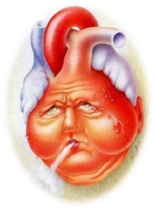
What is Heart Failure?
“A clinical syndrome characterized by typical symptoms (e.g. breathlessness, ankle swelling and fatigue) that may be accompanied by signs (e.g. elevated JVP, pulmonary crackles and peripheral oedema) caused by a structural and/or functional cardiac abnormality resulting in reduced cardiac output and/or elevated intracardiac pressures at rest or during stress”
McDonagh TA et al EHJ (2021) 42, 3599 - 3726 doi:10.1093/eurheartj/ehab368
Notes:
So what is heart failure? ( read slide)

Slide 10
Symptoms & Signs of HF
Common symptoms of HF include:
Common signs of HF include:
Shortness of breath / dyspnoea
Orthopnoea
Paroxysmal nocturnal dyspnoea
Reduced exercise tolerance
Fatigue
Ankle swelling / oedema
Elevated jugular venous pressure
Third heart sound (gallop rhythm)
Laterally displaced apical pulse
Pulmonary crepitations
Peripheral oedema
Take a detailed history for symptoms and risk factors for heart failure.
Patients with heart failure do not always present with classical symptoms, especially young patients
Notes:
So in order to detect.. It is important we know what signs and symptoms are.
Common signs include peripheral oedema, elevated JVP and tachycardia
Typical symptoms consist of breathlessness, fatigue, ankle swelling
No sign or symptom is both sensitive and specific for the diagnosis of heart failure
Not all symptoms will be present in all heart failure patients, and some symptoms such as dyspnoea and oedema will be indicative of other conditions such as chronic obstructive pulmonary disease
In the elderly, obese people and those with chronic lung disease, the signs and symptoms of heart failure may be difficult to identify and interpret
It is important to emphasise that often patients present with non specific symptoms such as fatigue and in the elderly they can present with confusion.
Emphasise how important it is to take a thorough history and examination particularly looking out for signs of heart failure but also for causes such as murmurs that may highlight valvular disease as an aetiology
Once a diagnosis of heart failure has been made, the signs and symptoms are important in monitoring a patient’s response to treatment and stability over time
Persistence of symptoms despite treatment usually indicates the need to additional therapy and/or escalation to the specialist HF team (do not underestimate the role and importance of the HF Nurse Specialist team – they work across both primary and secondary care and are a good point of contact for advice and guidance)
Go through the symptoms and signs that patients with heart failure are likely to develop

Slide 11
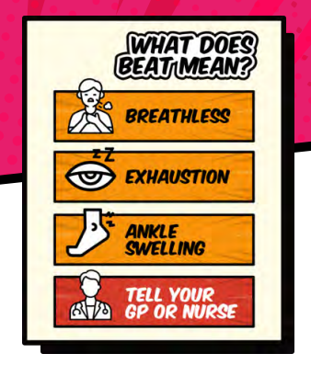

Notes:
Pumping Marvellous Charity, a dedicated heart failure charity, has a great acronym. B.E.A.T.
Breathless
Exhaustion
Ankle swelling
Time to get a blood test.
These will be great to have up round your surgeries etc to help raise awareness to patients on the signs and symptoms. There is lots of information on the Pumping Marvellous website, and you can order the posters there.

Slide 12
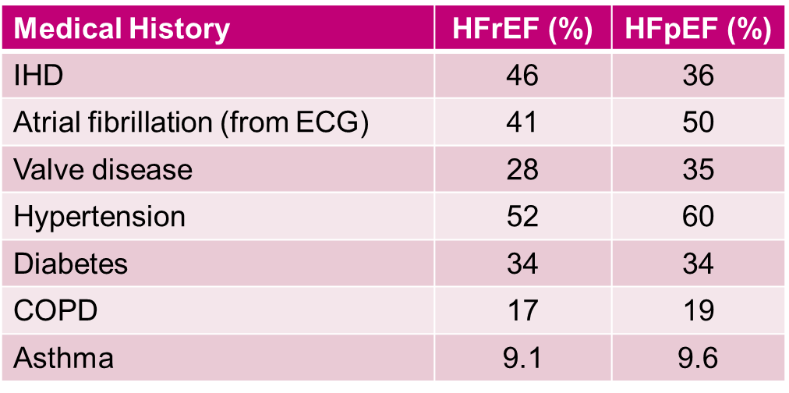
Causes & co-morbidities of HF
https://www.nicor.org.uk/wp-content/uploads/2020/12/National-Heart-Failure-Audit-2020-FINAL.pdf <accessed 22/04/2022>
Notes:
This slide lists those risk factors and co-morbidities which contribute to the development of HF
HF is a syndrome rather than a compete diagnosis and the underlying cause of cardiac dysfunction should always be determined.
Optimal management of co-morbidities – can reduce M+M associated with condition → delay onset and reduce progression of the condition

Slide 13
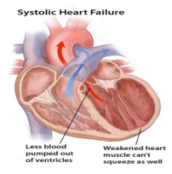
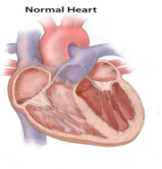
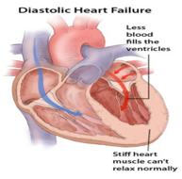
Types of Heart Failure
Systolic Dysfunction (LVSD)
Diastolic Dysfunction
EF = This refers to the amount of blood pumped out of the left ventricle with each heartbeat.
It is expressed as a % and over 50% is considered normal
Notes:
Just to confuse you all, there are different types of HF
Normal heart – describe left ventricle – main pumping chamber of the heart.
Animation 1: LVSD [HFrEF] → LV dysfunction - Dilatation – ability of the ventricle to contract becomes impaired – unable to work efficiently to pump/eject blood out of the ventricle
Animation 2: Diastolic dysfunction – stiff left ventricle due to hypertrophy
Animation 3: Define ejection fraction - % of blood pumped out of the heart with each heart beat. - > 50% accepted as normal
Differentiation of patients with HF based on LVEF is important due to underlying aetiologies, demographics and co-morbidities in addition to response to treatment
systolic dysfunction is defined as an LVEF less than 40%.
Diastolic dysfunction refers to cardiac dysfunction in which left ventricular filling is abnormal and is accompanied by elevated filling pressures

Slide 14
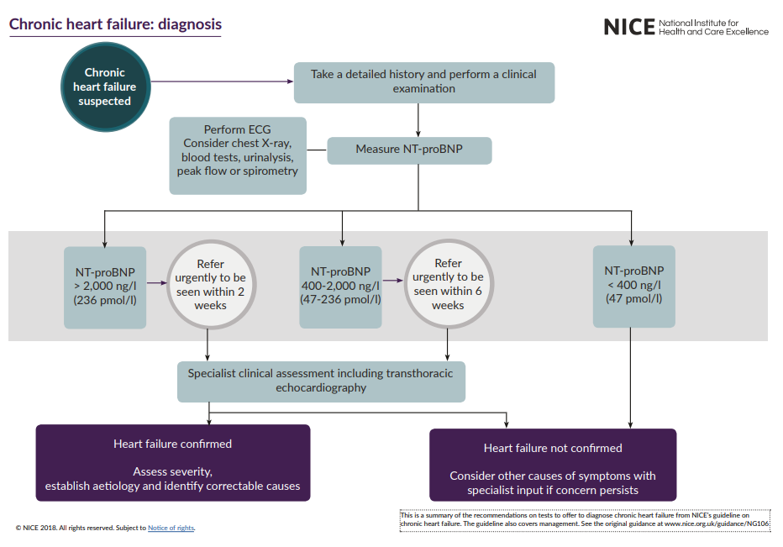
Notes:
So how should we diagnose. Follow the pathway.

Slide 15
NTproBNP
>2000 refer urgently for specialist assessment and ECHO (within 2 weeks)
Between 400 and 2000 refer for specialist assessment and ECHO (within 6 weeks)
<400 HF unlikely, consider other causes or discuss with HF specialist if still strongly suspected.
ECG
Only 7.5% of HF patients have normal ECG
Look for Left Bundle branch block
Aids in identifying abnormalities that may be causing or worsening heart failure symptoms
Chest X-ray
Can enable the detection ofan enlarged heart and to establish if there are any signs of congestion or infection. In addition, it may reveal lung diseases, which may cause symptoms similar to heart failure
ECHO
Echocardiography remains the optimal choice for diagnosing HF
Enables understanding of the LV function to determine what type of heart failure it is
Assists in finding causes of heart failure
Establishes fluid status of patient to have a great understanding of the haemodynamics
Notes:
So in summary if you are suspecting HF, you need to think of doing these 4 things, as well as other routine bloods etc.

Slide 16
Protect
Improved health outcomes and patient experience
Pharmacological intervention and pathways
Improved/increased access to evidence-based therapies aligned with local clinical pathways
Notes:
Now once they are diagnosed; we need to manage these patients, we need to protect them. We need to relieve their symptom burden, and give them the best chances of longer life.
So we need to ensure that they have access to all the evidence based therapies, interventions and pathways that are suitable for them.

Slide 17
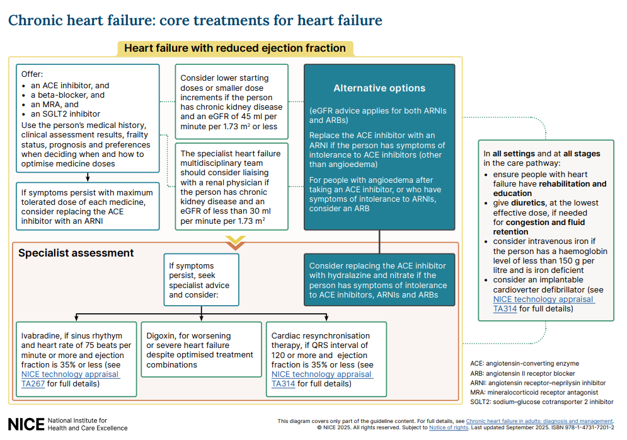
Notes:
Now how we protect them depends on what type of HF they have.
For HFrEF
There are 4 pillars of treatment, no longer advised necessarily to stagger their introduction, but to use you clinical assessment skills and a holistic, personalised approach to get them on the highest tolerated doses of all the recommended drugs.
These NICE guidelines have just been updated, and as you can see it is clear now that SGLT2i should be introduced and that ARNIs can now be introduced within primary care, with specialist advice. Ofcourse, this is new, and there may be some apprehension with this. It is quite common now for specialist teams to have started ARNI anyway even before an ACE was trialled, so you will probably find a large proportion of your HFrEF patients already on it if they have been through specialist team. However, it is important for you to consider starting this with some advice if your patients are remaining symptomatic on ACE or ARB.
Equally the other new thing highlighted is the consideration of IV iron therapy, and so the importance to be looking at that aswell as renal function

Slide 18
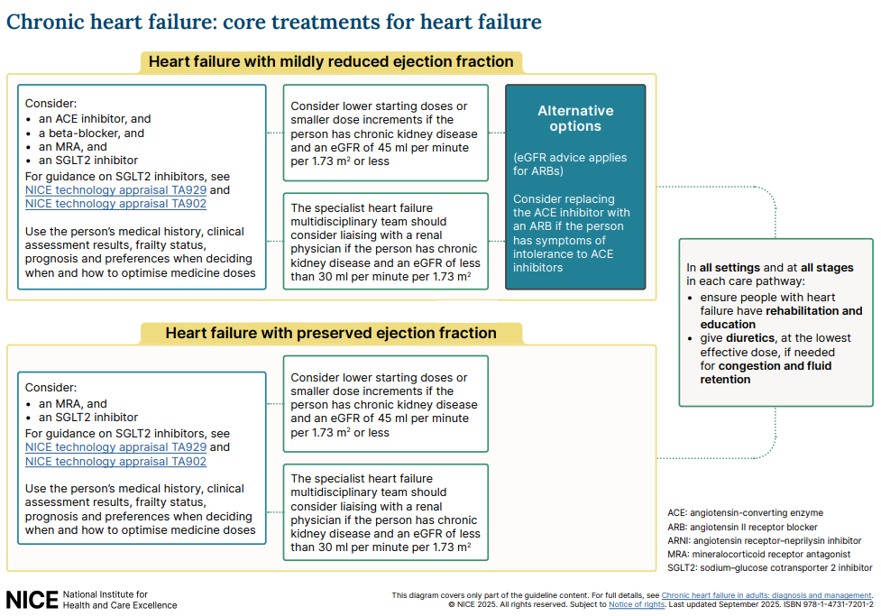
Notes:
IN HFmEF … the same 4 pillarsapart from ARNI as an alternative
And with HFpEF we now have 2 pillars recommended alongside the symptom control diuretics for treatment. The MRA and the SGLT2i. There will be many of your patients not on these as yet, as many HFpEF may not be seen by specialist HF nurses in some areas, so I would strongly advise that these 2 pillars are now considered when you are doing your long term reviews/HF reviews.

Slide 19
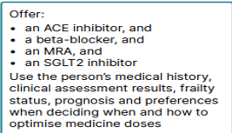
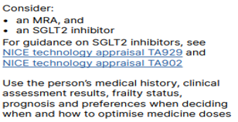
Pillars of Treatment
HFrEF and HFmEF
HFpEF
Diuretics
Notes:
So in summary…
4 pillars for HFrEF and HFmEF.
2 pillars for HFpEF
And diuretics for fluid overload/congestion for symptom controil.. These do not give any prognostic benefit, but will improve peoples daily lives.

Slide 20
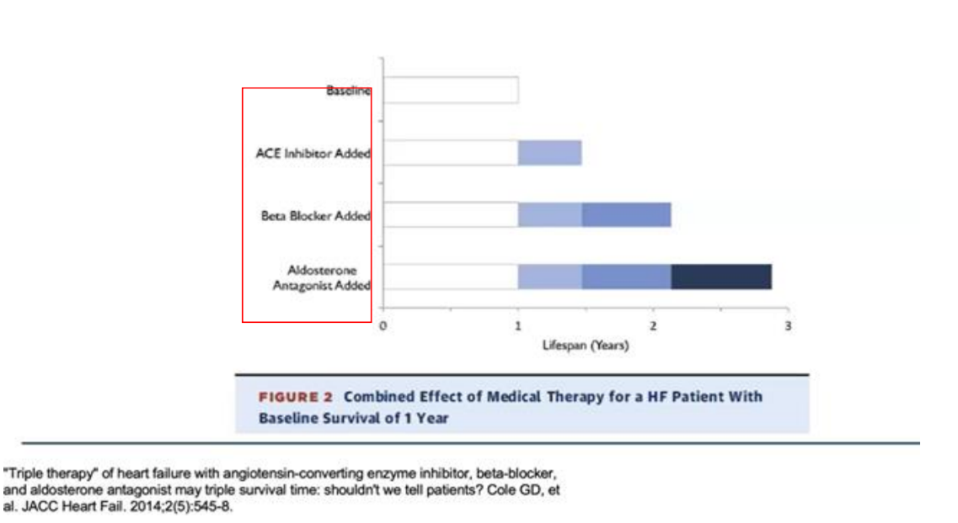
Notes:
So why these 4 pillars.
Firstly although old, and before the SGLT2i came along, there was strong evidence that triple therapy improved lifespan three fold by having all 3 treatments in place.

Slide 21
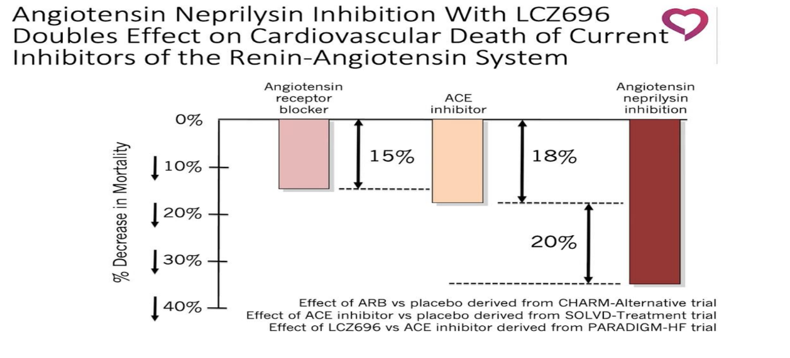
Notes:
And those apprehensive about ARNIs… we can see that swapping from an ACE to ARNI can decrease mortality by a further 20%.

Slide 22
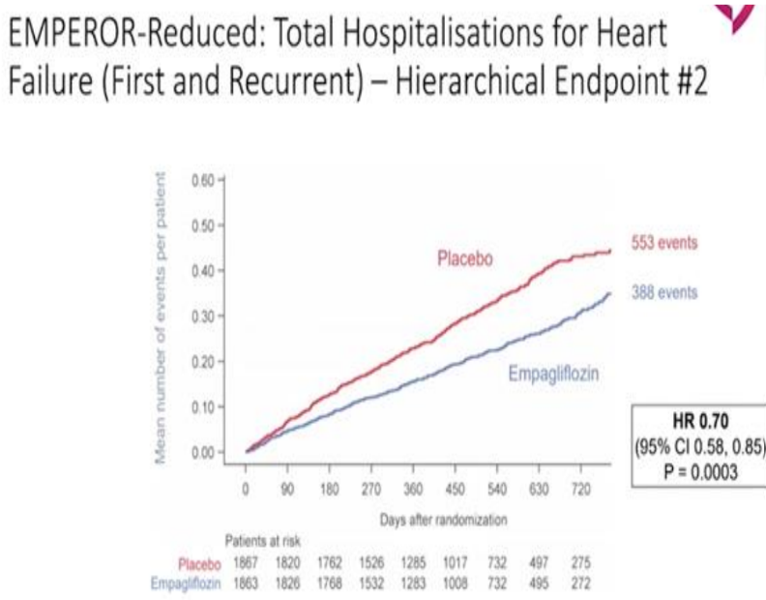
Notes:
Equally with the SGLT2i.. This is for Empa, but Dapa had similar results.. That it can really improve symptoms to such an effect that can have a huge effect on further decompensating episodes requiring hospital admissions.

Slide 23
ACE/ARB/ARNI/MRA
Before prescribing measure the person's renal function and electrolyte levels.
Measure their renal function and electrolyte levels:
- 1 to 2 weeks after starting treatment
- 1 to 2 weeks after each dose increment
- Every 3 to 6 months once the maximum tolerated dose has been established
-Any time renal function may be compromised
If the person's serum creatinine level increases by more than 50% or their potassium concentration increases to more than 5.5 mmol per litre, follow local guidelines
Measure the person's blood pressure or ask the person to measure their own blood pressure, before and after each dose increment.
For potassium binders recommended as options in NICE technology appraisal guidance for treating hyperkalaemia, see the guidance on: • patiromer (TA623, 2020) • sodium zirconium cyclosilicate (TA599, 2022) and refer to local guidance
Notes:
So just a bit of guidance when using these treatments.

Slide 24
Beta Blockers
Assess for heart rhythm, heart rate and conduction abnormalities using a 12-lead ECG before deciding whether to prescribe a beta-blocker.
Do not offer a beta-blocker to people with second-degree or third-degree heart block who do not have a pacemaker or to people with bradycardia (that is, a heart rate of less than 50 beats per minute).
For people with symptoms and bradycardia, consider repeating a 12-lead ECG after each dose increment
Do not withhold treatment with a beta-blocker solely because of age or the presence of peripheral vascular disease, erectile dysfunction, diabetes, interstitial pulmonary disease or chronic obstructive pulmonary disease.
Assess heart rate and clinical status after each dose increment.
Notes:
And for Beta Blockers

Slide 25
Iron Therapy
In people with heart failure with reduced ejection fraction, assess iron status and check for anaemia with all of the following blood tests;
- transferrin saturation (TSAT)
- serum ferritin
-haemoglobin.
Consider iron sucrose, ferric carboxymaltose or ferric derisomaltose for people with heart failure with reduced ejection fraction and haemoglobin of less than 150 g per litre if they have iron deficiency defined as:
- TSAT of less than 20% or and ferritin100- 299ng/ml
- serum ferritin of less than 100 nanogram per ml
If iron deficiency anaemia is identified, do not assume that it is related to the person's heart failure and think about investigating for alternative causes.
Notes:
And this is the specific new guidance for the consideration of patients iron status.

Slide 26
Titration
ACE/ARB
Initiate ACE/ARB e.g- Ramipril 1.25mg-2.5mg od/Losartan12.5mg-25mg od
ARNI
Beta Blocker
Monitor heart rate, blood pressure, and clinical status (for symptoms and signs of heart failure) after each dose increase. ​
Aim for target dose or, highest tolerated dose and maintain indefinitely unless adverse effects occur ​
Monitor renal function and blood pressure after each dose titration and then once stable measure monthly for 3 months then every 6 months
Aim for target dose or, highest tolerated dose and maintain indefinitely unless adverse effects occur ​
Monitor renal function and blood pressure after each dose titration and then once stable measure monthly for 3 months then every 6 months
Do not increase the dose if the person has signs of worsening heart failure, symptomatic hypotension (such as dizziness), or excessive bradycardia (heart rate less than 50 beats per minute). ​
Aim for heart rate 60 beats per minute ​
If the heart rate decreases to 50 beats per minute – consider halving dose.
MRA
If Cr <200 µmol, K<5.0 mmol Initiate
Aim for 2 weekly intervals until target dose or highest tolerated dose achieved
Aim for target dose or, highest tolerated dose and maintain indefinitely unless adverse effects occur ​
Monitor renal function and blood pressure after each dose titration & then once stable measure monthly for 3 months then every 6 months
SGLT2i
Dapa/Empa: there is no titration recommended dose 10mg od​unless severe liver impairment= 5mg od
In patients with heart failure SGLT2 inhibitors are given to diabetic and non- diabetic patients​
There is a small risk of DKA with SGLT2 inhibitors and pts should be aware of sick day rules
Aim for 2 weekly titrations until target dose or highest tolerated dose achieved
If transferring to Entresto from ACEI, following specialist advice, then a 36hr washout period is required
Aim for 2 weekly titrations until target dose or highest tolerated dose achieved
Initiate beta blocker eg Bisoprolol 1.25mg or 2.5mg od/ Nebivolol 1.25 or 2.5mg od/ Carvedilol 3.125mg bd
Aim for target does or highest tolerated dose and maintain.
If not T1DM or previous DKA
See local guidance for recommended SGLT2i
Initiate Dapagliflozin 10mg eGFR ≥15/ If eGFR >20 Empagliflozin 10mg
Initiate Entresto – 24/26mg bd ( if eGFR <60/ low BP)
49/51mg bd if eGFR> 60 and BP allows/ was on high dose of ACEi or ARB
Can titrate up to 50mg od​
Spironolactone/ Eplerenone at 25mg (12.5mg if frail)
Notes:
So how do we titrate, as I said previously, no l;onger necessarily need to add one drug in at a time, but it is often best to start at small doses so you can monitor that renal function…

Slide 27
Clinical Review
Monitor all people with heart failure. Provide:
- a clinical assessment of functional capacity, fluid status, cardiac rhythm, cognitive status and nutritional status
- a review of medication, including need for changes and possible side effects
- an assessment of renal function
- iron status and haemoglobin measurement
Provide more detailed monitoring if the person has significant comorbidity or if their condition has deteriorated since the previous review.
Determine the frequency of monitoring based on the person's clinical status and the stability of their condition. If the person's clinical condition or medication has changed, use a short timeframe for monitoring (days to every 2 weeks). For stable people with proven heart failure, monitor at least every 6 months.
For people with heart failure who want to be involved in monitoring their condition, provide sufficient education and support from their healthcare professional to enable this to happen, with clear guidance on what to do in the event of deterioration.
Notes:
So when seeing these patients these are the things you need to consider when undertaking that review.

Slide 28
Perfect
Reduction in heart failure hospitalisations and/or readmissions
Cardiac rehabilitation, remote monitoring and self-management pathway approaches
Notes:
And once you have got them on their maximum tolerated doses, we need to keep them well and keep them out of hospital.
We need to perfect their care.
So need to think about how we enable them to self manage, and ofcourse see whether they can have access to that 5th pillar.. Which is cardiac rehabilitation.

Slide 29
Role of Primary Care
The primary care team should carry out the following, at all times, for people with heart failure, including during periods when the person is also receiving specialist heart failure care from the MDT:
ensure effective communication links between different care settings and clinical services involved in the person's care
lead a full review of the person's heart failure care, which may form part of a long-term conditions review
recall the person at least every 6 months and update the clinical record
ensure that changes to the clinical record are understood and agreed by the person with heart failure and shared with the specialist heart failure MDT
arrange access to specialist heart failure services if needed
Notes:
Within primary acre its about keeping on top of them, access MDTs if you can… contact the specialist services and ensure the patient is well informed.

Slide 30
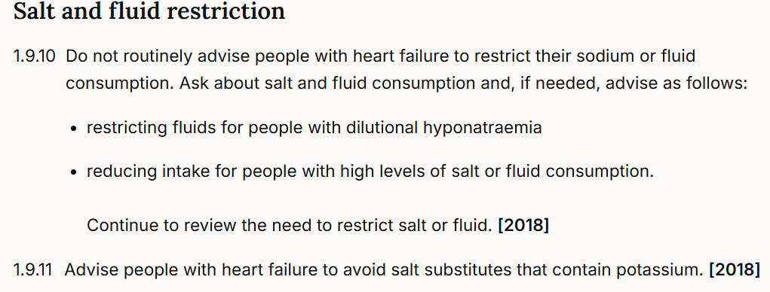
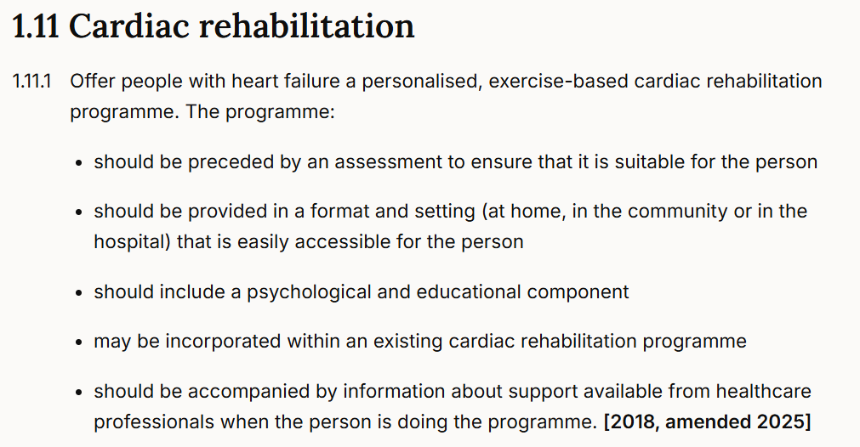
Lifestyle advice
Notes:
NG106 provides some helpful lifestyle advice around smoking cessation, alcohol consumption and diet.
Fluid restriction is no longer recommended
(As a general rule of thumb recommend 2l/day)
Animation 2: ESC – big focus on patient centred care and self-management. Lots of people with the condition are quite well informed
Animation 3: strong recommendation for exercise based cardiac rehabilitation → associated with improved QoL and survival.

Slide 31


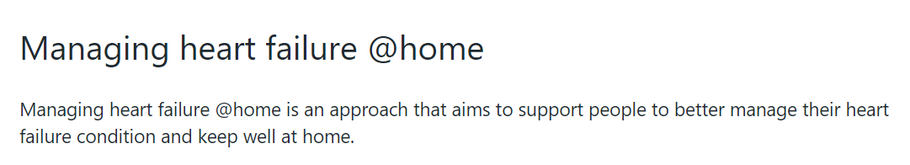
Self Management
Notes:
Great patient information can be given to patients to help them self manage from BHF and pumping marvellous.
Also utilising remote monitoring to aid self management has come into forefront with @Home initiatives. So this is something you may want to consider looking at in your PCN .

Slide 32
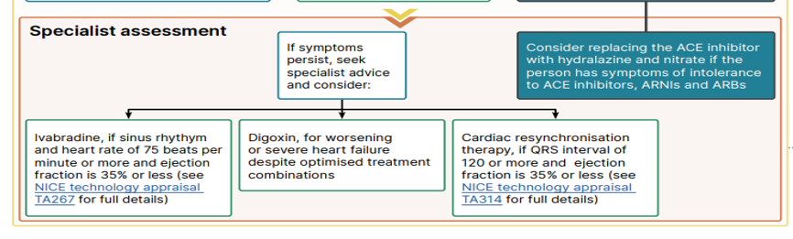
When to refer on
Acute
(usually requires urgent intervention)
Chronic
Patients who have had HF for sometime¹
Symptoms develop and persist over time (long-term condition)
Sudden/new onset in person without known cardiac dysfunction (severe symptoms and signs in ≤24 h)^{2,3}
Sudden worsening of chronic HF (known as acute decompensated HF; ADHF)^{2,3}
Notes:
Heart failure can be separated into acute and chronic heart failure
Chronic heart failure is a long term condition that progressively get worse over time.
Acute heart failure (AHF) refers to:
rapid or gradual onset of symptoms and/or signs of HF,
severe enough for the patient to seek urgent medical attention,
leading to an unplanned hospital admission or an emergency department visit.
Patients with AHF require urgent evaluation with subsequent initiation or intensification of treatment, including i.v. therapies or procedures.
Animation 1: Seek help - if patients present with symptoms suggestive of acute heart failure – immediate referral into secondary care is advised and liaise with your HF specialist team

Slide 33
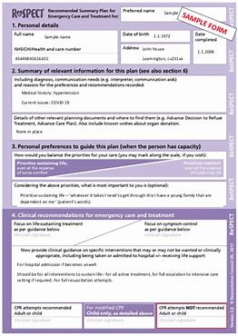
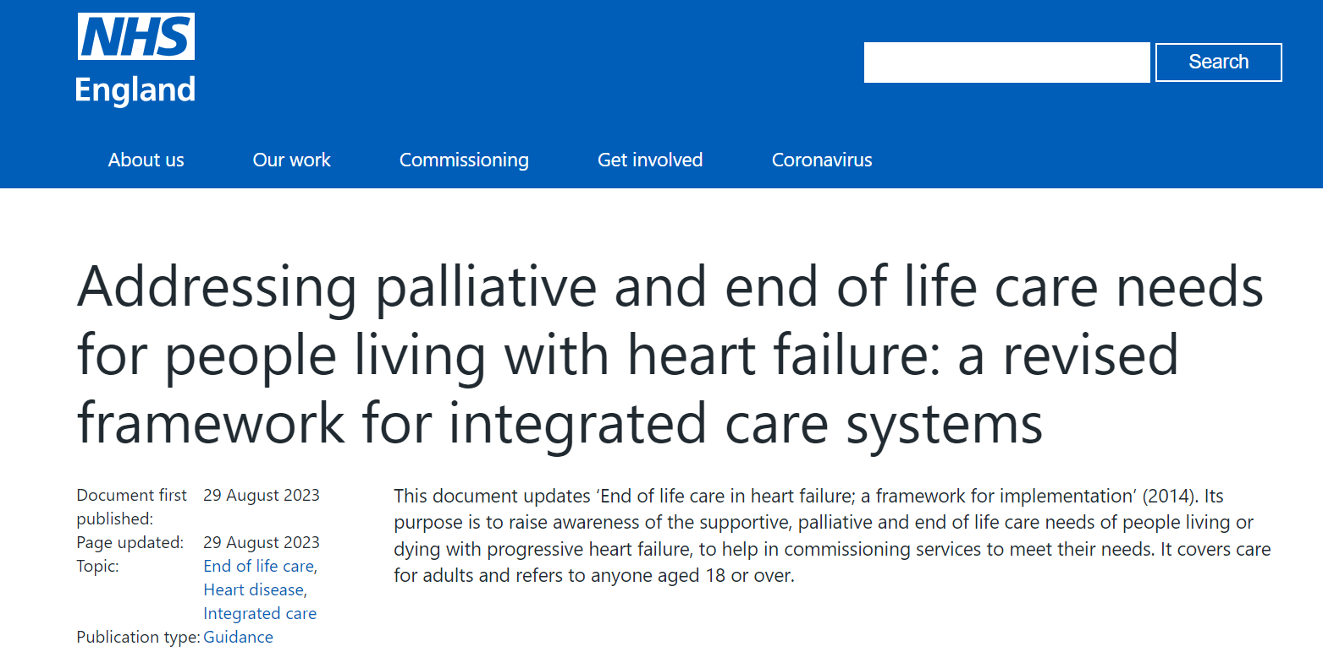

Palliative Care
“Its not all about dying”
When to consider palliative care in heart failure
On optimal medical treatment and deteriorating
Multiple admissions to hospital
HF meds being reduced although worsening symptoms
Worsening renal function
Recurrent shocks from ICD
Poor quality of life
No further medical options
Other issues to consider
Patients are frail older people
Often patients prefer to remain at home
Being in hospital for an extended period may impact on mobility, independence and confidence
High inpatient mortality
30% annual mortality post hospitalisation
Notes:
Heart failure is a chronic and a progressive condition
Palliative care in vitally important to managing end-stage pts
When managing pts with heart failure it is important to be aware of where they are in there disease progression and look for red flags that may indicate palliative care needs to be considered
Also it is important to be aware of what the patient wants, and their priorities, such as quality of life an impact on there family and there own independence
Need to consider advanced care plans.. Respect forms etc.
While the disease trajectory of each patient with HF is unique, there is a generalizable pattern of gradual decline, punctuated by episodes of acute deterioration leading either to sudden death or death due to progressive HF.
Communication about the disease trajectory and anticipatory planning should start when a patient is diagnosed with advanced HF.
A team-based approach to palliative and end-of-life care for patients with HF has been proposed.
Specific models of palliative care for patients with advanced HF have been also reported. They reduce hospitalizations, without a clear effect on survival, and have some effects on QOL and symptom burden.
Symptom assessment should be performed on a regular basis. In addition to clinical assessment, symptoms can be assessed using the Numeric Rating Scale, the Edmonton Symptom Assessment Scale (ESAS) or ESAS-HF, or the Integrated Palliative care Outcome Scale.

Slide 34

Thank you for listening – any questions?
For further information contact; Pip Richards
Philippa.Richards@healthinnovationwm.org

