Slide 1
Why we need a CVD prevention focus in Coventry and Warwickshire
Uju Okereke
Consultant in Public Health
26/11/2025

Slide 2
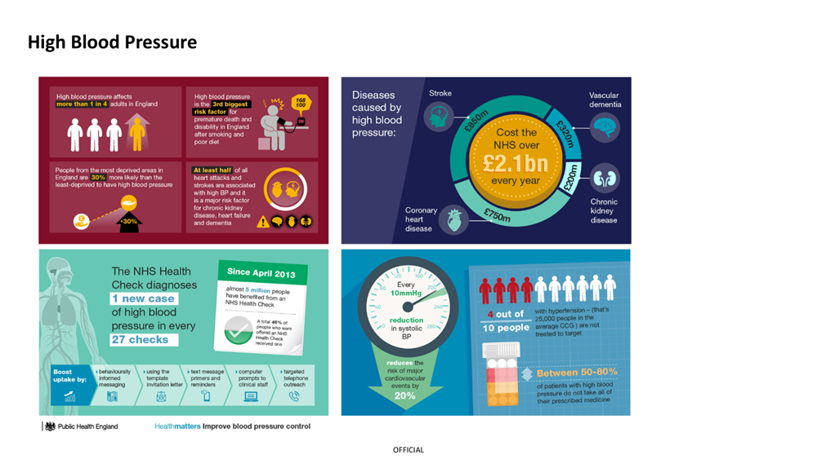
Why is CVD prevention important?
The latest Global Burden of Disease study shows that the second top cause of early death for the people of England after neoplasms is CVD (heart disease and stroke).
According to the BHF, the UK’s heart health has declined more quickly at the start of the 2020s than in any other decade for over 50 years
Rise in the rate and number of deaths in working-age adults (20-64) from cardiovascular disease in the UK. Rising to 55 deaths per 100,000 in 2023 from 49 per 100,000 in 2019 – the first sustained increase in at least a generation.
The rate at which people are dying before the age of 75 from heart disease is rising more than twice as quickly in the poorest parts of England. It is even higher in black Asian or minority ethnic groups.
Those with severe mental illness (SMI) have a 53% higher risk of CVD and 85% higher risk of death.
Sources*
https://www.thelancet.com/journals/lancet/article/PIIS0140-6736(18)32207-4/fulltext
https://www.bhf.org.uk/what-we-do/news-from-the-bhf/news-archive/2025/may/worst-start-to-decade-heart-disease-50-years-bhf-strategy-launch#:~:text=New%20analysis%20shows%20there%20has,in%20at%20least%20a%20generation.
https://www.bhf.org.uk/what-we-do/news-from-the-bhf/news-archive/2024/may/growing-gap-early-heart-disease-rates-between-rich-poor#:~:text=Since%202019%2C%20in%20the%20most,smaller%20cities%20such%20as%20Wokingham.
Notes:
Scientific studies have shown that a 10mmHg reduction in blood pressure resulted in:
17% reduction for coronary heart disease
27% reduction for stroke
28% reduction for heart failure
13% reduction in all-cause mortality

Slide 3
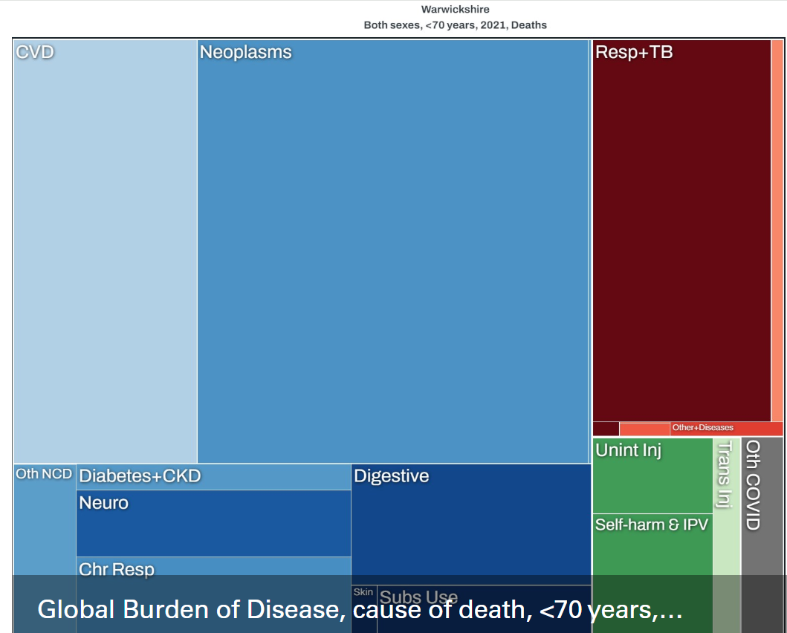
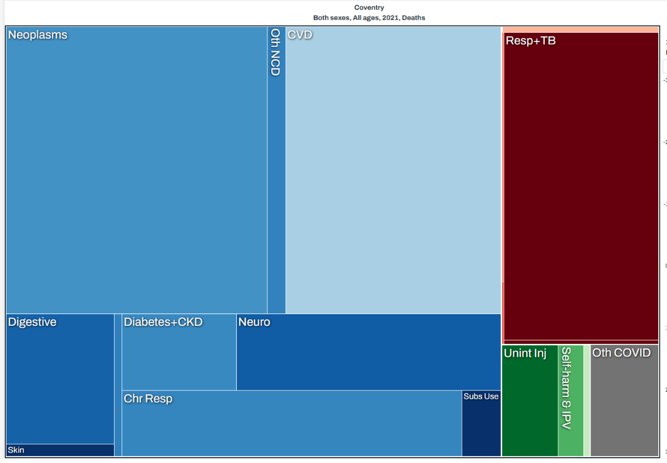
Why is CVD prevention important?
Top causes of death in Warwickshire
Top causes of death in Coventry
Notes:
In terms of premature mortality, the biggest killers in Warwickshire of those aged <70 are neoplasms (where they are malignant this is cancer) at 36% of total deaths and CVD which accounts for 17% of deaths – together accounting for half of all deaths. (Source: What stops people living longer in Warwickshire? https://www.warwickshire.gov.uk/directory-record/8051/what-stops-people-living-longer-in-warwickshire.)
There is a similar picture in Coventry. neoplasms make up the biggest proportion of deaths (26.8%), followed by CVD (22.1%)

Slide 4
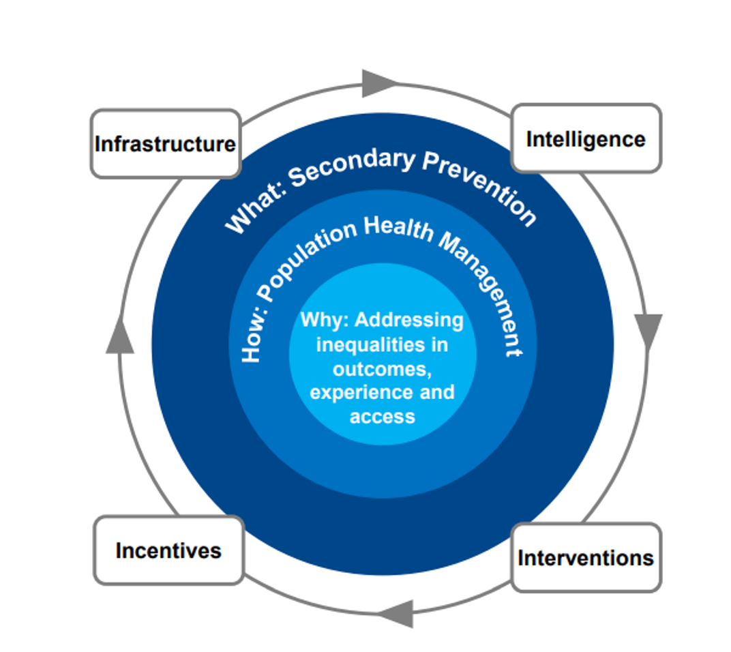
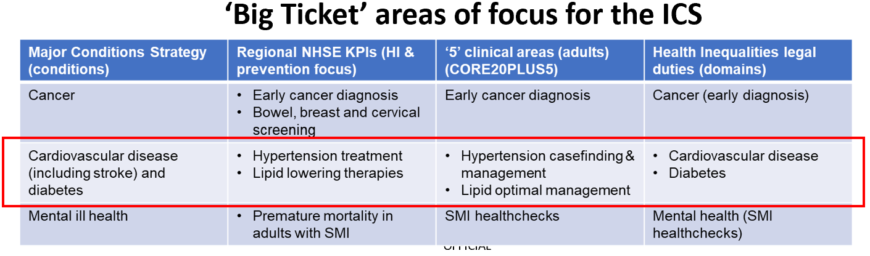
Strategic alignment to national and ICS priorities around Health inequalities and prevention
Notes:
The NHS 10 year plan lists Cardiovascular disease and Dementia amongst its top priorities for adult.

Slide 5
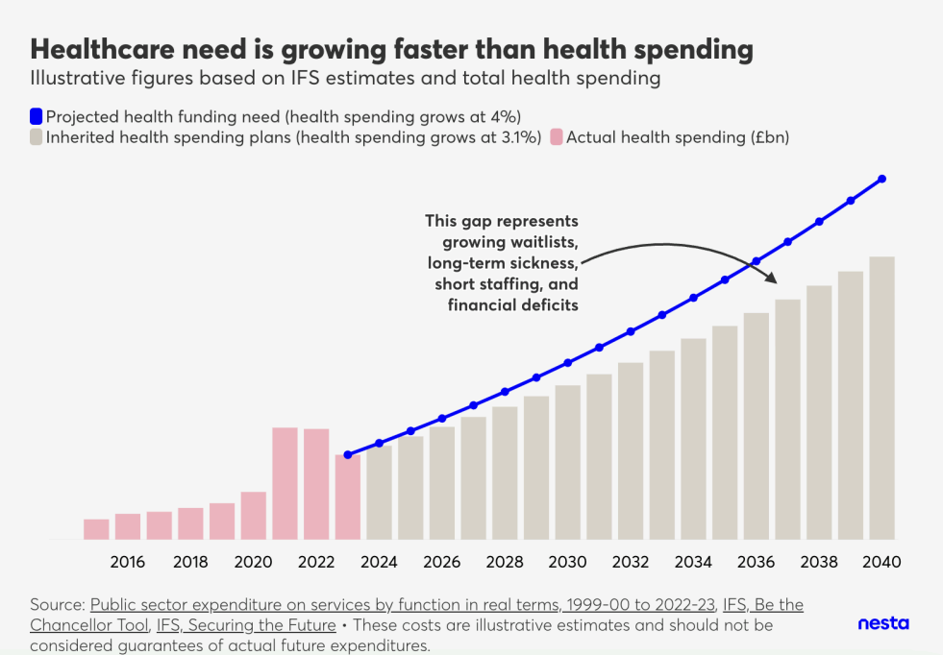
Closing the gap through increased funding alone, even if offset by productivity gains, is both inefficient and inequitable compared to preventing worsening health.
How to save the NHS: Primary Prevention, NESTA, June 2024

Slide 6
The CVD Prevention Challenge
Associated risk factors and conditions for CVD include smoking, obesity, hypertension, high cholesterol, atrial fibrillation, and diabetes.
70% of CVD is potentially preventable by addressing these factors.
Secondary prevention – using medication to treat high risk conditions like blood pressure and high cholesterol – is very effective at preventing cardiovascular disease.
Under use of NICE recommended, high impact treatments that prevent CVD is substantial and longstanding – with little change over many years.

Slide 7
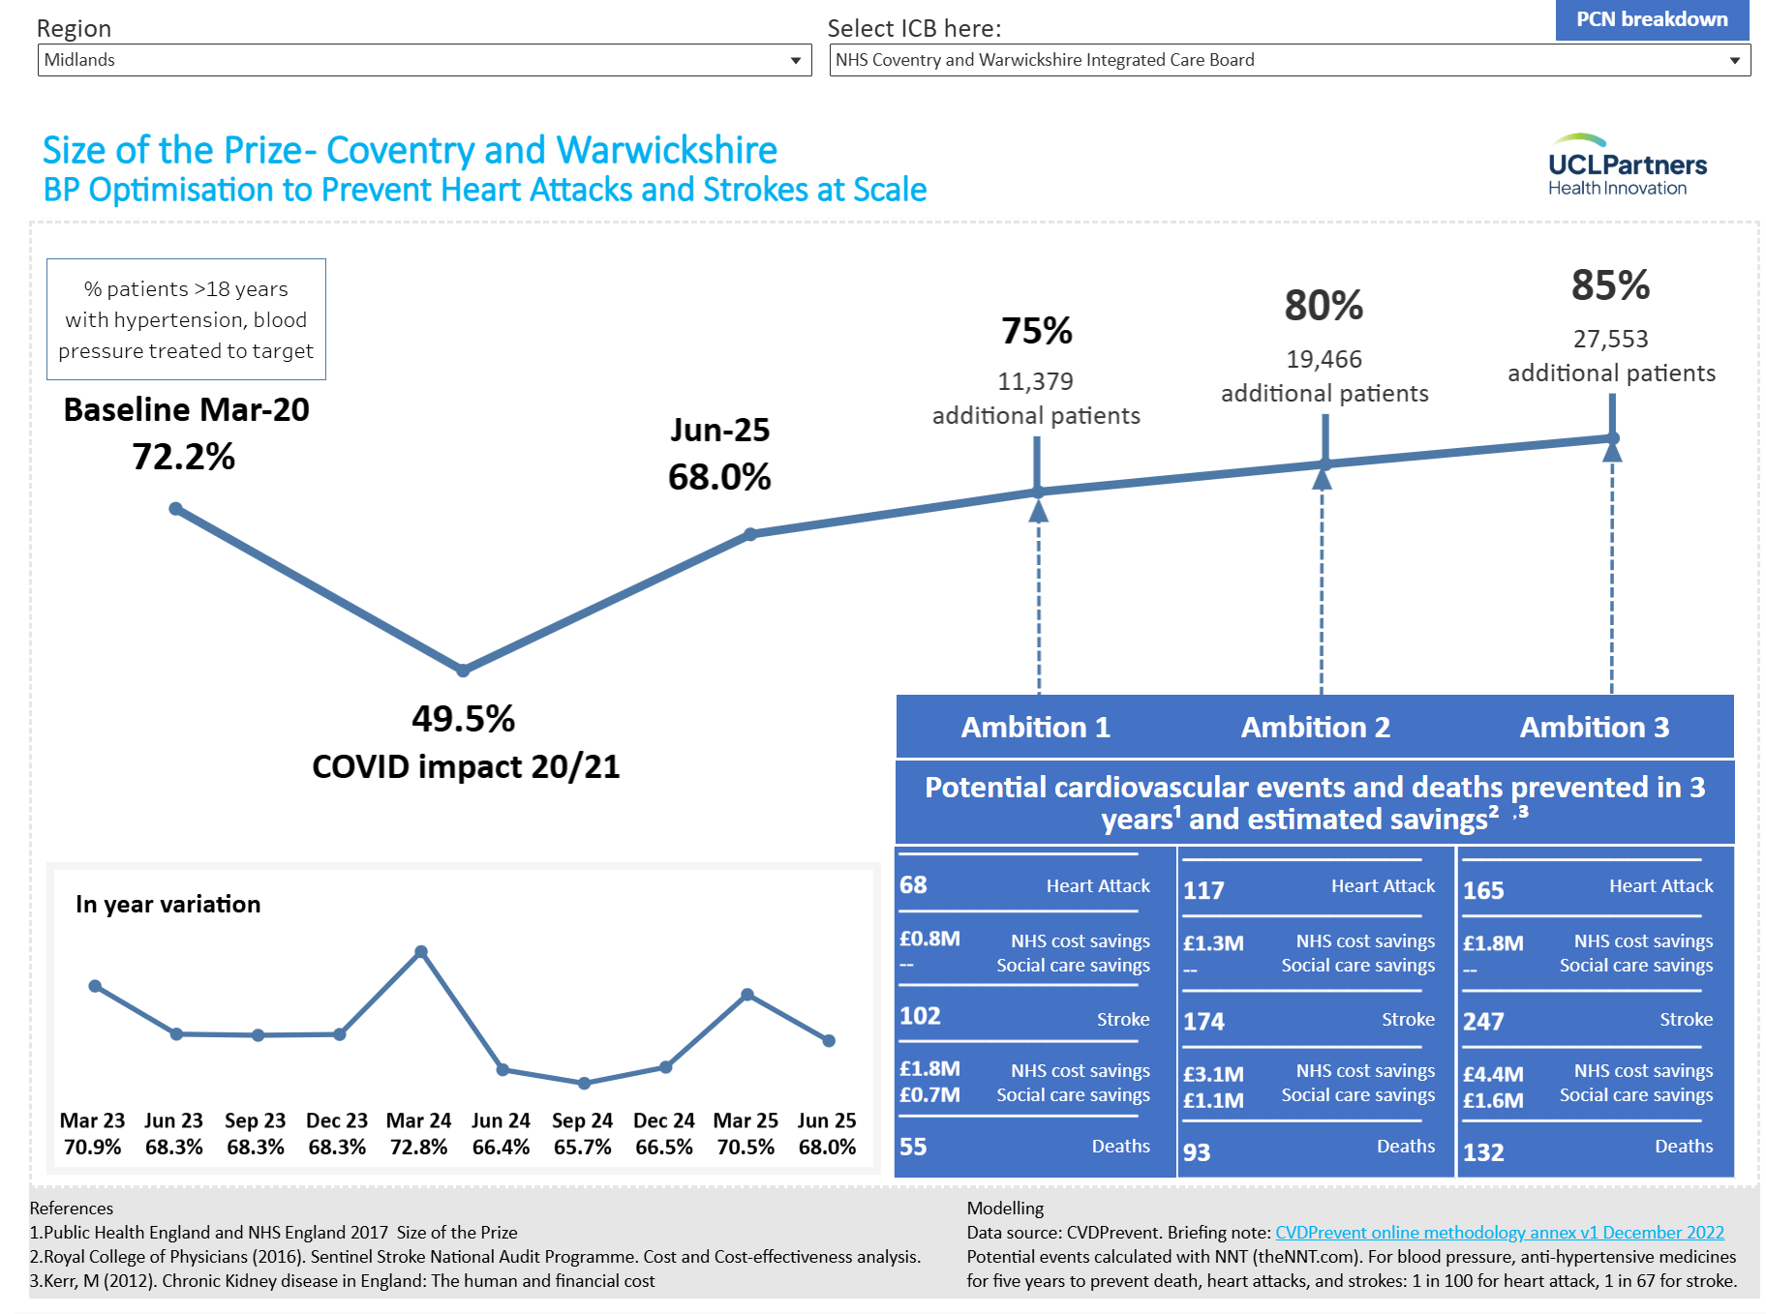
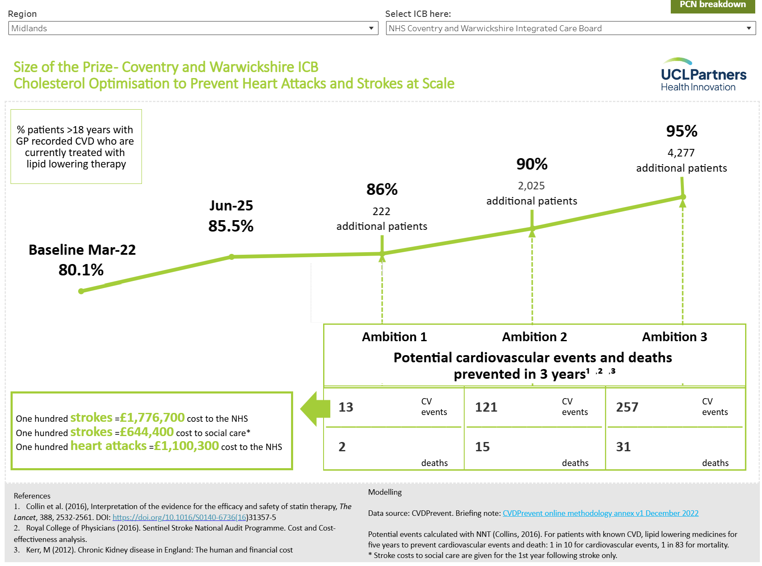
Size of the prize data for NHS CWICB
Notes:
£5.5M in 3 years

Slide 8
Size of the prize data for NHS CWICB
One third of people with diagnosed high blood pressure are not treated to target
Progress is limited: after four years, optimal treatment rates have still not returned to pre-pandemic levels.
In-year variation: every year there is a temporary peak in March that coincides with measurement day for the Quality and Outcomes Framework. This is followed by a sharp fall to previous levels that does not recover until the following March.
Geographical variation: there is substantial variation in optimisation rates between practices with achievement across England varying from under 40% to over 90%.
Opportunity: Size of the Prize sets reasonable levels of ambition that go beyond the historical status quo of suboptimal treatment.
Across England if just 80% of people with diagnosed high blood pressure were on optimal treatment, many thousands of heart attacks and strokes would be prevented in just 3 years, saving millions of pounds in health and care costs and in the wider economy.
For people with established CVD, cholesterol lowering treatment (such as statins) is essential to reduce the risk of further heart attack or stroke.
Around one in six people with CVD are not taking this life saving medication.
This work models how many heart attacks, strokes and deaths would be prevented and how much NHS and social care spend would be saved if treatment rates were increased to reasonable ambition levels.
Across England, if just 90% of people with CVD were treated with statins, thousands more heart attacks and strokes would be prevented in three years. This translates into hundreds of prevented cardiovascular events in every ICB area.
Large numbers of people are not taking the recommended dose or intensity statins. Optimising treatment in these patients will prevent many more heart attacks and strokes.

Slide 9
The CVDACTION Health Economic Impact Model
4 high risk conditions: high blood pressure, high cholesterol, chronic kidney
disease and diabetes
4 high impact treatments that are NICE recommended but substantially underused (Blood pressure lowering, cholesterol lowering, renin angiotensin inhibitors, SGLT2 inhibitors)
4 major outcomes: heart attack, stroke, heart failure, end stage kidney disease
3 scenarios:
1. Step Change as the minimum realistic near-term improvement level. For
example, step change for blood pressure = 80% patients treated to target.
2. Advanced (representing substantial improvement on the way to Full Uptake)
3. Full Uptake (not fully achievable in practice as medicines will not be
appropriate for every patient)

Slide 10
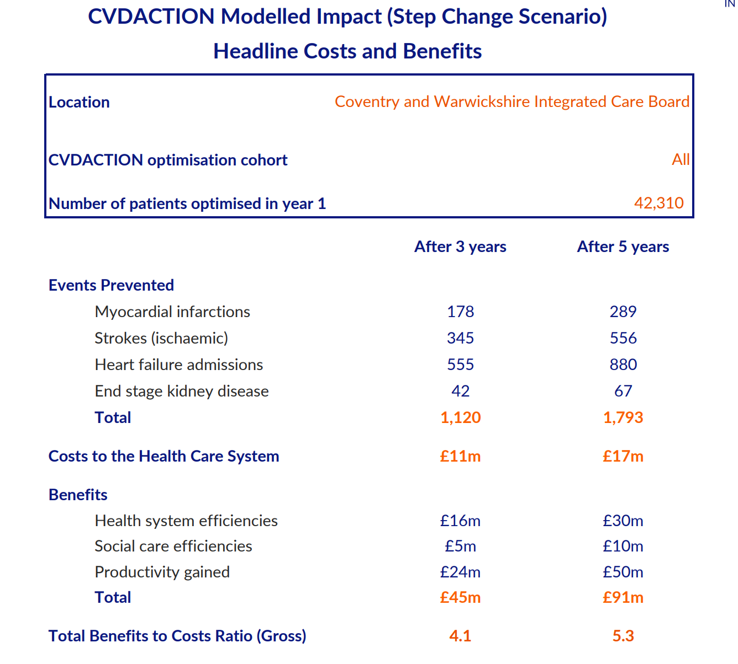
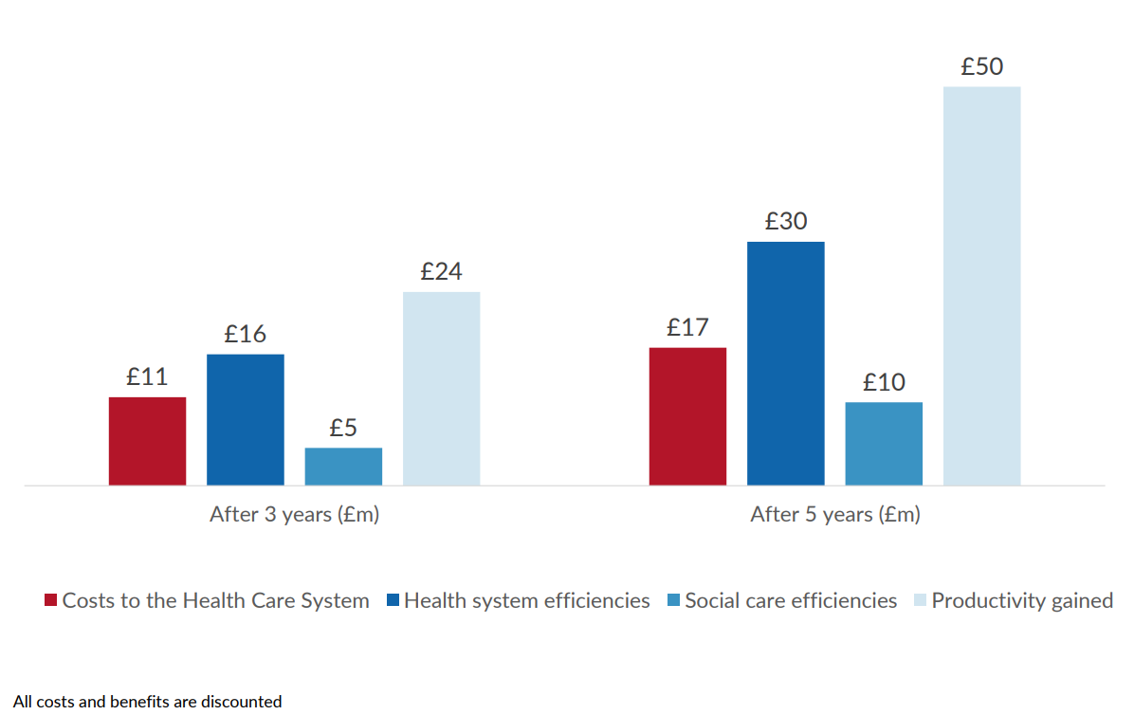

Slide 11
Proposed actions in primary care and community settings
Detection of and optimising the management of hypertension and hypercholesterolaemia by:
Identification of High-Risk Patients not already covered by the GMS contract or QOF:
Opportunistic case finding in GP practices and in the community including community Pharmacy
Treatment optimisation
Community engagement and VCFSE sector involvement
Digital tools for consistent data use and evaluation
Prioritising areas of high deprivation and population need
Notes:
Caveat: case finding activity, will increase the prevalence of hypertension and cases of hypercholesterolaemia from our baseline. This is important to remember and consider when assessing achievement of project targets.

Slide 12
Impact of a prevention approach on Individuals and the System
For Individuals:
Proactive care: Helps identify at-risk individuals early through a PHM approach, enabling targeted interventions before illness develops or worsens.
Personalised support: Emphasizes personalised care approaches, enabling individuals to co-design care based on what matters to them.
Empowerment: Promotes initiatives like Making Every Contact Count (MECC), allowing frontline workers to empower individuals during routine interactions.
Better outcomes: Aims to reduce premature mortality and morbidity by addressing modifiable risk factors (e.g. smoking, diet, inactivity, hypertension, high cholesterol).
For the System:
Reduces demand on urgent and secondary care by shifting resources to preventative activity and early intervention.
Improves resource allocation through PHM data insights.
Embeds collaborative working across NHS, local government, and community organisations.
Supports sustainable transformation by aligning preventive care with strategic planning.

Slide 13
THANK YOU

Slide 14
QUESTIONS

