Slide 1
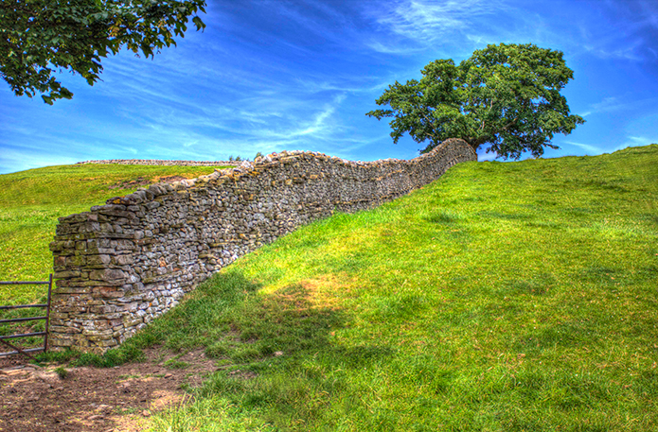
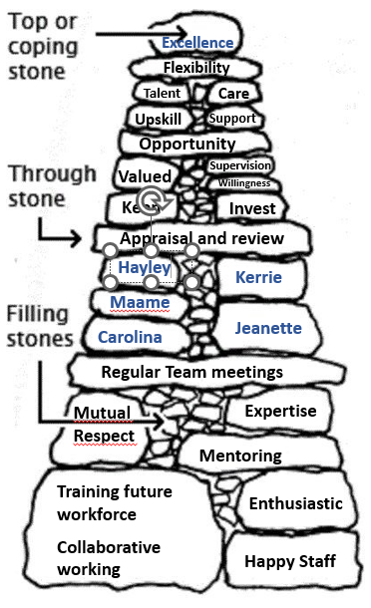



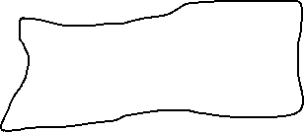
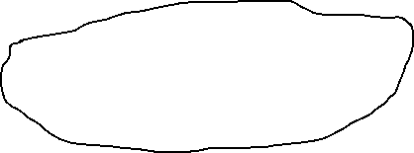




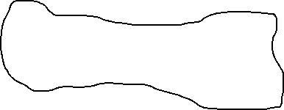
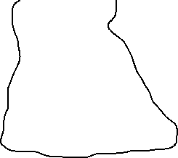

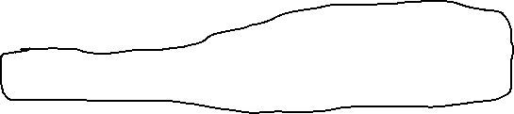
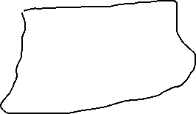

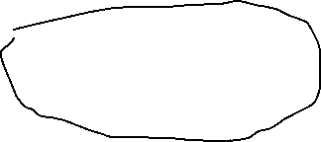

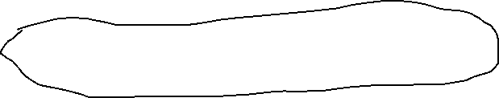
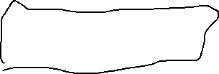
Building on further transformation and development of a GP practice nursing team at Forrest Medical Centre
Dry stone walls are very strong. The way the stones are placed on the wall helps hold the structure in position.
In 2024, we presented how we started the process and in 2025 we show the stones we are continuing to build our wall with.
Our ground is prepared, our foundations are laid, we have chosen and placed our stones carefully so far, we are keeping our wall stable with ‘through stone’ of regular nurse meetings and using out practice vision and values as ‘a line’ to continue build the wall and taking ongoing care of the wall.
Jeanette planned quarterly visits to home for people with LD for annual health checks
in response to
DNA rates
Carolina practice lead for all
ring pessary fits and changes
Kerrie GPN and Jeanette HCA supporting PCN community event giving lifestyle advice, and opportunistic BP checking
Audit of patients from DV houses - primary care usage, clinical presentations, prescribing + fit note patterns
Nurses developed SOP for new vaginal wall prolapses noted at cervical screening : advice for prolapse and proactive offer of ring pessary assessment.
Maame completed nurse prescriber training and implemented medication reviews of diabetic management and asthma and COPD prescribing
Maame requesting and path result processing of diabetic patients monitoring (course to support)
Maame in process of
completing final year of nurse
practitioner qualification
Kerrie
supporting
cancer bus tour raising awareness
of early cancer symptoms and
cancer screening as HI PCN work
In collaboration with CWICB
comms team, Maame presented on patient information videos for patients with asthma about MART + AIR regimes to reduce
SABA prescribing
Kerrie as prescribing ANP doing weekly session of MH medication reviews
Kerrie as ANP requesting and path result processing for weekly ward round at residential care home (course to support)
Maame as acute working ANP managing own radiology results from weekly assessment
supported session
Carolina handed over shingles
clinic to HCA Jeanette
Group consultations for patients with asthma inhaler changes to MART /AIR regimes to reduce SABA prescribing
Carolina trained and handed
over LD annual health checks to HCA Jeanette
Kerrie re audited of care home
weekly ward round care and outcomes
Carolina training
GP Assistant team in ECGs, urine dipstick,
releasing Practice Nurse team time
The Transformation of the Nursing Team for our practice, is ongoing and aims to provide excellent care. We are still building our wall!
Planned next stones: Carolina to do contraception course (with monies) and become first contact at practice; Maame ANP completion course…

