Slide 1

Helping people with a learning disability, who have behaviour that challenges, to avoid harm from psychotropic medicines
Caroline Maries-Tillott, Jordan Leith

Slide 2
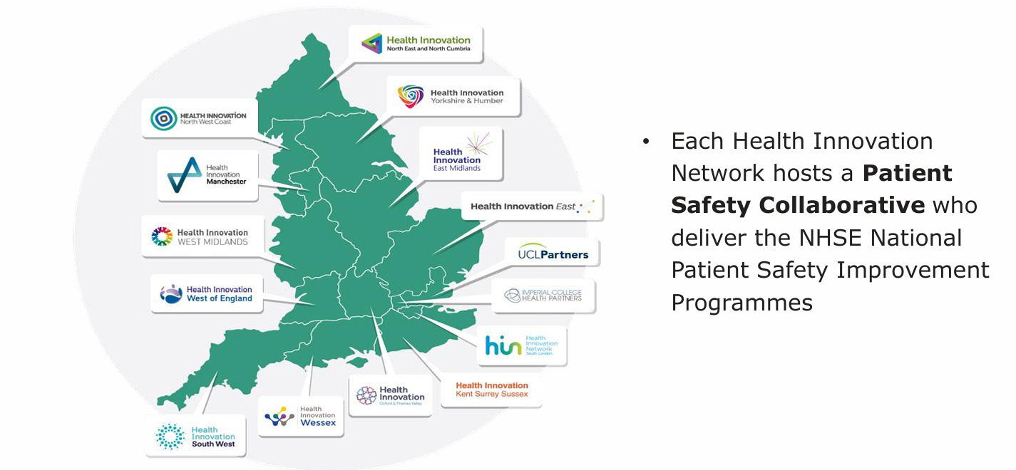
The Health Innovation Network,
Patient Safety Collaboratives…
… A national network of local organisations
Notes:
C

Slide 3

Medicines Safety Improvement Programme
(MedSIP)
Portfolio of projects co-ordinated by NHSE, part of the National Patient Safety Strategy
Address the most important causes of severe harm associated with medicines
The programme affects safety culture, safety systems and the high-risk medicines in common use
It brings the science of continuous safety improvement to bear on these complex problems
Notes:
C

Slide 4
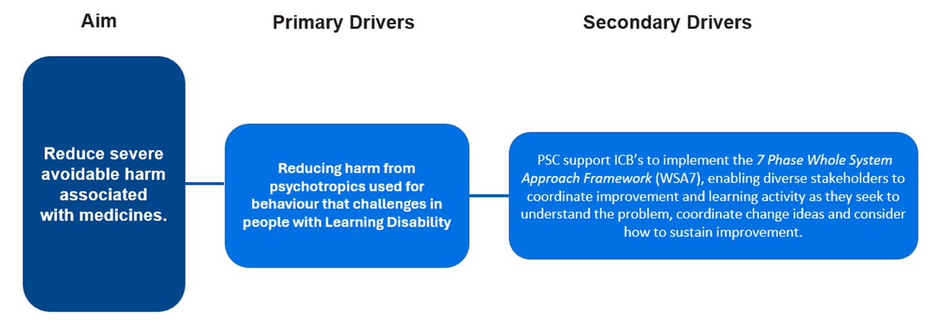
NB: This may now be at neighbourhood level, or ICB level, so the final driver diagram may be slightly different.
Notes:
C

Slide 5
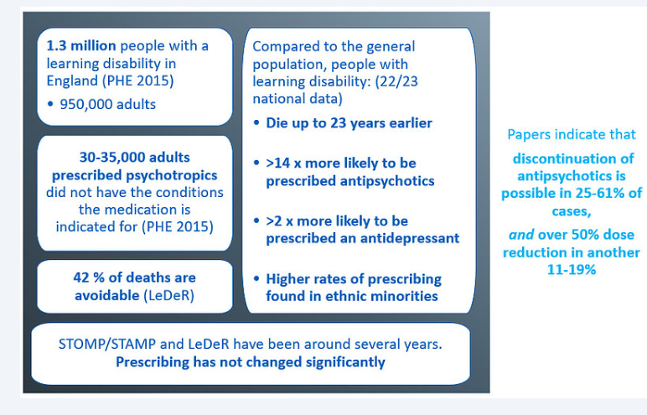
Why focus on this?
Psychotropic medications often have side-effects and can affect a person’s quality of life
They should only be used if there is a clear clinical indication.
Where possible psychotropic medicines should be avoided for behaviour that challenges.
But when needed, prescribing should be at the lowest dose, be reviewed regularly, and stopped as soon as possible.
  NICE 2015
Notes:
C

Slide 6
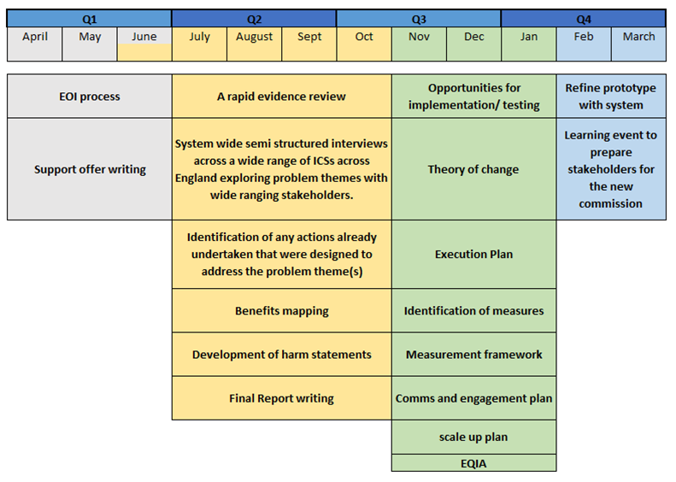
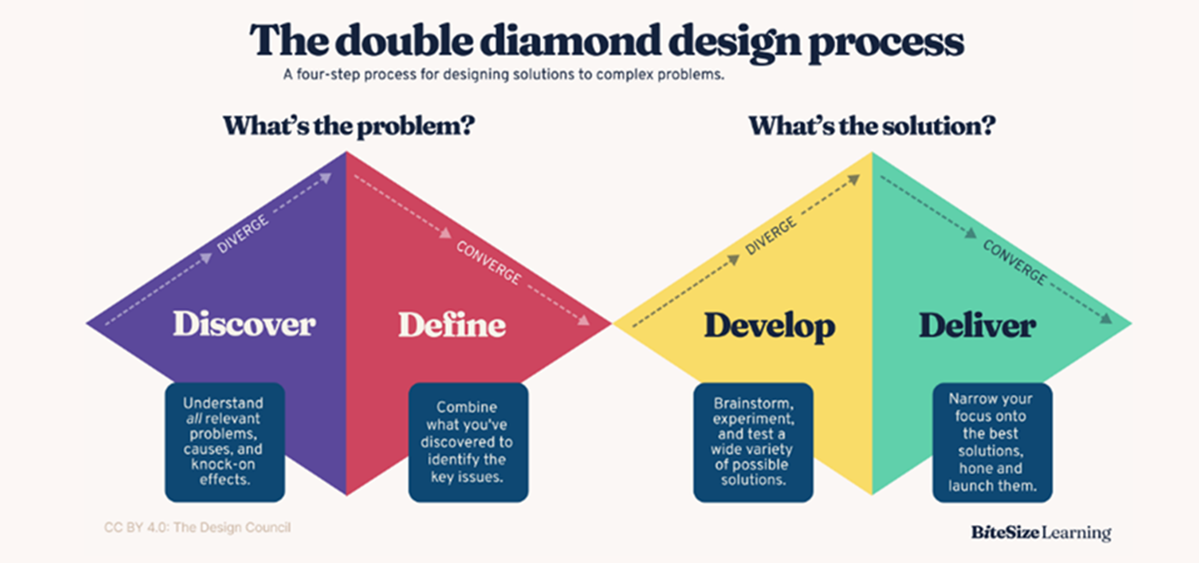
How was the programme developed?
Clarify scope of pipeline
Create and agree delivery plan + governance framework
Notes:
J

Slide 7
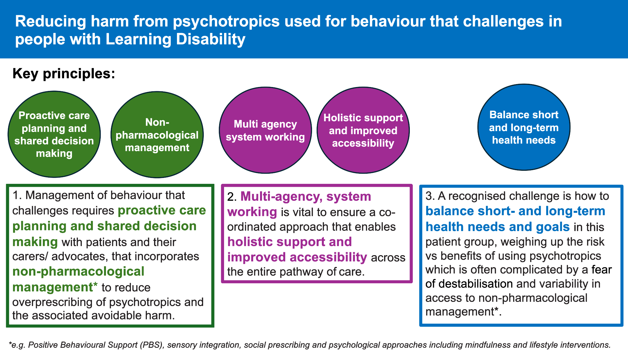
Notes:
J

Slide 8
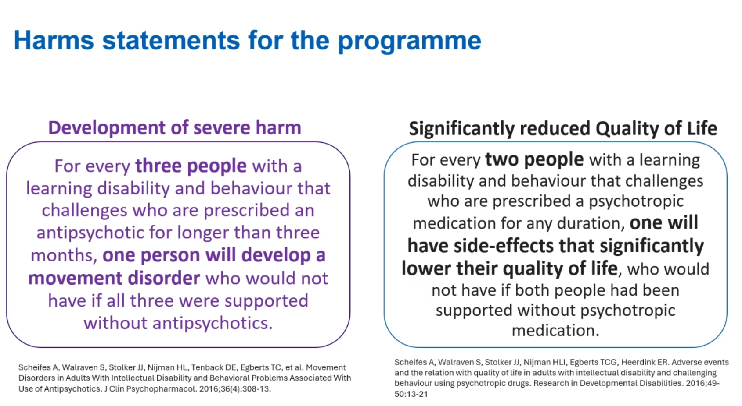
Very under- researched Small studies Articles did not include Autism alone

Slide 9
What are the national outcome measures?
Long-term Antipsychotic Prescribing Metric
2. Total Antipsychotic Prescribing Metric*
Essentially the combined total milligrams of all antipsychotic medication prescribed to people with learning disability for behaviour that challenges
Converted to a common single agent to allow estimation of
Total antipsychotic burden across the whole target population
Essentially the
Number of people
With a learning disability, prescribed antipsychotics, for behaviour that challenge
*Oral Risperidone Equivalence (ORE) is an experimental measure and should be used with caution. It is used here as an indicator of antipsychotic burden in a population ONLY. ORE should NOT be used at an individual patient level.
For full search specification see appendix 2 within: MedSIP data collection supporting information v7 - FutureNHS
Notes:
J

Slide 10
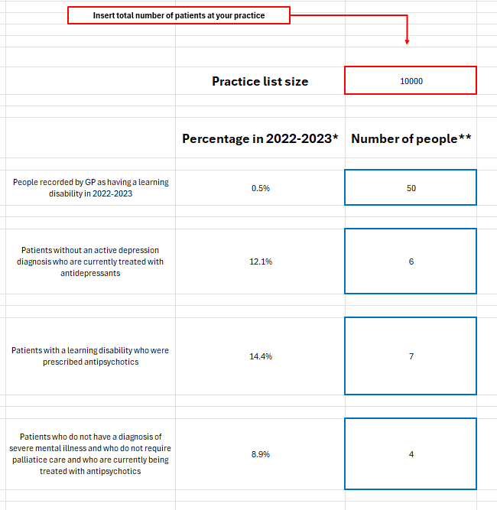
What does this mean for my practice?
Depends on practice size
Can use Patient Calculator Estimator
For an average practice (10,000 patient list)
  50 People with learning disability
  4 people prescribed antipsychotic which isn’t indicated
  6 People prescribed antidepressant which isn’t indicated
Does this feel manageable?
Notes:
J - 50 People out of 10,000 who need extra support, who are the recipient of health inequalities, who die on average 20 years younger than the rest of the population, 10 of whom are at risk of severe harm, right now that need our help.
Can HIWM help you, via this programme, to find them and do something about it?

Slide 11
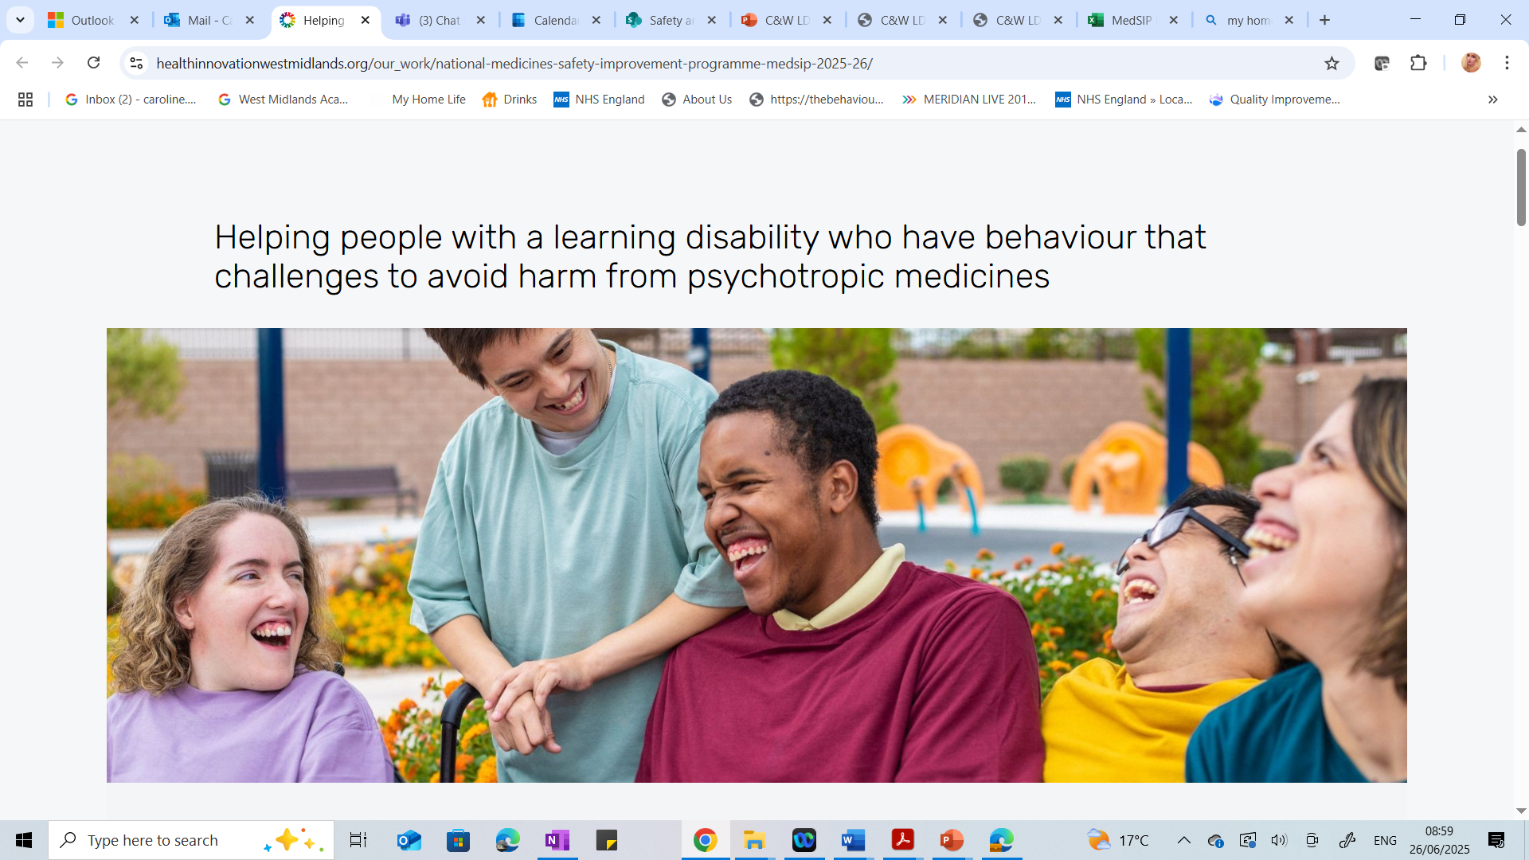
At risk of severe harm
and/or severe reduced quality of life
By taking medicines they are no longer benefiting from
…at least 4 people in every practice
Do we know who they are?
Can we find time to help these individuals?
What support would you need?
How can this programme, help you, to help them?
How do we avoid the cycle happening again for others?
Take a moment to reflect:
Notes:
J

Slide 12
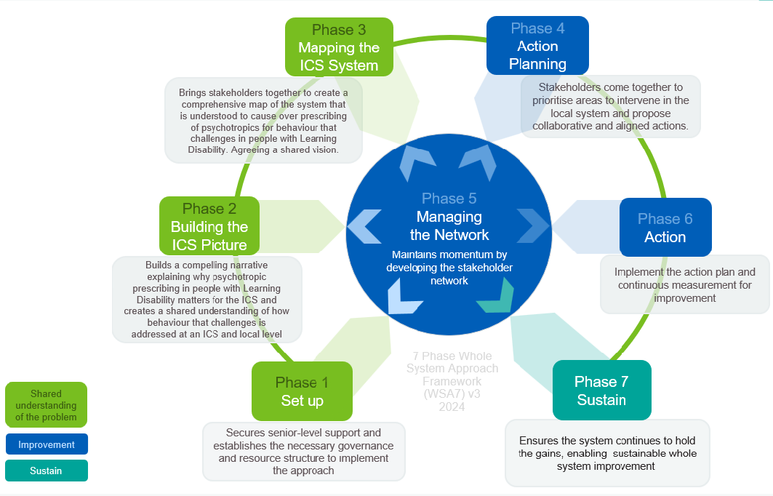
Whole system approach to change
Can you help us building the ICS picture and map C&W system?
Notes:
C

Slide 13
Group Activity #1 Discussion
What motivated you to attend the workshop today?
What drives your interest in STOMP?
Do you know of any good practice / case studies / activity / specific GPs with an interest in STOMP or reducing harm from Psychotropics?
How might we engage other groups to create a passion for improving the lives of people with a learning disability with behaviour that challenges?
Have you any experience of supporting people with learning disability with behaviour that challenges?
Notes:
C

Slide 14
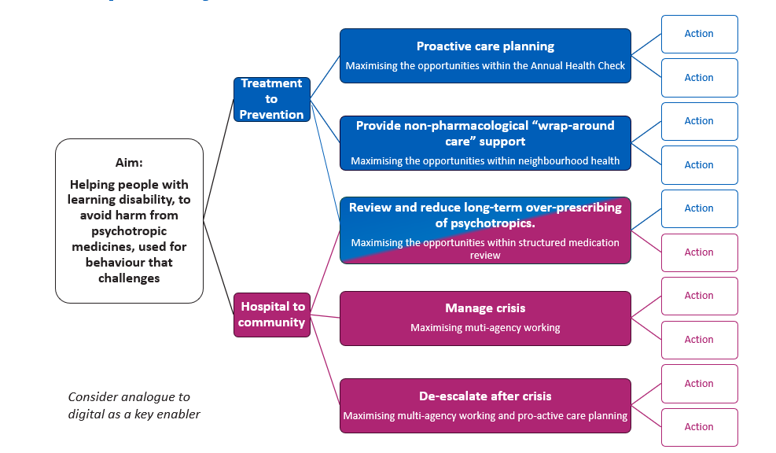
Driver Diagram with five areas of possible improvement in the pathway of care
Notes:
C

Slide 15
Group Activity #2
1.
Using the post it notes provided
Please indicate any assets, including community assets
That you are aware of in C&W ICS which could be classed as services that link to these five pillars
2.
3.
4.
5.
Notes:
C

Slide 16
Group Activity #3
How do we make it everyone's business? How do we build a burning platform?
What one action will you take back to practice following today's session?
If you could change one thing moving forward - What would it be?
Interested in being a champion?
Notes:
C

Slide 17
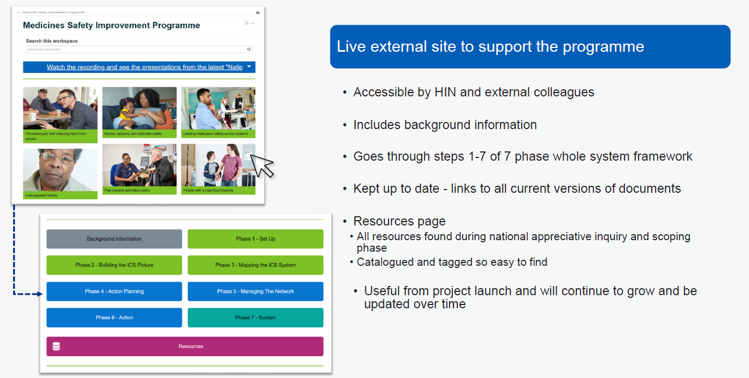
FuturesNHS MedSIP programme
Notes:
C

