Slide 1
STOMP -
A Pharmacist’s Perspective
September 2025
Tracy Ewing
Clinical Governance Pharmacist

Slide 2
Background
Winterbourne View – Time for Change (2014)
  Transforming the commissioning of services for people with learning disabilities and/or autism
  From Actions to be taken: Services will seek to reduce the use of physical intervention, seclusion, mechanical restraint and the inappropriate or harmful use of medication with the clear aim of eliminating them for each individual
1st June 2016 NHS England led a ‘call to action’
  support prescribing healthcare professionals to review inappropriate prescriptions for people under their care who have a learning disability and/or autism : STOMPLD

Slide 3
From 2016 STOMP information
Estimated on an average day in England, between 30,000 and 35,000 adults with a learning disability were prescribed an antipsychotic, an antidepressant or both without appropriate indications (psychosis or affective/anxiety disorder)
People with a learning disability are thought to be 16 times more likely and autistic people 7 times more likely to be prescribed an antipsychotic than the general population
5–15% of people with learning disabilities have behaviour that challenges

Slide 4
From 2016 STOMP information
In Primary Care in adults known to GP to have a learning disability were taking prescribed:
  17.0% antipsychotic drugs
  16.9% antidepressants
  7.1% drugs used in mania and hypomania
  4.2% anxiolytics
  2.7% hypnotic

Slide 5
Aims of STOMP
To reduce and stop inappropriate antipsychotic medication
Better care and quality of life
Patient centred care
Regular medication reviews & Annual Health Checks (14+ years old)
Involve people, families and support staff in decisions about medicine
Non-pharmacological therapies and practical ways of supporting people

Slide 6
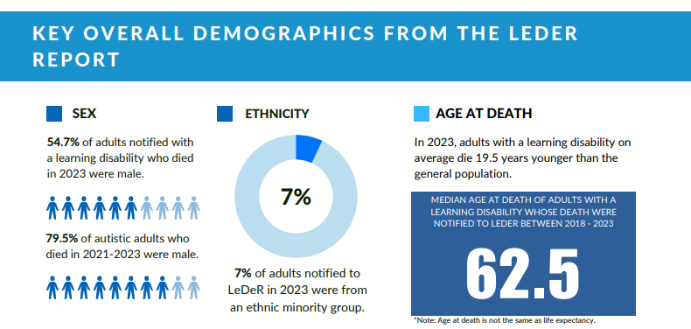
Demographics from LeDeR Report 2023 (Published Sept25)
(LeDeR – Learning from lives and deaths – people with a learning disability and autistic people)

Slide 7
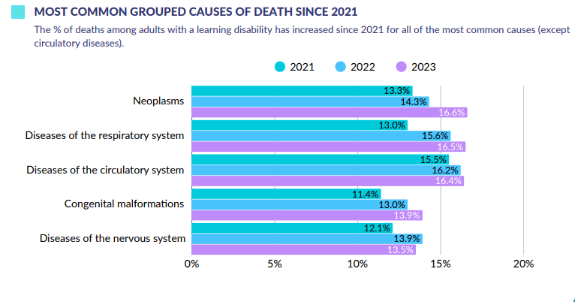
Demographics from LeDeR Report 2023 (Published Sept25)

Slide 8
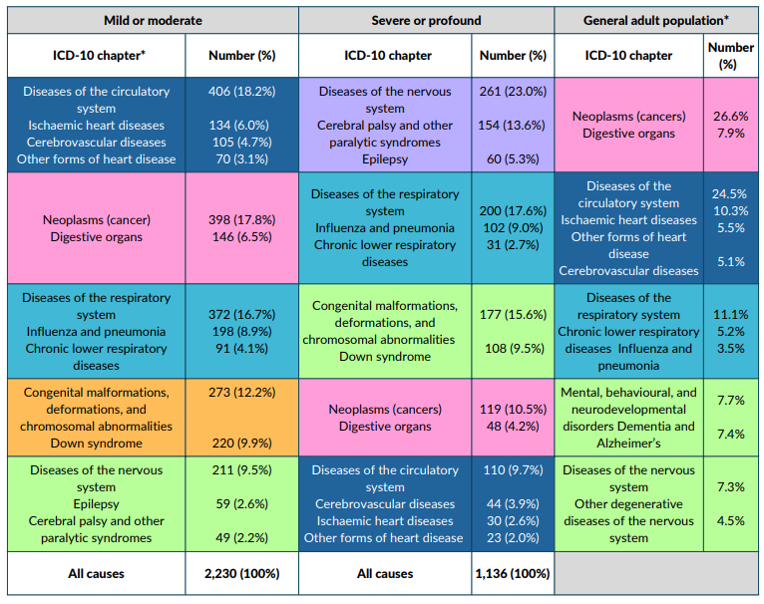
Demographics from LeDeR Report 2023 (Published Sept25)
Most common ICD-10 chapter causes of death by the level of learning disability for adults who died from January 2021 to December 2023 and for whom a LeDeR review was completed

Slide 9
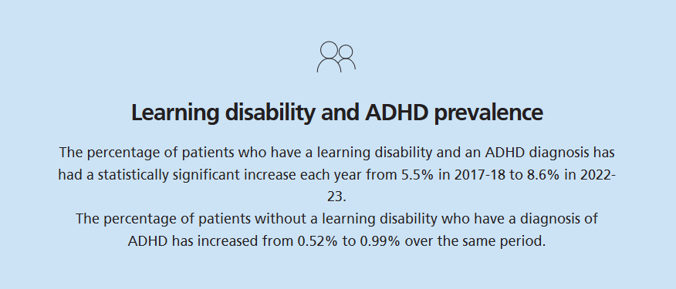
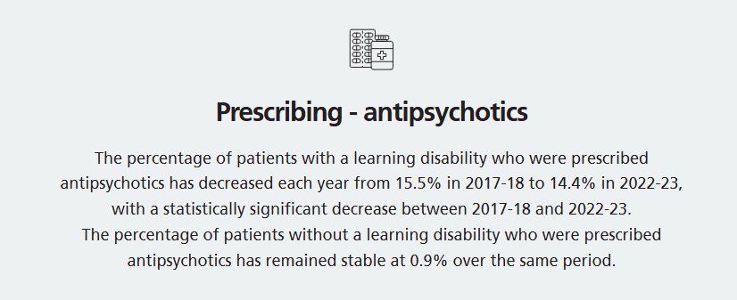
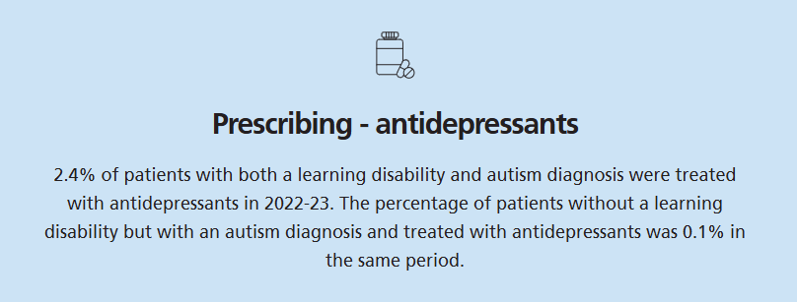
Key facts from NHS Health and Care of People with Learning Disabilities, Experimental Statistics 2022 to 2023

Slide 10
Possible complications of people with a learning disability
Physical health
  Poorer physical health
  Higher rates of epilepsy
  Higher rates of obesity
Increased risk of early death
  Lower average life expectancy
  Higher proportion of deaths attributed to avoidable causes
Mental health problems
  Higher risk of developing mental health such as depression, anxiety & bipolar disorder
Social Isolation
Communication difficulties

Slide 11
Potential adverse effects of antipsychotics/antidepressants
Extrapyramidal symptoms
Weight gain
Dyslipidaemia
Hyperprolactinaemia
Sedation
Sleep apnoea syndrome
Anticholinergic
Postural hypotension
Reduced seizure threshold
Impaired glucose tolerance
Cardiomyopathy
QT interval prolongation
Stroke risk
VTE
Neuroleptic malignant syndrome
Pneumonia
Abnormal LFTs
Photosensitivity
Skin and subcutaneous tissue disorders
Diplopia
Misuse and abuse
Restless legs syndrome
NICE Clinical Knowledge Summaries (CSK) Psychosis and Schizophrenia

Slide 12
Incidence of adverse effects for antipsychotics
Drug | Sedation | Weight Gain | Hypotension | Prolactin elevation | Proloned QT Interval
Aripiprazole | - | + | - | - | -
Chlorpromazine | +++ | ++ | +++ | ++ | ++
Clozapine | +++ | +++ | +++ | - | +++
Flupentixol | + | ++ | + | +++ | -
Haloperidol | + | + | + | +++ | ++
Lurasidone | + | + | - | - | -
Olanzapine | +++ | +++ | + | + | +
Quetiapine | +++ | ++ | ++ | - | ++
Risperidone | + | ++ | ++ | +++ | +
Zuclopenthixol | ++ | ++ | + | +++ | +
Adapted from table 1.7
The Maudsley Prescribing Guidelines in Psychiatry 15th Edition

Slide 13
Weight Gain
Possible causes of weight gain:
  Sedation, resulting in decreased activity
  Increased thirst (due to dry mouth)
  Reduced metabolism
  Neurotransmitter –mediated increase in appetite
  Changes in leptin levels
  Fluid retention
  Endocrine effects e.g. increased prolactin
Most weight gain occurs in the first 16 weeks of therapy, but gradual increase can continue (Varies between individuals)
Antidepressants:
  Tricyclics: thought to be drug-induced carbohydrate craving and a decreased metabolic rate
  Mirtazapine: Patients often report a voracious appetite, with intense cravings for carbohydrates.

Slide 14
What have we done?
Staff training
Patient/carer resources
Audit
Positive behavioural support
Very easy read leaflets
“No medication” leaflet
STOMP audits developed
New ways of working
Pilot clinics e.g.
Behaviour
Medication reduction
MDT presence
Alternatives to medication
Inpatient
Community

Slide 15
How can pharmacists be involved with STOMP
Medication Reviews
  Is the patient taking medications not required?
  Have they been taking a medication too long?
  Is the dose correct?
  Is it prescribed for the correct indication?
Annual Health Checks
  Contribute
Physical Health Monitoring
  Is physical health monitoring being completed as indicated by SPC/NICE?

Slide 16
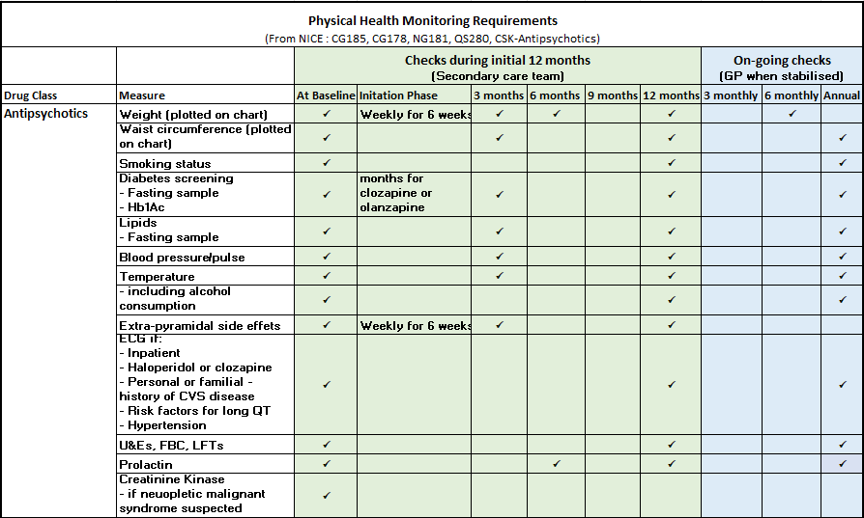
Physical Health Checks

Slide 17
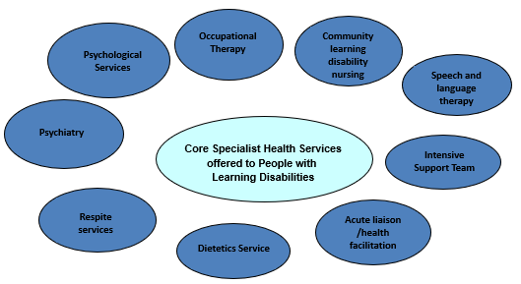
Specialist Services

Slide 18
Learning Disability Support
The Community Learning Disability Team (CLDT) have set up an email address that can be used by practice based staff seeking advice related to working with a patient who has a learning disability.
It is for primary care colleagues to use to seek guidance, signposting etc if they have queries but don’t feel that a formal referral is required.
The inbox is monitored by the Community LD Nurses on a regular basis CLDTGPadvice@covwarkpt.nhs.uk
Queries may include:
  Reasonable adjustments
  Mental capacity / best interest decisions
  STOMP/psychotropic medication

Slide 19
Referrals
Learning Disability Referral Team:
Address: The Loft, Manor Court Drive Nuneaton CV11 5HX
Telephone: 0300 131 2320
Email: LDreferrals@covwarkpt.nhs.uk
Referral Form

Slide 20
Team Information
Coventry and Rugby CLDT: Tel 02476 324380 Team manager: Mark French mark.french@covwarkpt.nhs.uk
North Warwickshire CLDT: Tel 02476 315867 Team manager: Martin Povey martin.povey@covwarkpt.nhs.uk
South Warwickshire CLDT: Tel 01926 317746 Team manager: Amy Crofts amy.crofts@covwarkpt.nhs.uk

Slide 21


