Slide 1


Consulting with people living with a learning disability – taster session
Trudi Ward, regional tutor

Slide 2
Ground rules
Be fully present throughout the event
Take part to the best of your ability and fully engage in the session
Listen actively and show respect for the opinions of others
Challenge respectfully
Share your experiences
Maintain confidentiality

Slide 3
Outline of the session
Welcome, aim and learning outcomes
Activity: Challenges and solutions
What does a good consultation look like?
CPPE resources
Action planning
Close

Slide 4
Aim
The aim of this taster session is to consider how you can successfully consult with people living with a learning disability and identify learning resources to support you to further develop your confidence and competence.

Slide 5
Learning outcomes
identify barriers and challenges when consulting with people living with a learning disability
identify strategies and resources to address challenges and barriers in consultations with people living with a learning disability
describe how to appropriately involve carers, family members and support workers in the consultation, and identify how to gain consent to do this
apply appropriate person-centred consultation skills to meet the needs of people living with a learning disability

Slide 6

Icebreaker
How many consultations with people with learning disabilities have you undertaken?
Less than 15
15 to 50
Too many to count

Slide 7
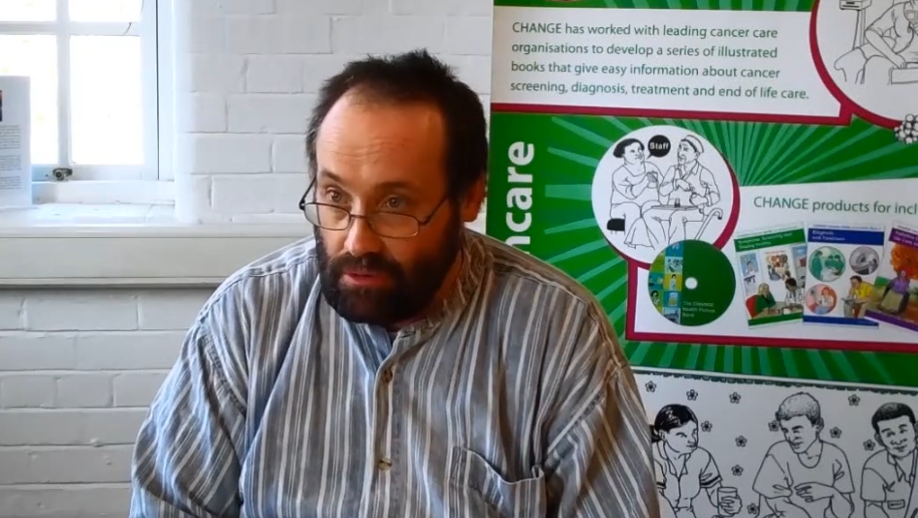
Shaun’s bad experience
Shaun's bad experience on Vimeo

Slide 8

How did that make you feel?

Slide 9
Activity – Challenges & Solutions
Part 1
What are possible challenges and barriers in consultations with people with learning disabilities?
  From the person’s and their families’ perspective
  From the pharmacy professional’s perspective
Part 2
What are potential solutions?

Slide 10
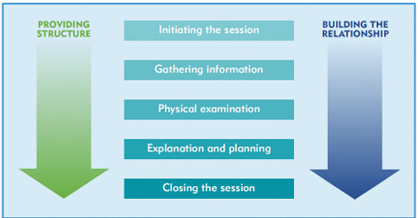
The Calgary-Cambridge Guide
Notes:
Initiating the session: no surprises
Outline the structure of the consultation at the start. Doing this means that you can summarise at points and let the person know what is coming next. People who have a learning disability may feel uncomfortable or anxious in new or busy environments. Think about how well the person will cope with waiting in the facilities that you have available. Consider making reasonable adjustments, such as giving the person the first appointment of the day. If there are unavoidable delays, keep the person informed so that they know what to expect. Some people with autism are hypersensitive to noise and others fearful of crowds. They may be anxious while waiting their turn.
For further information on supporting people with autism during consultations see: www.nhs.uk/conditions/autism/autism-and-everyday-life/advice-about-medicines-and-medical appointments/ Consider the environment that the consultation should take place in. Taking on complex information in a busy or unknown environment can be overwhelming for the person.3 Allow the person some time to settle into the new environment. Think about whether your usual practice environment is suitable, or if it is better, or possible, to visit the person in their own home or a neutral and familiar environment such as a day centre.
Building the relationship
You will need to build rapport with the person just as you would with anyone else. Focus on the person rather than the disability. Consider your own verbal communication. Tone and speed of speech is important to consider. Aim to speak more slowly and clearly using a soft yet reassuring tone. However a word of caution is not to patronise. Non-verbal communication skills are just as important. Demonstrate active listening by facing the patient as you speak. This will help people who may have hearing difficulties understand what you are saying. In the same way that your body language is important, think about that of the person with the learning disability. Signs of anxiousness and frustration may become apparent if a person is having difficulty understanding you, or is unhappy in the situation of the consultation. Be prepared to respond to that by allowing the person a pause or time to tell you how they feel. Learning disabilities Be approachable and genuine. Welcome the person with a smile and introduce yourself by your first name and role. If the person has come along with a parent, carer or support worker, then address the person first. Parents, carers and support workers can offer a wealth of information in the consultation but it is important to always bring the discussion back to the patient; they should be the focal point of the discussion. Encouraging the person to take part and engage right from the start is an important step. Some people may need ‘permission’ to join in the discussion and to ask questions as you move through the conversation.
Providing structure
A clear consultation structure will be more important to a person who has a learning disability than it is to other people. It can be helpful to set out the structure of the consultation at the start, so they know what to expect. You can refer back to the consultation structure as you progress through the session.21 It might be appropriate to use something visual, for example, a leaflet with pictures as a way to structure the consultation. You can refer to the leaflet to illustrate to the person where the consultation is going, and to support you to keep the consultation on track.
Gathering information
When you are gathering information talk directly to the person, and bring the carer into the conversation with the person’s permission when clarification is necessary.
Find out why the person has attended today and what their goals for the consultation are.
Ask the person what they want to get from your conversation today.
Explore the person’s understanding, concerns, ideas and expectations of the consultation and their medicines.
Note the language that the person is using, so that you can reflect this back in your responses to them, both in terms of words and complexity.
If they want to show you something, allow them to do so. This builds rapports and is often a way in which the person will highlight how they can communicate with you.
As the consultation progresses there may be times when you need to rephrase questions to make them clearer.
Think about how you introduce and use a pause.
Physical examination
If a physical examination is required as part of the consultation, then explain and demonstrate what you are going to do first, to reduce the person’s anxiety.
Be aware that some people with a learning disability may be hypersensitive to pain.
Explanation and planning Agree an action plan, taking into account a holistic approach and any goals that the person has.
Shared decision-making will involve explaining the risks and benefits of treatment in a way that is meaningful to the patient. It might be appropriate to use decision aids.
Prioritise the information that you give. It is better to limit the amount of information given in one session and be successful than to overwhelm the patient.
Be prepared to explain something several times and do this without being condescending or patronising.
Keep your explanations clear and concise, using only one or two information words per sentence.
Use simple language and avoid using jargon or abstract words. For example ‘Take the tablets twice a day’ can be confusing. It would be better to say ‘Take one tablet with your breakfast and one tablet with your dinner’. Mencap have a guide to help you avoid jargon: https://stuff.readingmencap.org.uk/wp-content/ uploads/2017/09/08.Jargon_Buster_A4_chart.pdf
Chunking information is important. For example, give all of the information about blood pressure medicines together, and then give all of the information about diabetes.23 Give information at a level appropriate to the person’s understanding. You should tailor this to the individual, and the extent to which you need to do this will vary according to their learning disability and personal preferences.
Check the person’s understanding, using open questions, for example “what do you think I mean by…?” Be aware of the person agreeing or acting as if they are in agreement, without fully understanding what you have said. 21 Learning disabilities Give appropriate written information about what has been discussed for the person to take away with them in the form of accessible information.
The CPPE Accessible Information Standard – making it work e-learning has further information on the service adjustments that you are required to provide for people who have a learning disability, as well as those with other communication difficulties. It might be appropriate to offer the person an easy read leaflet containing pictures, however not every person with a learning disability will want this so offer them a choice. Sources of leaflets suitable for people with a learning disability include: https://spectrom.wixsite.com/project/easy-read-medication-leaflets Closing the session Summarise the key actions and if possible ask the person to tell you what they will do after the consultation.23 It might be appropriate to write this down using simple language, and it can be helpful to use pictures even if your drawing is not very good.
Provide a safety net, ie discuss what the person can do if things don’t go to plan. If you can, give the person an open offer to return. For example you might say, ‘If your medicines change or you have any questions about your medicines please come and see me – we can go through any of this information again’.22

Slide 11
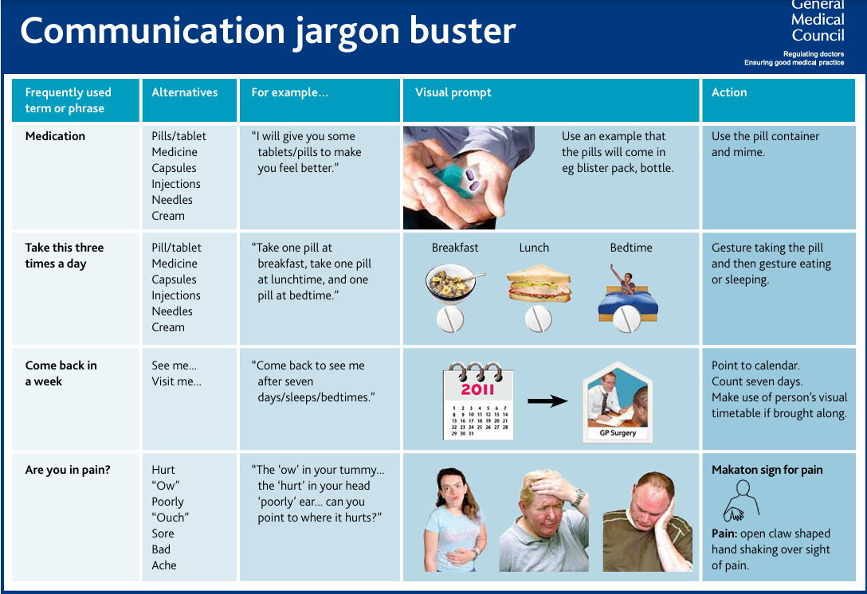
Notes:
Choose a couple of example from the first page

Slide 12
Obtaining Consent
C – Communicate. Can the person communicate their decision?
U – Understand. Can they understand the information you are giving them?
R – Retain. Can they retain the information given to them?
B – Balance. Can they balance or use the information?
Notes:
Many pharmacy professionals who we spoke with when we were developing this programme were concerned about properly obtaining consent from people who have a learning disability. You should assume that everyone has capacity to consent, until they demonstrate that they do not.
The CURB mnemonic has been developed to support professionals to assess a person’s capacity to consent
Coffey T. Advanced consulting – consulting with patients who have learning disabilities. 2012. www.gponline.com/advanced-consulting-consulting-patients-learning-disabilities/article/1157072

Slide 13
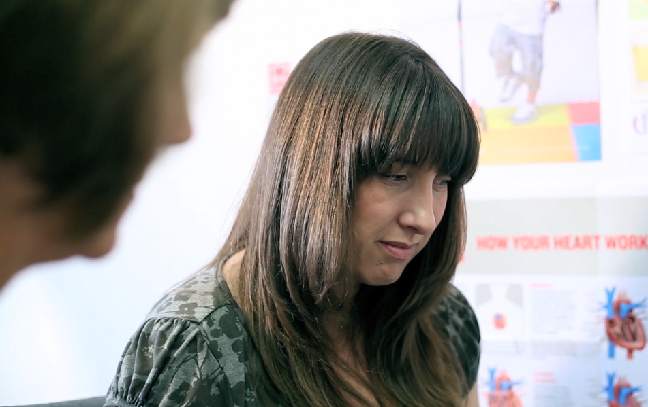
What does good look like?
https://vimeo.com/183629509
https://vimeo.com/183629503
https://vimeo.com/183629505

Slide 14

What was good about the consultations?

Slide 15
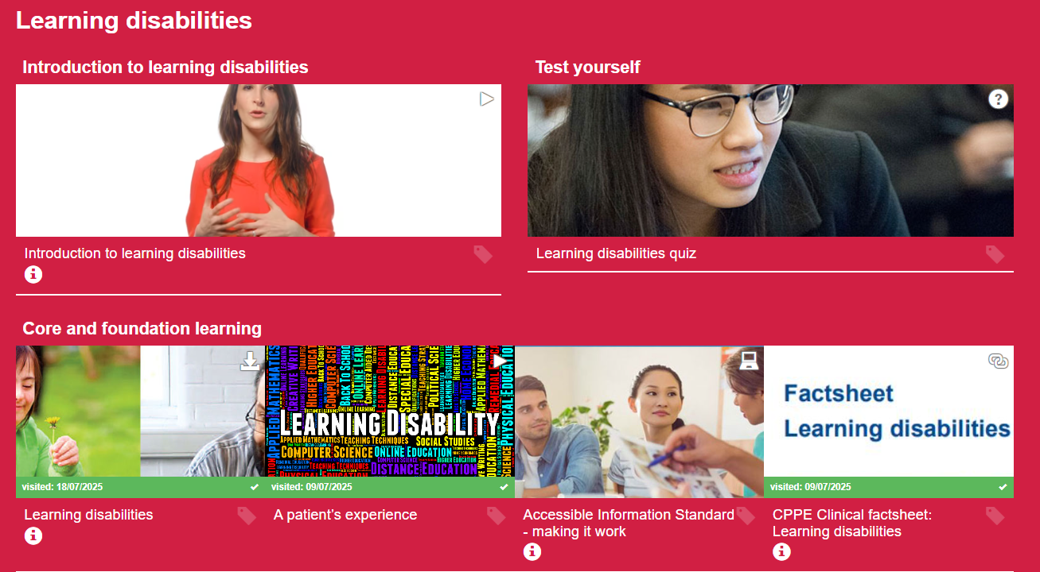
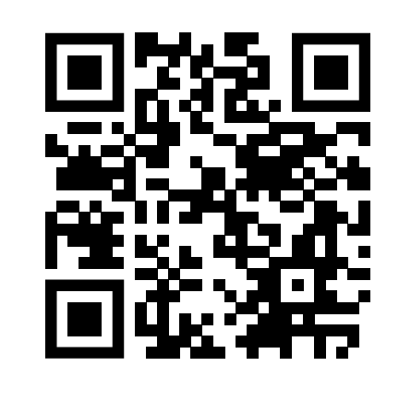
CPPE resources
Learning disabilities
Notes:
Highlight the distance learning and the fact sheets

Slide 16
Learning outcomes revisited
identify barriers and challenges in consultations with people living with a learning disability
identify strategies and resources to address challenges and barriers in consultations with people living with a learning disability
apply appropriate person-centred consultation skills to meet the needs of people with a learning disability
describe how to appropriately involve carers, family members and support workers in the consultation and identify how to gain consent to do this

Slide 17

Reflection, action planning and priorities
Take a few minutes to reflect on your main learning points and next steps following this taster session.
Identify:
one personal learning objective you will prioritise
one action you will implement in your practice
Notes:
Stock Photo ID: 430879922

Slide 18


