Slide 1
HealtheIntent (HDI) to support STOMP
Delivering STOMP Through Primary Care
Thursday 24th September 2025
Tim Hamson Head of BI
tim.hamson@nhs.net

Slide 2





118
DSAs signed enabling direct care uses
Patients can opt out
  Daily data feed of data into the platform.
Linked at patient level
GEH
ACUTE
Live
SWFT
ACUTE & Community
Live
113
CCNs signed enabling secondary uses
Online and compatible with multiple browsers (no software to install!)
Secure
UHCW Acute
Live
UHCW Community
In progress
Project Team:
Tim Hamson Head of BI – PHM
Ben Panton Senior Delivery Manager
Ben Wilczynski Information Governance Lead
3
Dashboards
PCD
18+ population
HTN risk model
CVD focus
Frailty
65+ population
Frailty and falls focus
Pop-profile
Whole population
Flexible case-finding
EDW
Data warehouse
Contact the team at
cwicb.cwphm@nhs.net
for support
Notes:
Ben P to have GP tracker availblae

Slide 3

Case-finding to support the national programme to stop over medication of people with learning disabilities and autism (STOMP)

Slide 4
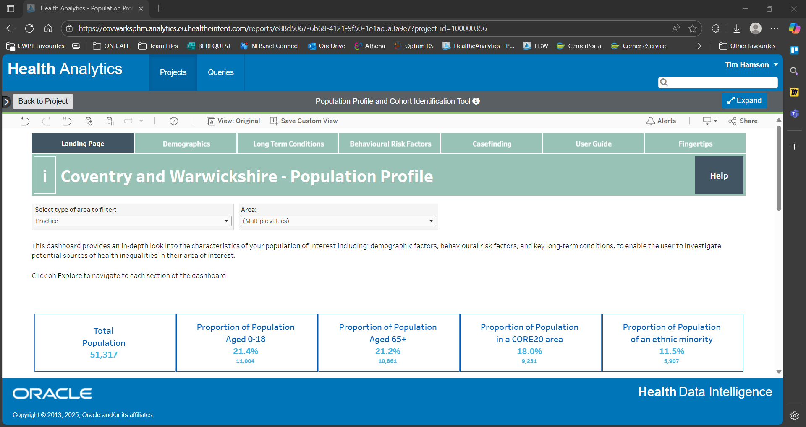

Filtered for our practices or PCN
50,000

Slide 5
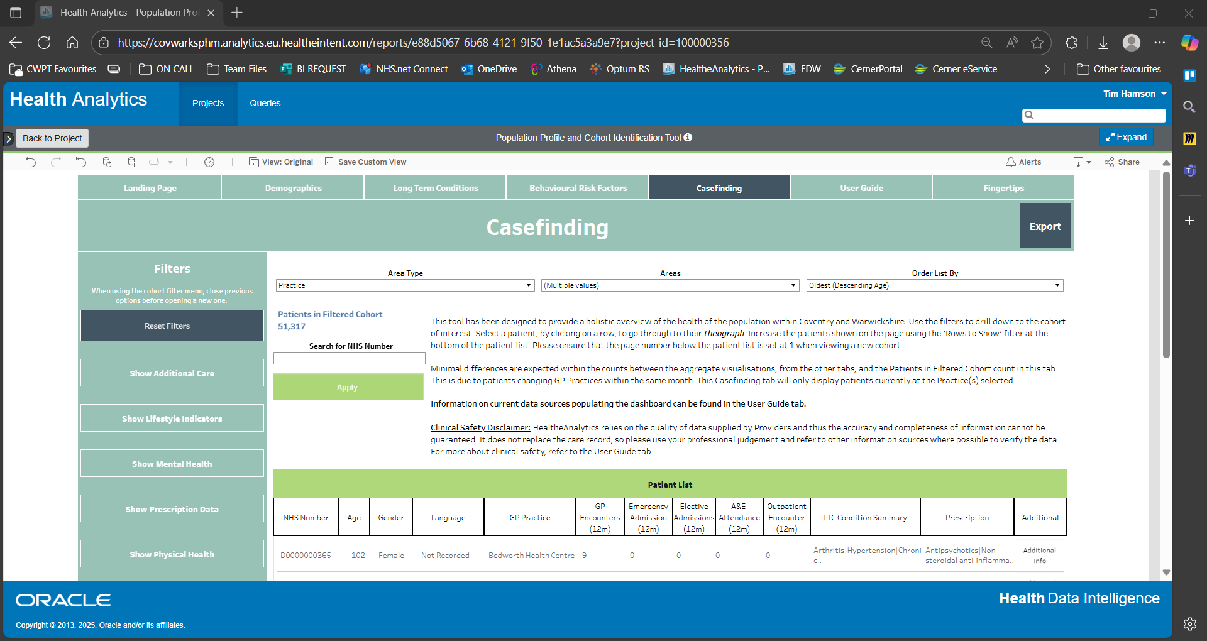

50,000
We have lots of options to refine our cohort…

Slide 6
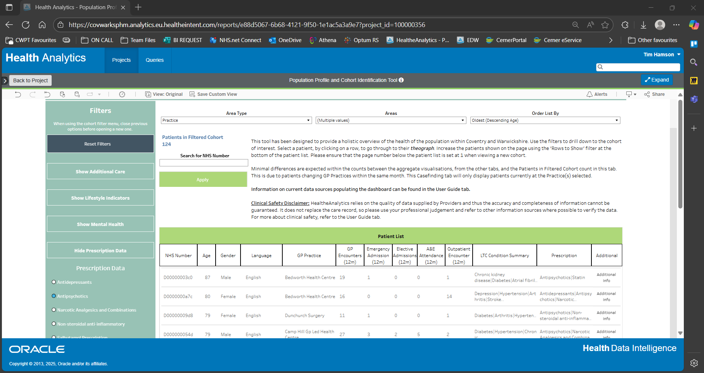


130
Focus on those with Learning disability…
… and Antipsychotics

Slide 7
Where to focus next…?
… around 20 Children and young people (U25)
Demographics
(Age, gender…)
… around 30 in Core 20 (20% most deprived)
Deprivation
… around 60 Obese, 20 smokers… 15 Obese AND smoke
Lifestyle
(smoking, alcohol …)
… around 100 have at least one physical condition, 40 have 3 or more
Around 350 people with a Learning Disability
Of those, around 130 prescribed Antipsychotics
Other Conditions
(CKD, Diabetes…)
… around 70 people are also prescribed anti-depressants
Prescribing other medication
… around 40 people have been to A&E at least once in the last year
Utilisation
(GP, A&E, etc)

Slide 8
Where to focus next…?
Demographics
(Age, gender…)
Deprivation
Lifestyle
(smoking, alcohol …)
Around 350 people with a Learning Disability
Of those, around 130 prescribed Antipsychotics
Other Conditions
(CKD, Diabetes…)
I now have my cohort of People who…
Have a Learning disability
AND prescribed antipsychotics
AND prescribed antidepressants
Prescribing other medication
Utilisation
(GP, A&E, etc)

Slide 9
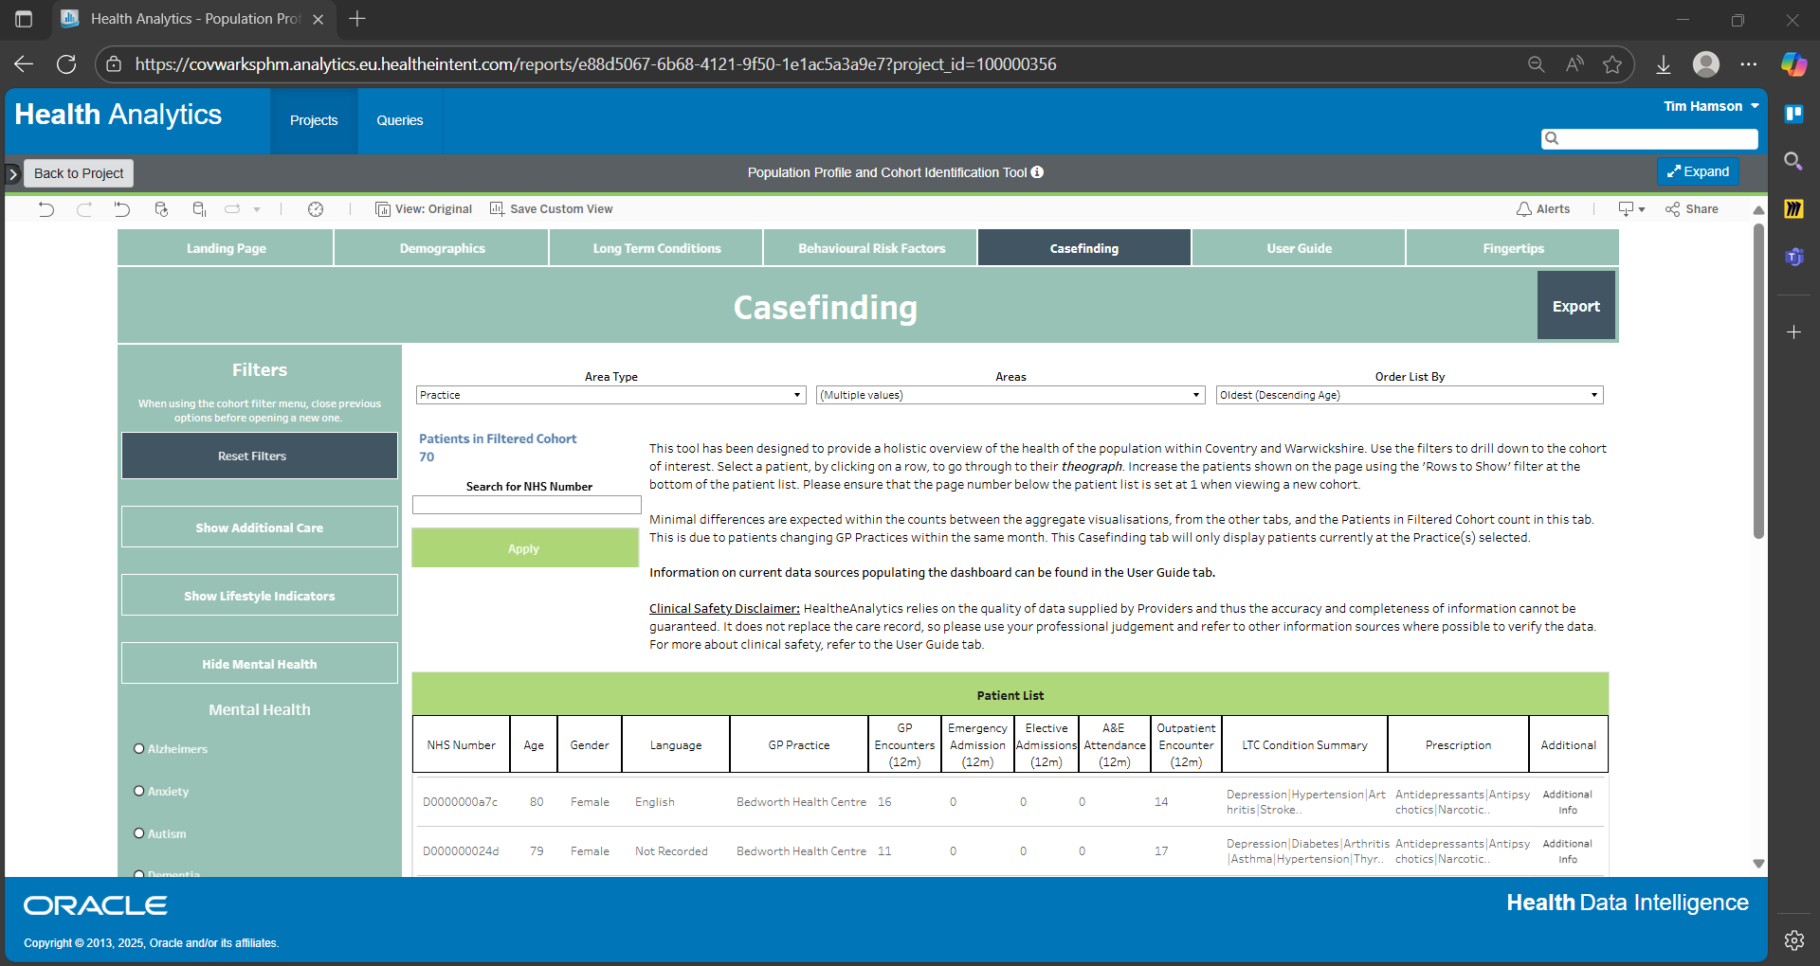
Date of Birth: 01/01/1900
Postcode: DE00 0MO
IMD Quintile: Most Deprived
Ethnic Category:
LTC Count: 3+ LTCs
BRF Count: 1
Alcohol Group: Alcohol Non-Use
BMI group: Overweight
Insufficient Physical Activity: Y
Tobacco Group: Ex-smoker
Physical Health: Arthritis|Asthma|Chronic Respiratory Disease…
Mental Health:Anxiety|Learning disabilities
Hover over ‘Additional Info’ for… additional info!

Slide 10

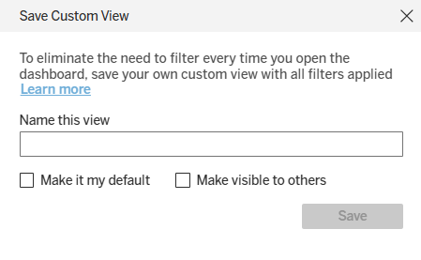
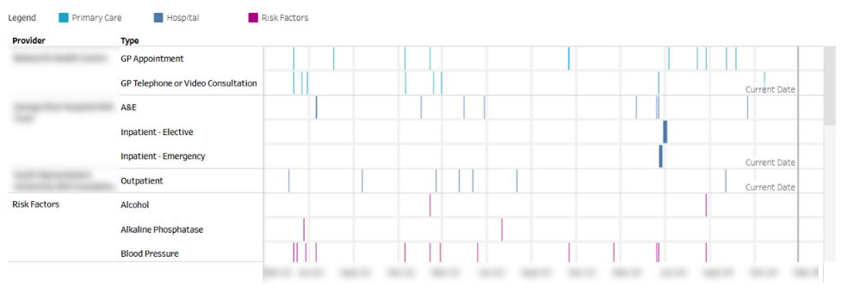
What next…
Export Patient List
Save search to use again (save multiple searches for different segments!)
View the theograph for more details about each patient
Notes:
USE THIS SLIDE AT THE END OF ANY WALKTHOUGH / DEMO TO SHOW

