Slide 1
Initial Education and Training Reforms (Pharmacist)
Roz Cheeseman Sejal Gohil
Head of Pharmacy Foundation Pharmacist Training Programme Director
Workforce Training and Education
NHS England (Midlands)

Slide 2

Standards for the Initial Education and Training of Pharmacists
One set of learning outcomes spanning the full five years of education and training – linked to continuum of post-registration development.
Incorporating skills, knowledge and attributes to enable pharmacists to independently prescribe from registration.
Introduces a (year 5) foundation training year with strengthened supervision and support and collaborative working between higher education institutions, statutory education bodies and employers.
Greater emphasis on equality, diversity and inclusion - address health inequalities.
Notes:
Based on slides used for David Webb visit to UoN (April 2023)

Slide 3

Key themes
Introduction of independent prescribing within initial 5 years
Introduction of clinical tariff within the MPharm
Responsibility change from; NHS Managed Sector (~800 trainees)
to all trainees in England (~2500-3000), with the intention that
NHS England will be the Statutory Education Body (SEB) for
pharmacy in England, responsible for:
  Pharmacist trainee recruitment
  Funding
  Oversight and quality assurance of Foundation Pharmacist training and work place based assessment
  Quality management of training sites

Slide 4
Key themes
Introduction of independent prescribing within initial 5 years
Introduction of clinical tariff within the MPharm
Responsibility change from; NHS Managed Sector (~800 trainees)
to all trainees in England (~2500-3000), with the intention that
NHS England will be the Statutory Education Body (SEB) for
pharmacy in England, responsible for:
  Pharmacist trainee recruitment
  Funding
  Oversight and quality assurance of Foundation Pharmacist training and work place based assessment
  Quality management of training sites

Slide 5

Independent prescribing as part of Education Reforms (Pharmacists)
2025/2026 Foundation Training Year will incorporate Independent Prescribing training and assessment
Collaboration with Pharmacy Schools Council to ensure continuum during the MPharm
Development of models for prescribing training and assessment during foundation pharmacist training
Supporting access to prescribing rotations and supervision for all trainee

Slide 6
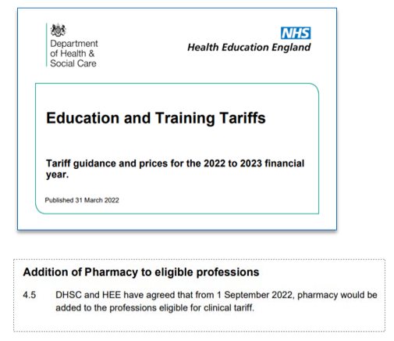
Introduction of clinical tariff within the MPharm
Access to DHSC Clinical Tariff from
1st September 2022 to support
clinical placements
Collaborative working with the
Pharmacy Schools Council to coordinate
IETP reform across the whole 5 years
Comprehensive FAQs on tariff available on
this page:
www.hee.nhs.uk/our-work/pharmacy/initial-education-training-pharmacists-reform-programme/undergraduate-clinical-placements

Slide 7

Single Commissioning Model: to enable change
A move from responsibility for NHS managed sector to all trainees in England
Single equitable route for recruitment of all trainees
Consistent model for the commissioning and funding for all trainees
Assuring quality of training sites, supporting supervisors in their role

Slide 8
Education Reform: Our current focus
Support roll-out of undergraduate clinical placements (Years 1-4): Access to DHSC Clinical Tariff since 1st September 2022 to support clinical placements. Joint working with employers and Pharmacy Schools Council.
Evolution of the Trainee Foundation Pharmacist Programme (Year 5): Development and introduction of consistent quality management, recruitment and cross-sectoral training posts throughout the transitional years and beyond.
Testing approaches to support the introduction of integrated independent prescriber (IP) training and rotational cross-sector posts.
Bridging training (Year 6): The foundation programme model includes support for pharmacists registering between 2020-25 – recognising the need for a consistently skilled pharmacist workforce.

Slide 9
Professional Practice Update
Additional Roles Reimbursement Scheme (ARRS)
New access to ARRS funding for PCNs, through the Direct Patient Care category, with the support of the PCN and ICB – for Pharmacy Technician Apprentices and Educational Supervisor Roles
Pharmacy Technician Apprentices
Pharmacy Technician Educational Supervisor
Clinical Pharmacist Designated Supervisor and Designated Prescribing Practitioner
These roles will be accessible via the ‘Direct Patient Contact (DPC)’ option.
NHSE is currently producing further guidance on this option which is available to roles that are not medical or nursing and can be up to an 8D in banding
Notes:
LF

Slide 10
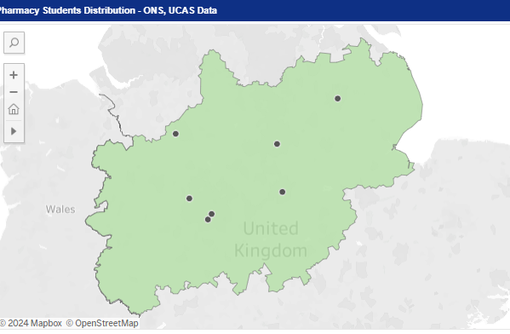
Pharmacist Training in the Midlands
4 years MPharm (inc placements)
Foundation Trainee Pharmacist
Aston University
University of Birmingham
De Montfort University
Keele University
University of Lincoln
University of Leicester
University of Nottingham
University of Wolverhampton
NHS Trusts
england.midlandsfoundationpharmacyrecruitment@nhs.net
Notes:
Looking at Foundation Pharmacists
Total numbers
128 NHS Trusts
160 community
Currently number of posts advertised >800
Anticipate half of these will ffill

Slide 11
Keep up to date: to check if up to date
To receive news by email about the initial education and training of pharmacists, please register here:
Find out more about the foundation training year
Find out more about the Newly Qualified Pharmacist pathway
Find out more about undergraduate clinical placements and tariff

