Slide 1

Welcome to our Personalised Care & Men’s Mental Health
7-in-1 Event
Jo Taylor & Jonathan Peters - Coventry & Warwickshire Training Hub
Paol Stuart-Thomson – SW&W Mind

Slide 2
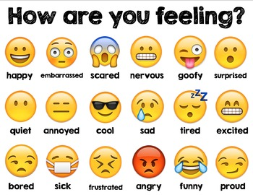

Check-in
Notes:
Check –in (don’t have to use this )

Slide 3
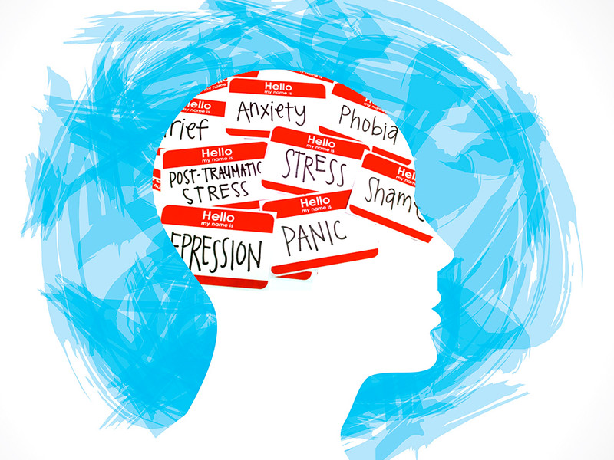
Personalised Care & Men’s Mental Health
7-in-1 Event
Agenda
Welcome, introductions & overview
Mental Health 1- Setting the scene & Quiz
Mental Health 2 - What to look for, signs & symptoms…
Mental Health 3 - How to get men talking, men’s talking toolkit
Mental Health 4 - Resources, support groups & signposting
Mental Health 5 - What is it like in practice? Scenarios
Mental Health 6 - Selfcare / Reflection - activities
Mental Health 7 - Marketplace, networking, catch-up!
Contacts:
Jo Taylor jo.taylor@southwarwickshiregps.nhs.uk
Paol Stuart-Thomson paol.stuart-thomson@swwmind.org.uk
Jonathan Peters Jonathan.Peters@southwarwickshiregps.nhs.uk
Notes:
Agenda and contact details

Slide 4
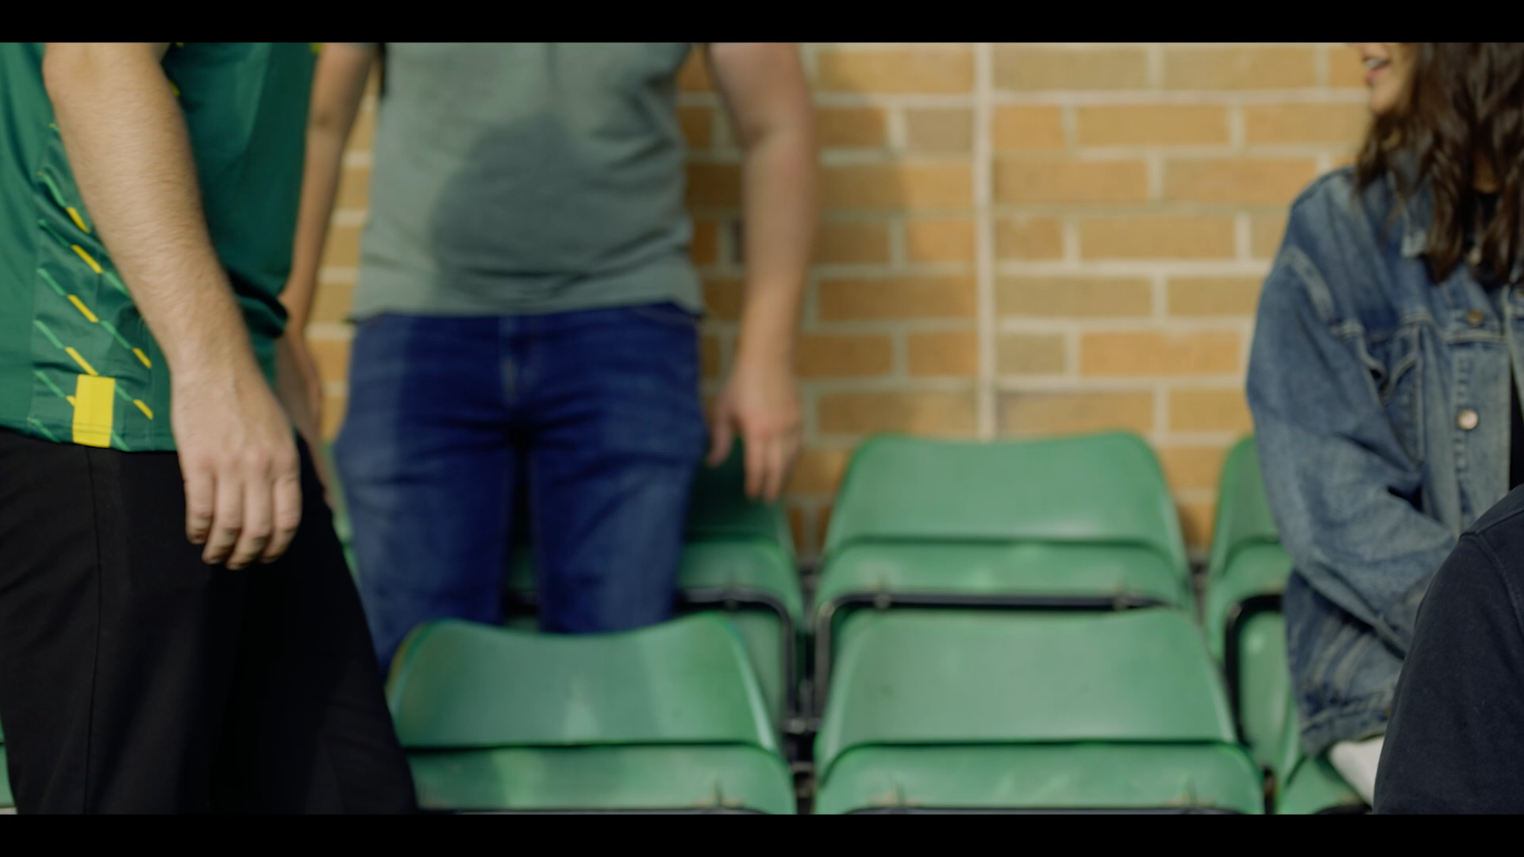

Slide 5
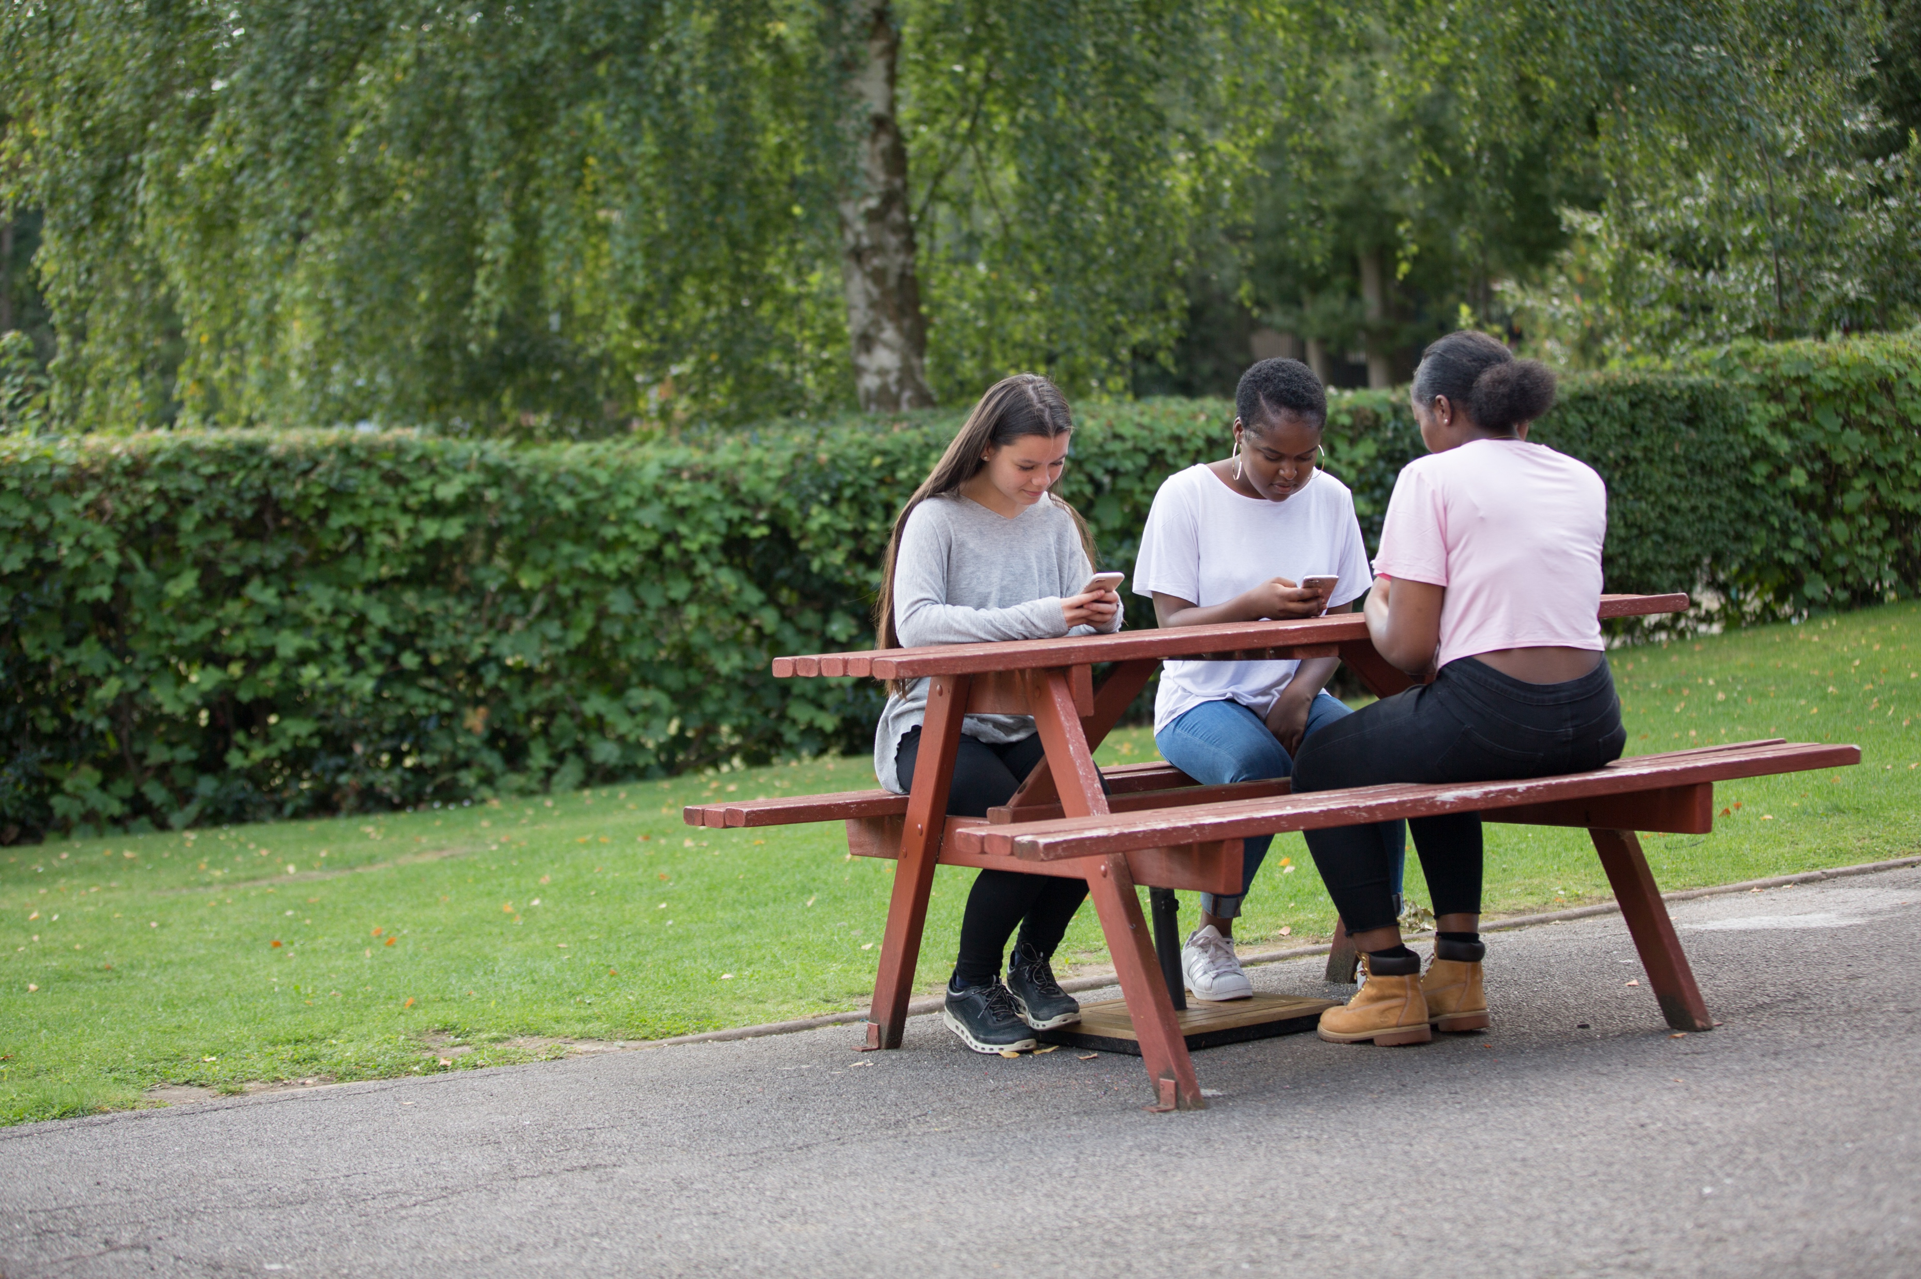


 | Quiz

Slide 7

48% of referrals to Healthy Minds (IAPT) psychological therapies for were male.
True or False
False: 36%
*NHS digital 2022

Slide 8
Over a third of men (35%) waited more than 1 year or have never disclosed a mental health problem to a friend or family member
True or False
False: 2 Years +*
*YOUGOV, 2021

Slide 9

52% of men would feel guilt, shame and or embarrassment in taking time off for a mental health concern vs. 12% for a physical health concern
True 👍 or False ❤️
TRUE*
*Opinion leader for MH Forum 2022

Slide 10
35% of male prisoners have two or more mental disorders
True 👍 or False ❤️
False: 72%*
*social exclusion unit

Slide 11
Equal numbers of Males and Females have Attention Deficit Hyperactivity Disorder or `ADHD`
True or False
False: Triple the number of males

Slide 12
72% of adults who go missing each year are male and 87% of those sleeping rough are male
True 👍 or False ❤️
True*
*University of york, 2021

Slide 13
74% of suicides in 2022 were Male with an average age of 50 -54 years
True 👍 or False ❤️
TRUE*
*ONS 2022

Slide 14
1 in 100 new dads experience postnatal depression
True 👍 or False ❤️
False: 1 in 10*
*National childbirth trust, 2022

Slide 15
A woman speaks about 7,000 words a day; a man speaks about 2,000
True or False
True

Slide 16
Men are “thick skinned” compared to other genders
True or False
True – Male skin is 25% thicker than female skin

Slide 17
 | Men’s mental health

Slide 18

  Spotting the signs

Slide 19
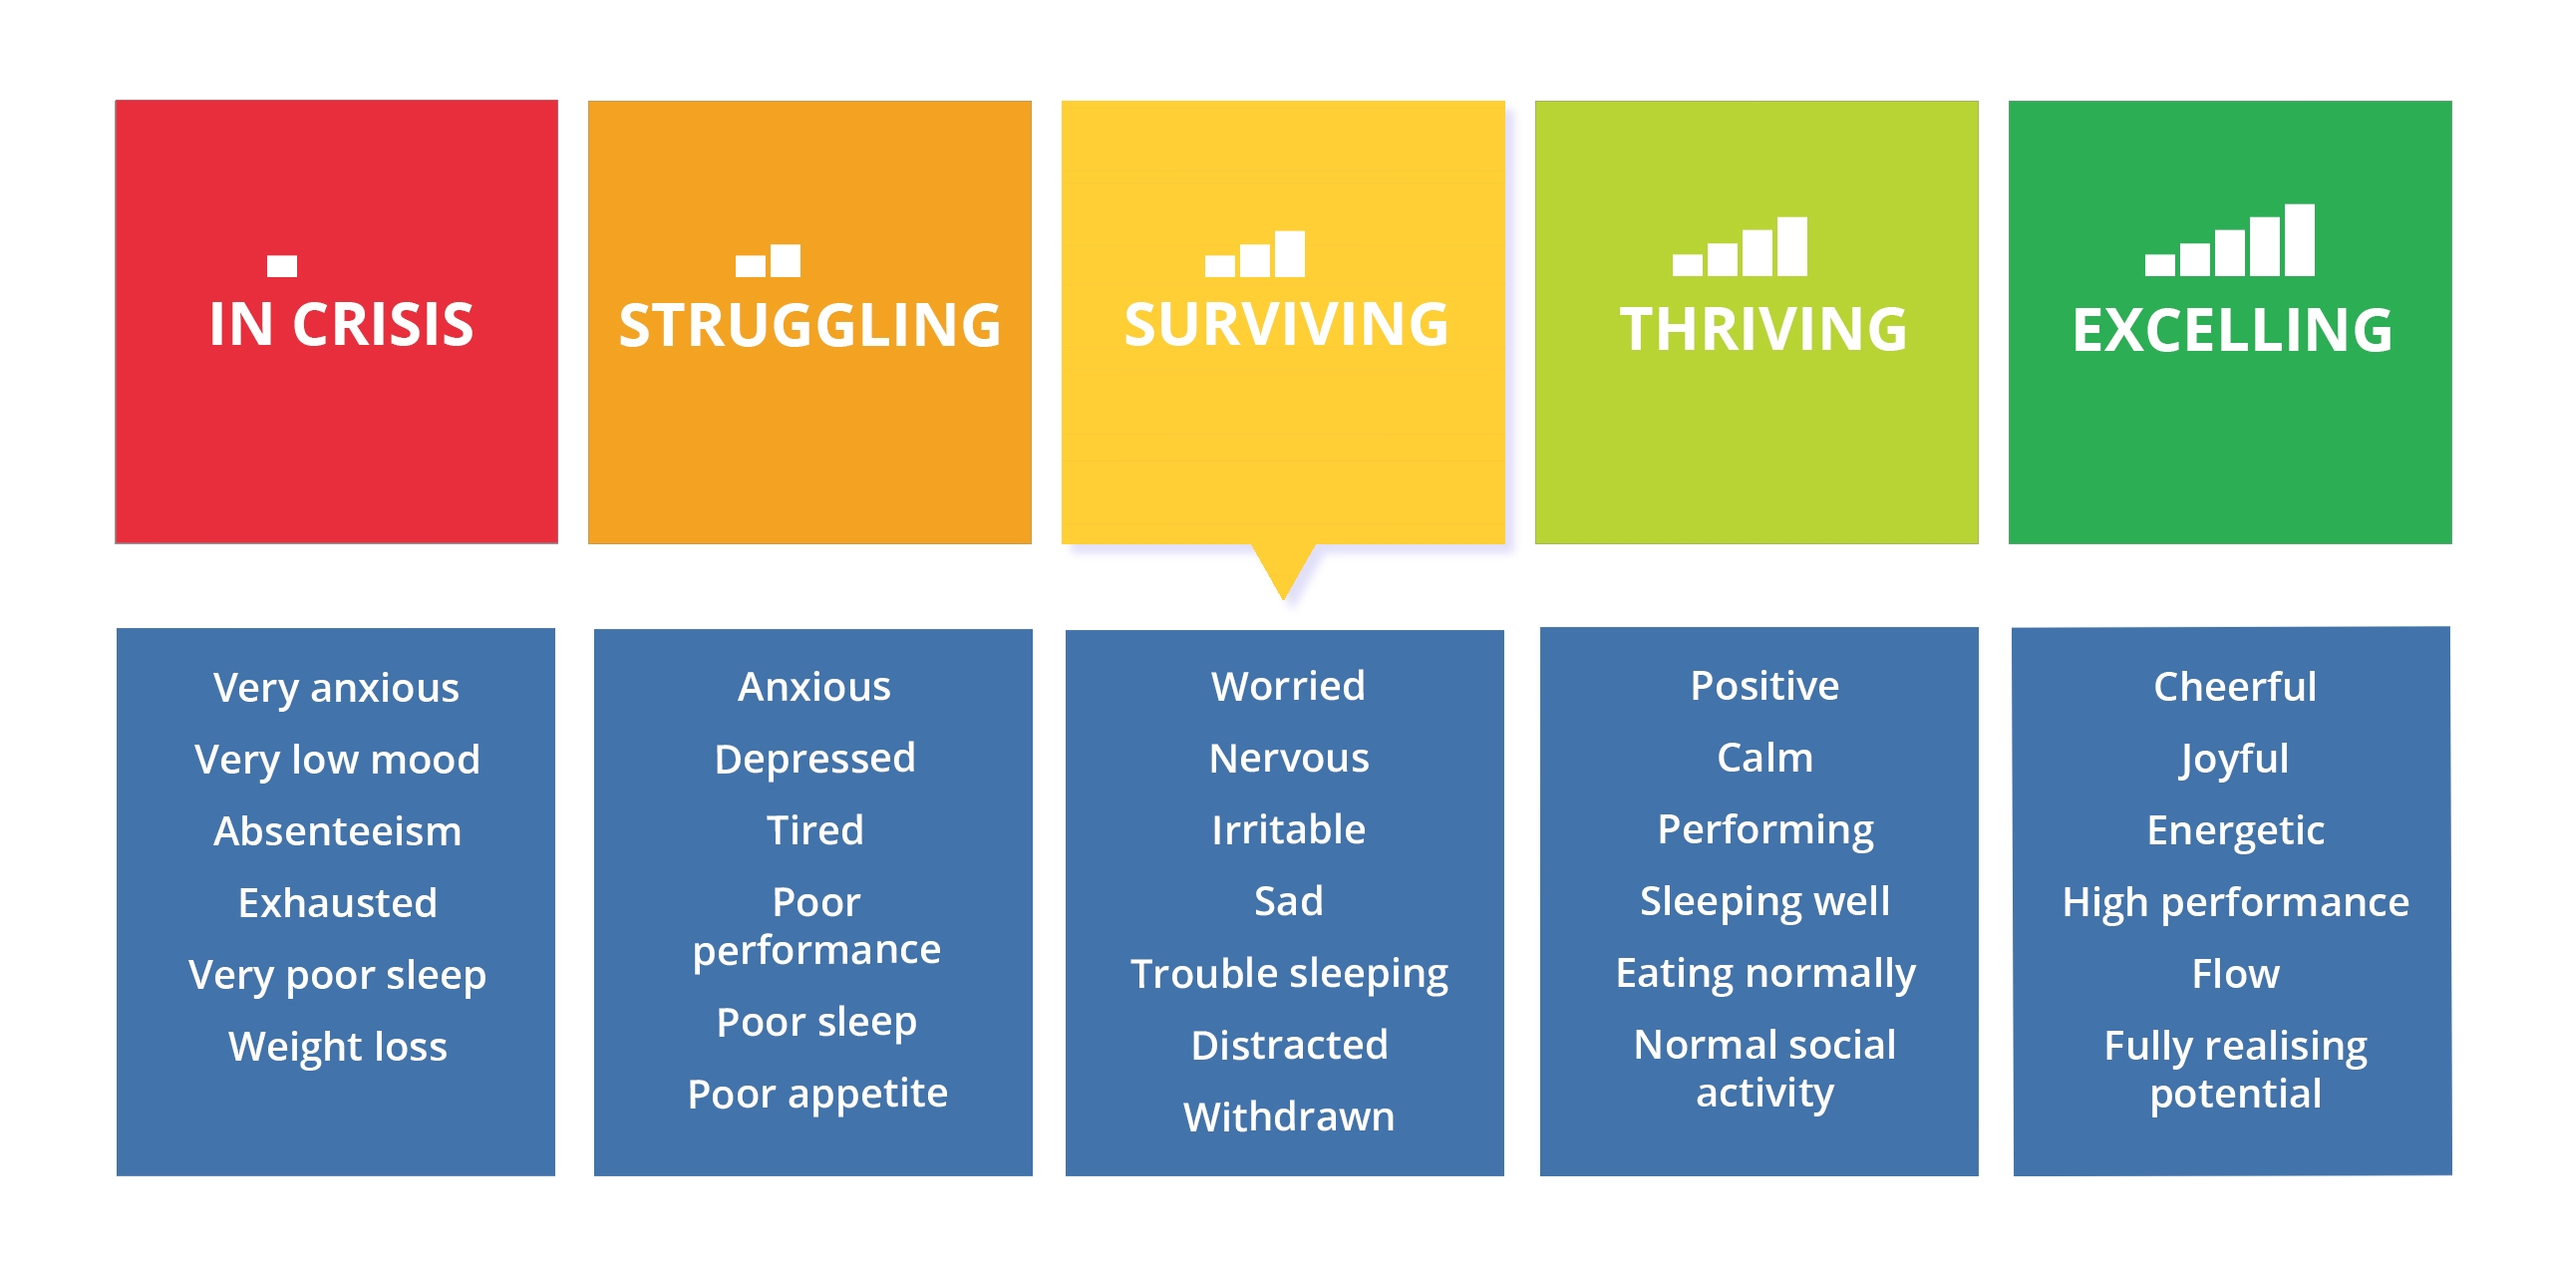
  Our mental health changes
Notes:
Life is full of ups and downs
Our physical health changes at points in our life so too our Mental Health.

Slide 20

T Shirt Exercise
Breakout Groups 10 Minutes
Activity
Design your own Men’s Signs T-Shirt using one piece of flip chart paper
On the front write or draw the signs others might see in a Man who is struggling with their mental health
On the back, write or draw what the man is really experiencing (thoughts and emotions)

Slide 21

Signs to look out for

Slide 22
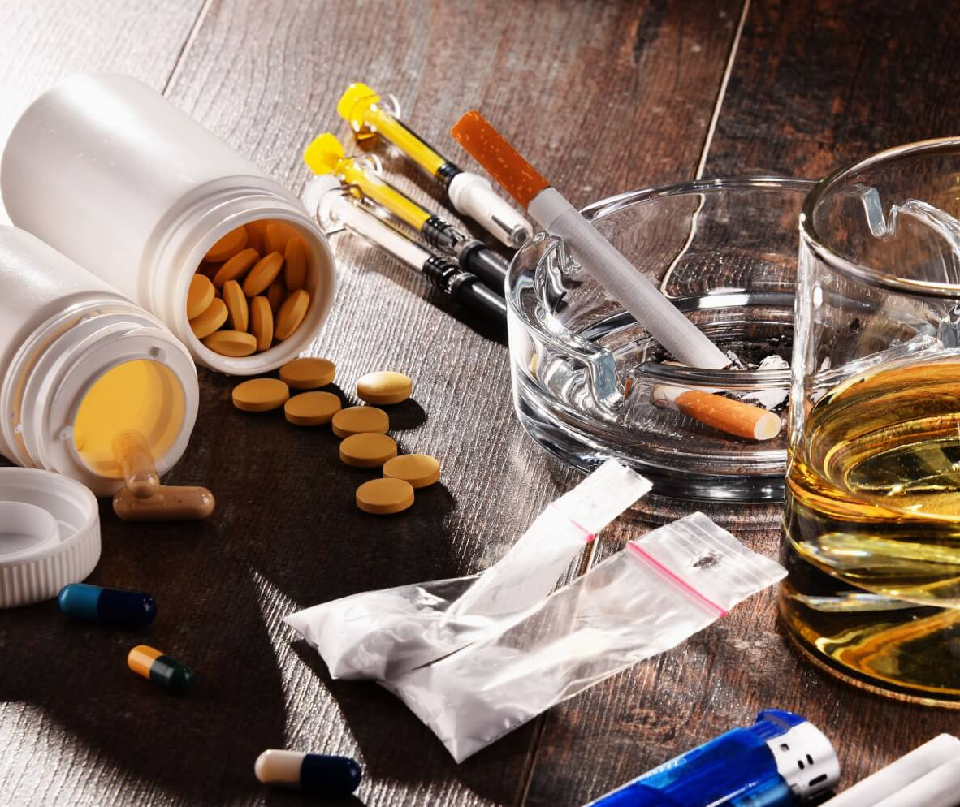
Substance
abuse

Slide 23
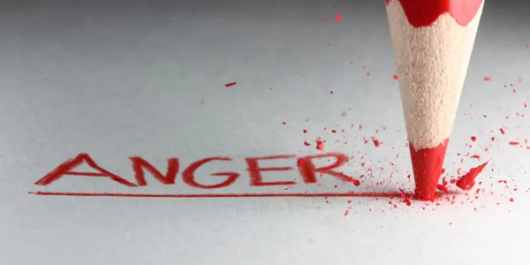

Slide 24


Exhaustion
Notes:
More common in men than women
70% of uk population does not get the average 7 – 9 hours sleep needed per night

Slide 25
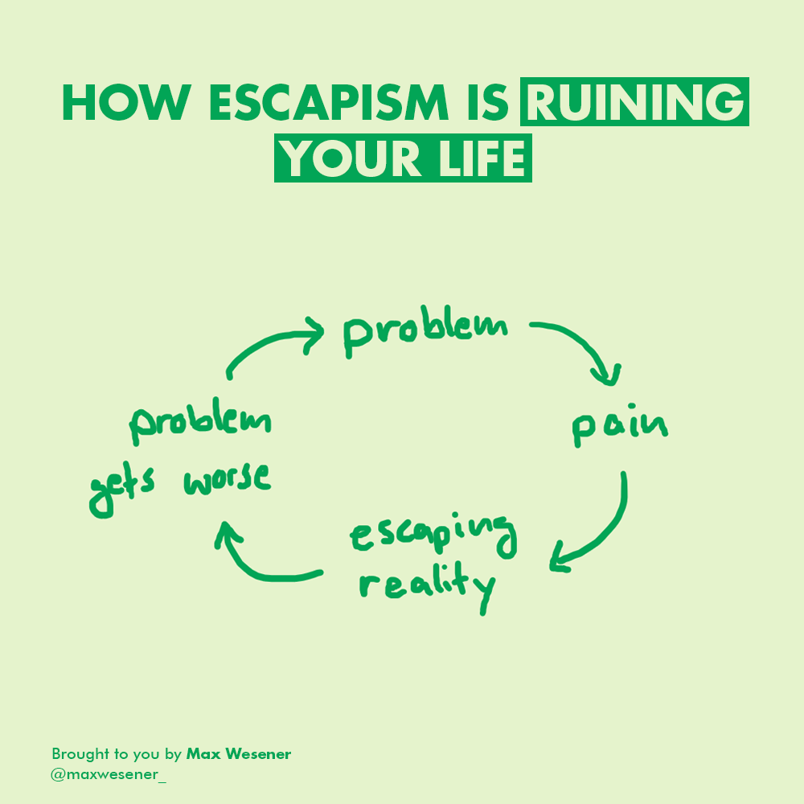
Notes:
spending extra time at work, engaging in sports or video games
Ignoring responsibility
The Markers of Responsibility Fatigue
How can you differentiate between being stretched a little too thin and feeling like you're under an avalanche of duties? Avellino says there are several specific red flags, including these four:
When asked how you are, you typically answer "busy" or "tired."
You pay attention to the needs of others, but often neglect your own.
You say "yes" to most things you are asked to do, regardless of your capacity or interest in doing them.
You often feel anxious or resentful.
Risk-taking can manifest itself in many ways:
 Impulsivity: You may act on impulse and not take
enough time to rationalise an action.
 You
may engage in violent, anti-social or bravado-
associated behaviour, such as driving really fast,
 Lack of concern for safety: You may cause
yours or other people’s lives in danger in search
of that dopamine kick.

Slide 26
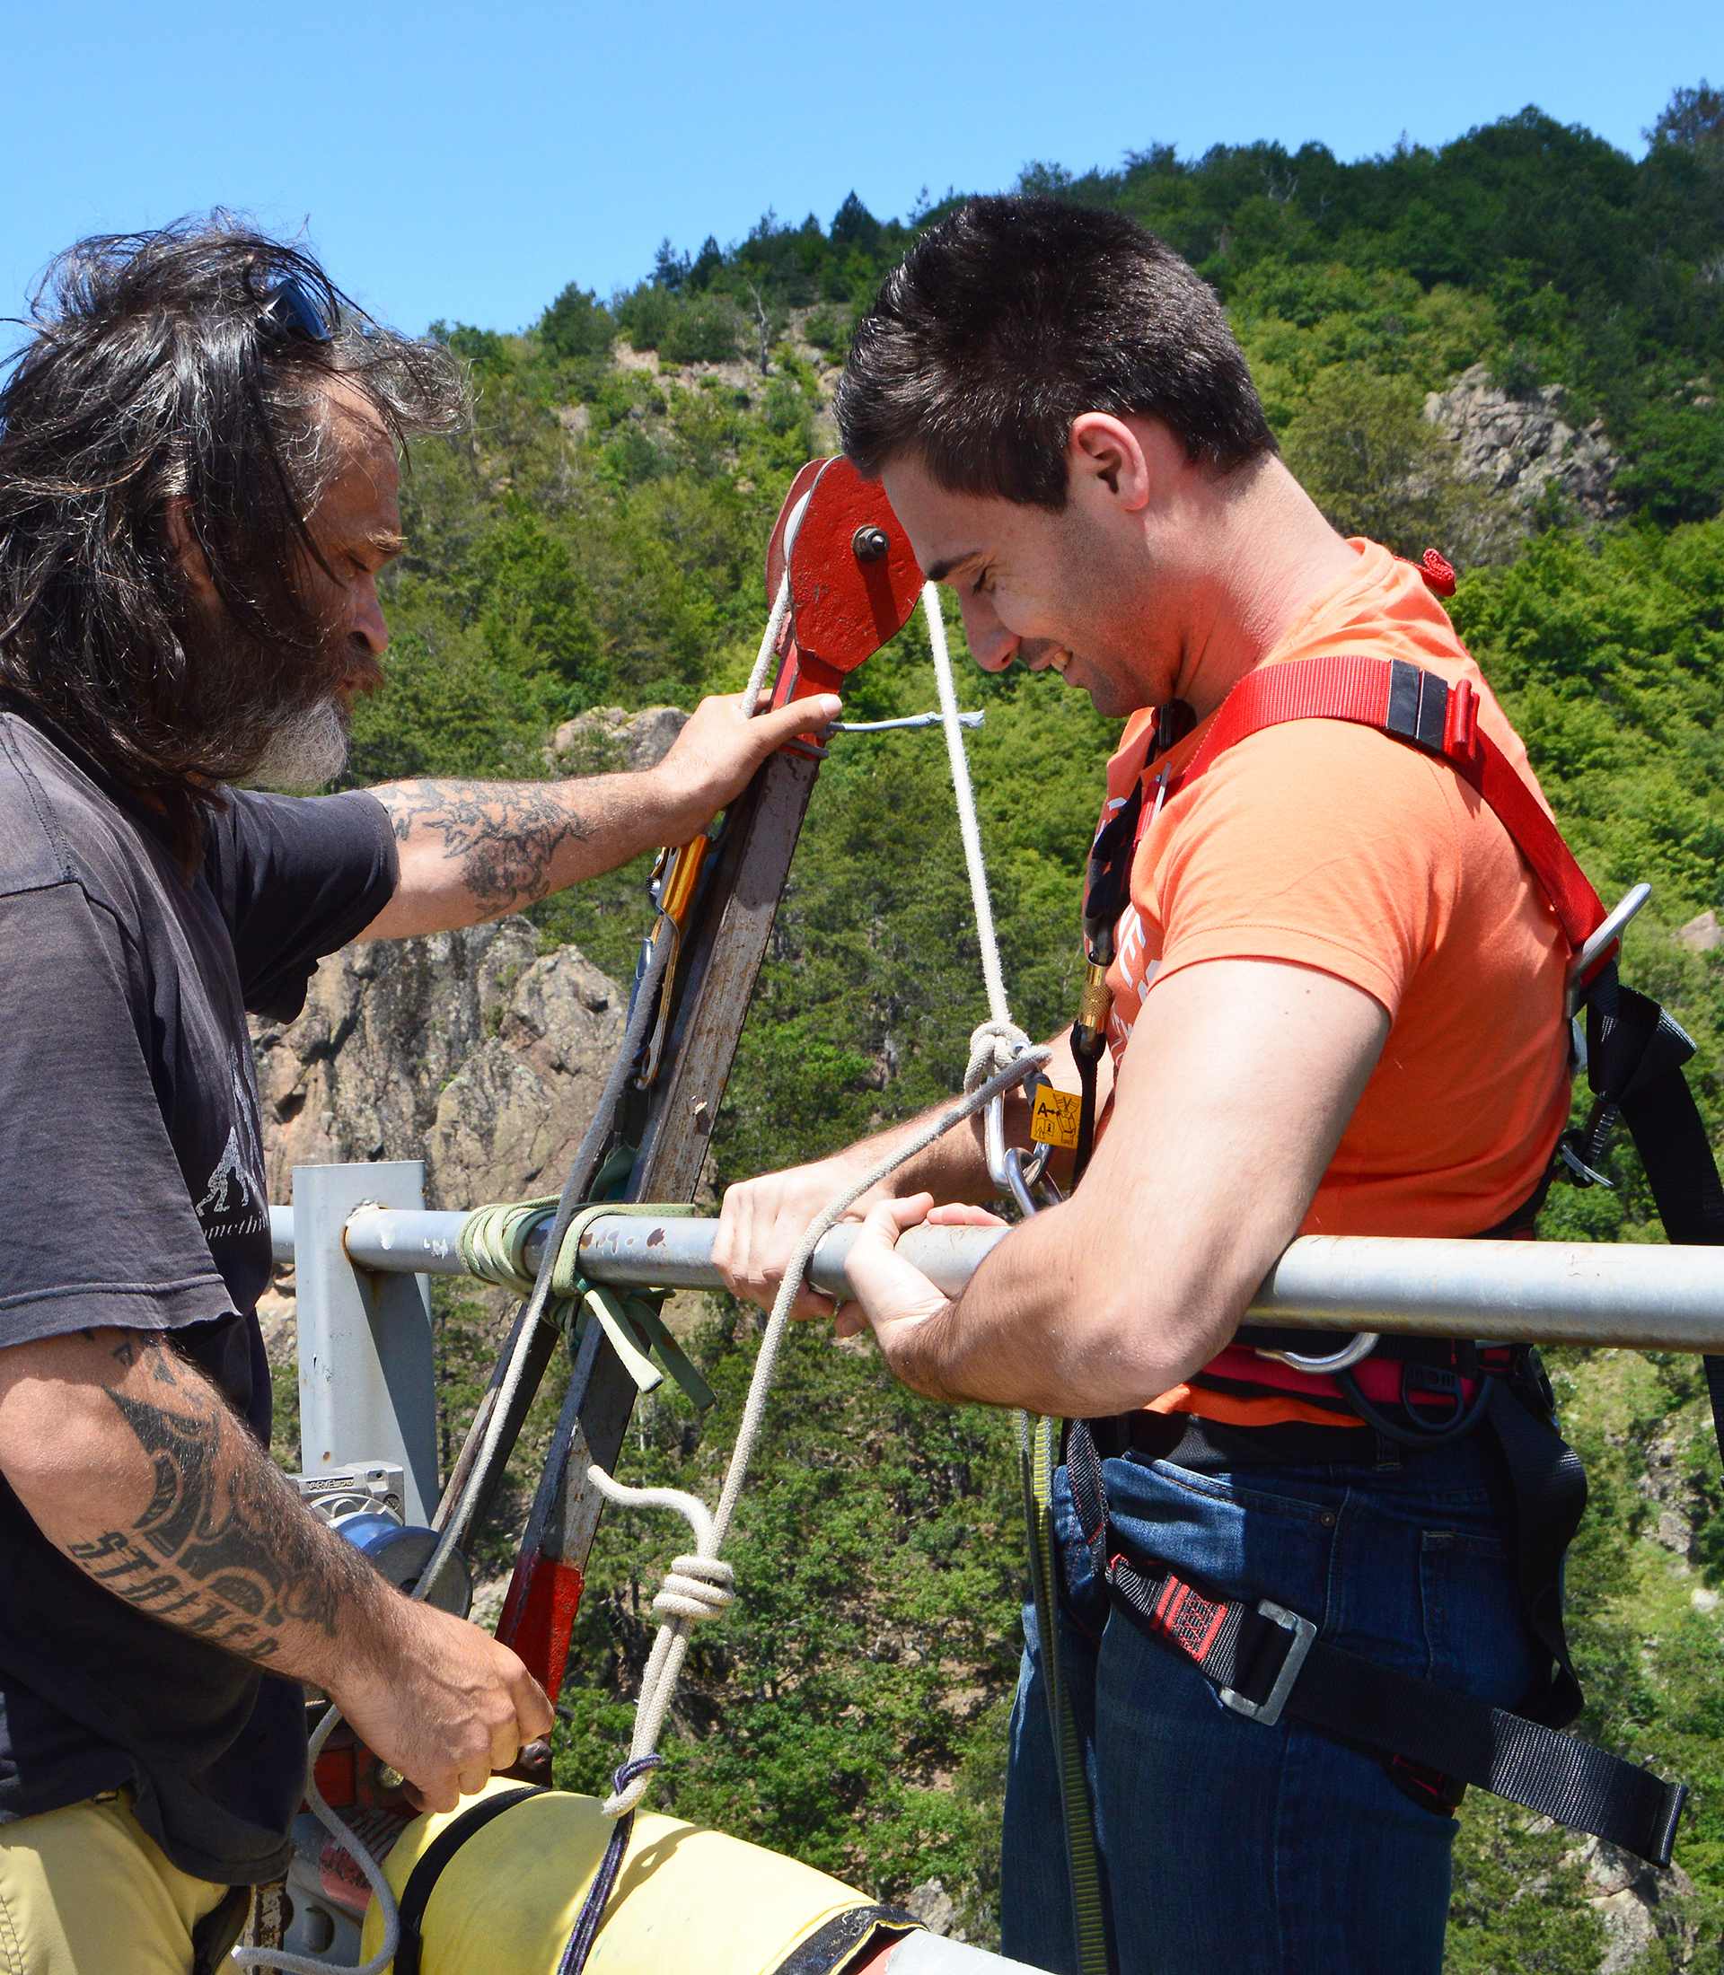
Risk taking
behaviours
Notes:
Young men are more likely to engage in risky behaviours such as reckless driving, substance abuse, binge drinking, unprotected sex, extreme sports/activities, gambling, sexting and other risky uses of social media.”
Sensation-seeking: Young men are more likely to seek new and exciting experiences that provide a thrill. This sensation-seeking behaviour is linked to dopamine, a neurotransmitter that is responsible for pleasure and reward in the brain
Peer pressure: Young men are often influenced by their peers to engage in risky behaviours, as they want to fit in and be accepted by their social group. Being part of a social group is very important for young people as they try to develop independence and autonomy from their family
Overconfidence: Young men tend to overestimate their abilities and underestimate the risks associated with their actions. This is because they have a sense of invincibility; young people tend to see death as a long way off and other negative outcomes or injuries as less likely to impact them as they feel healthy, fit and indestructible
Emotional regulation: Young people often have difficulty regulating their emotions, which can lead to impulsive decision-making. The prefrontal cortex, which is responsible for decision-making and impulse control, is not fully developed until the mid-20s
Masculinity: Young men are often socialised to believe that risk-taking is a sign of masculinity. This can lead to a desire to prove oneself and take risks to demonstrate courage and strength
Testosterone: Studies have suggested that testosterone may influence risk-taking behaviour in both men and women. In men, higher levels of testosterone have been associated with increased risk-taking behaviour, such as engaging in activities like skydiving or bungee jumping and taking financial risks

Slide 27
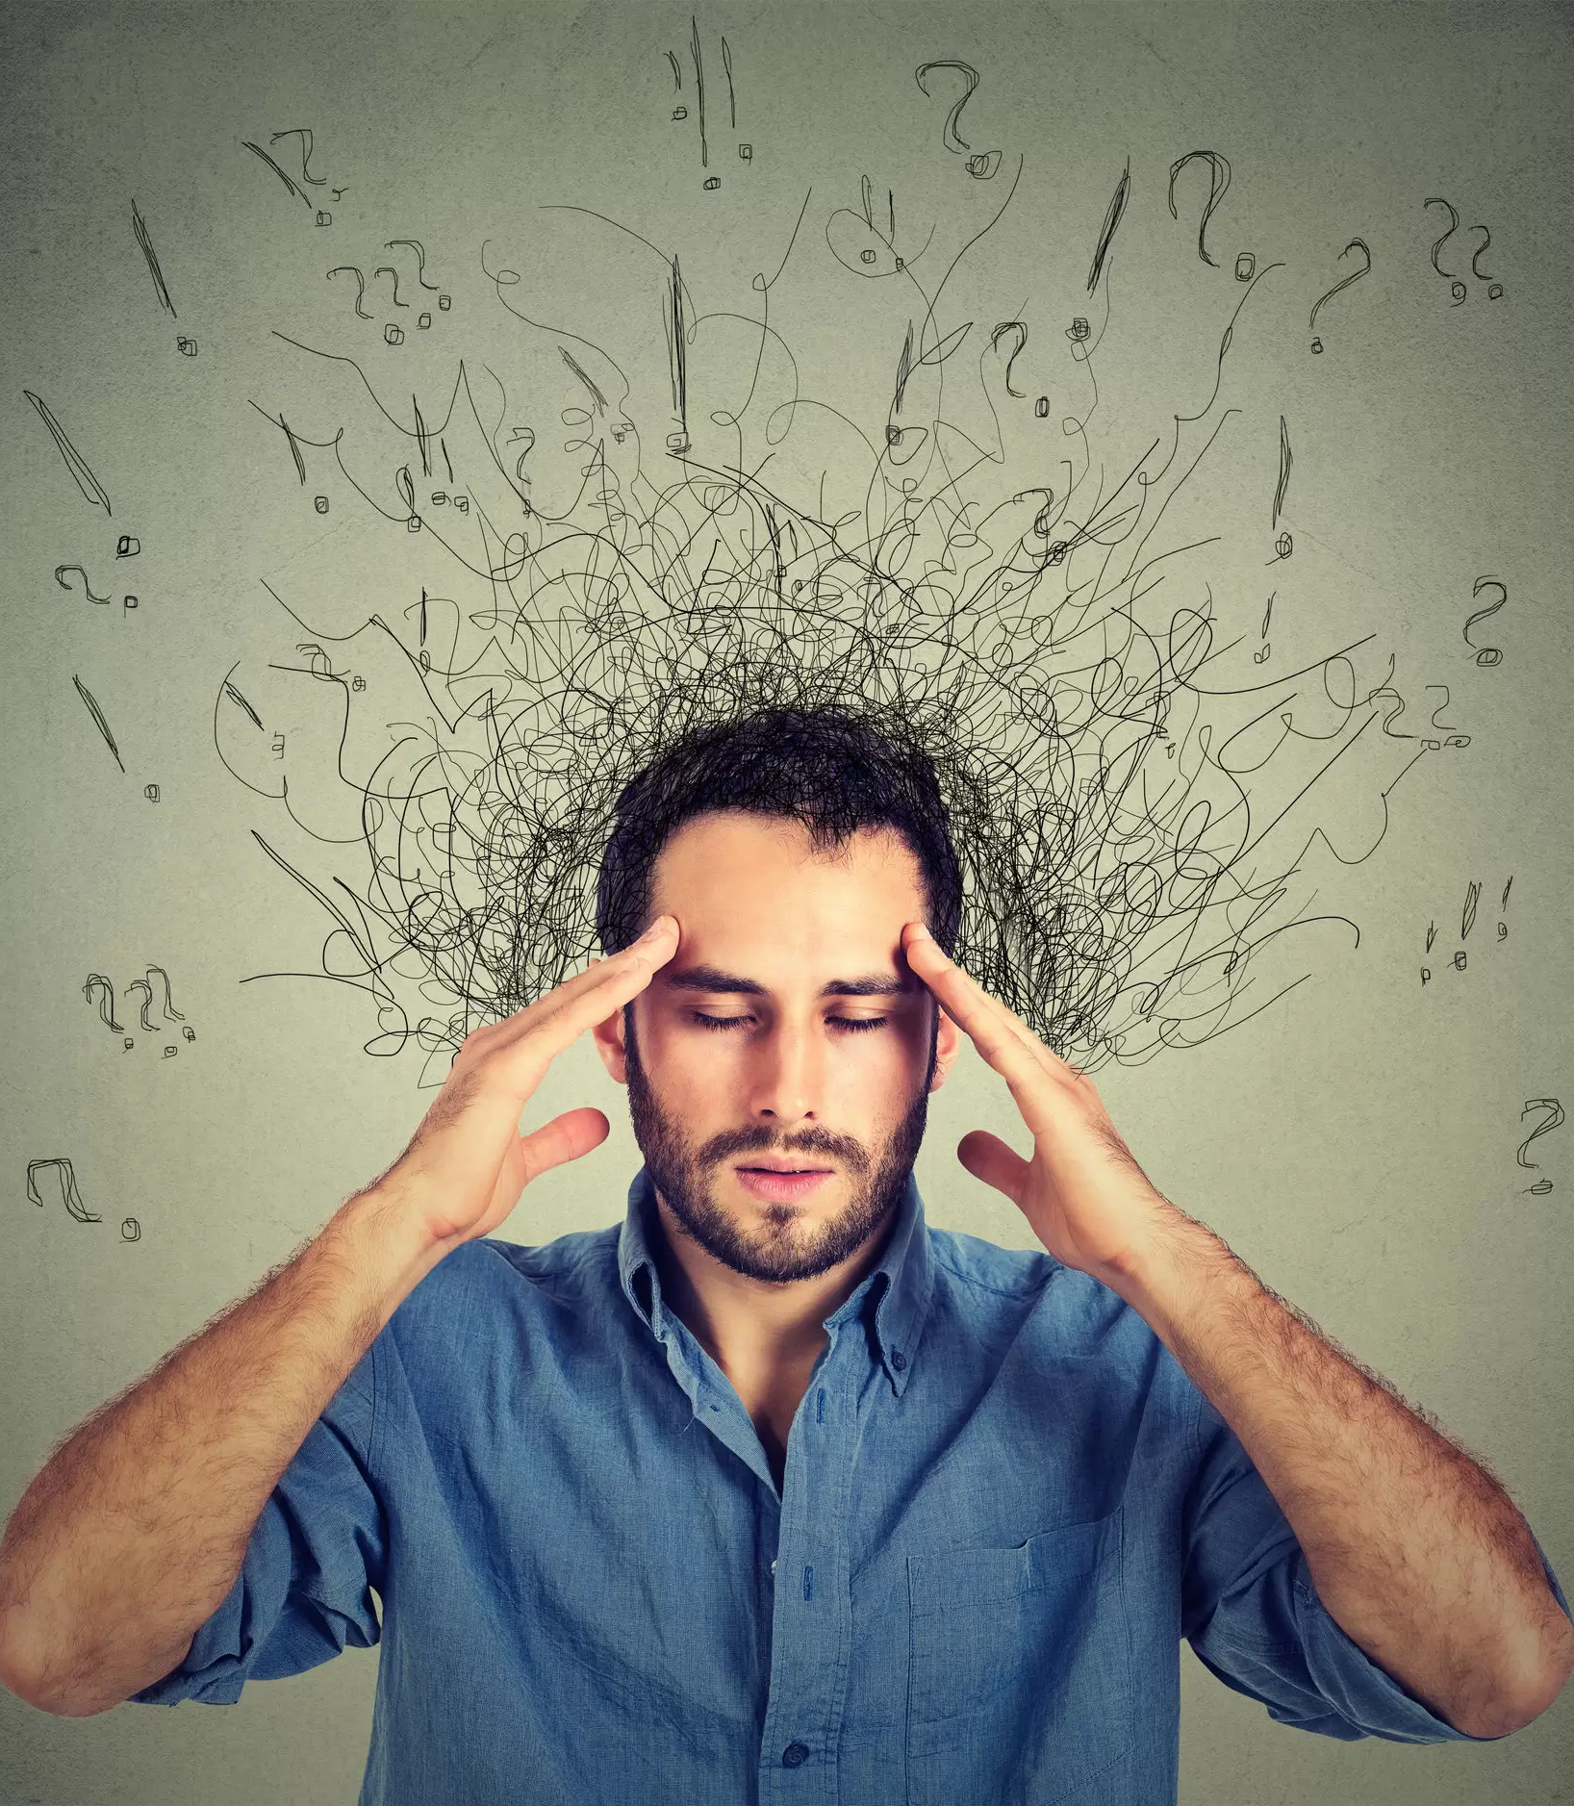
Worry

Slide 28

Loss of interest

Slide 29
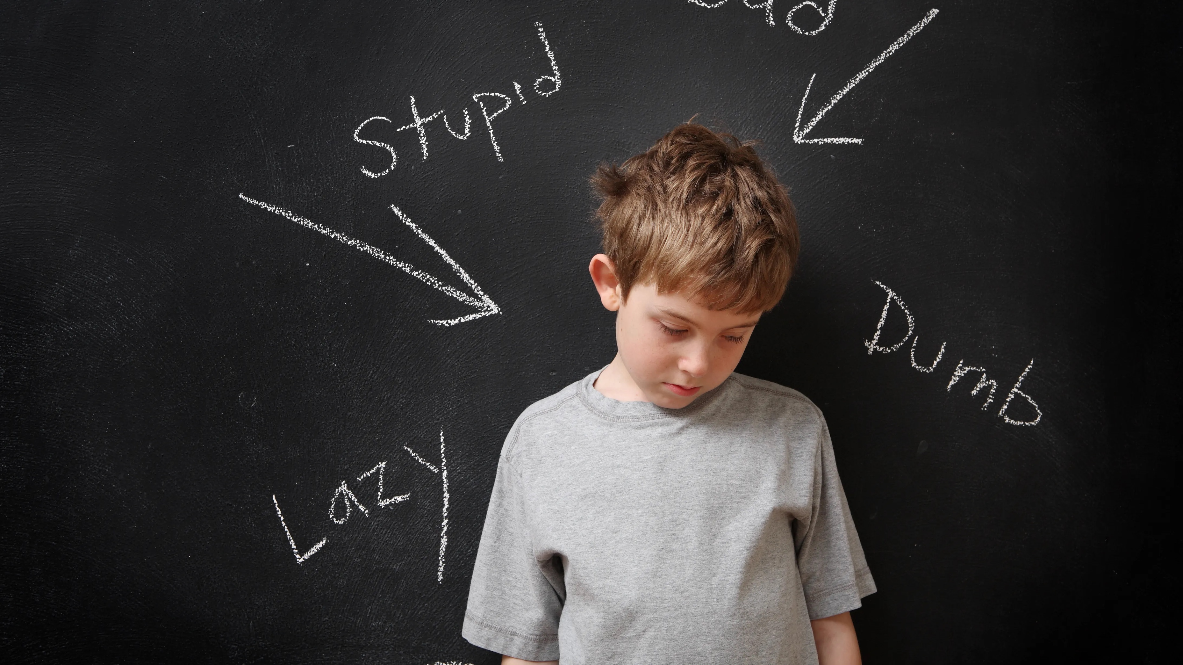
Low self-esteem

Slide 30
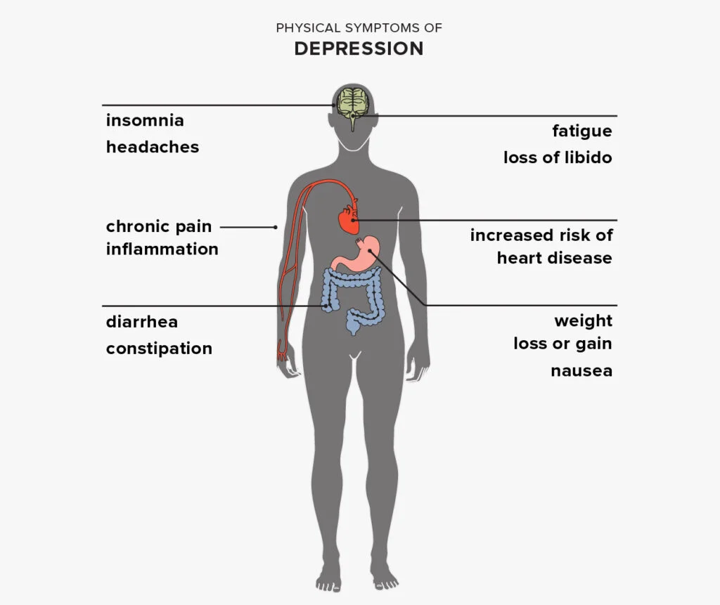
Physical Symptoms

Slide 31

Isolation
Notes:
Cutting ourselves off

Slide 32
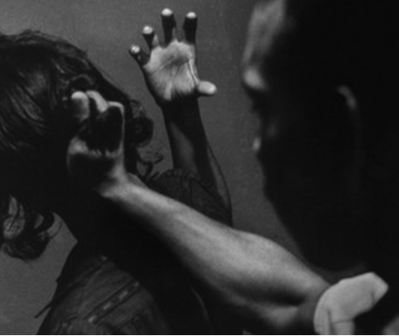
Abusive
behaviours
Notes:
Note: While controlling violent or abusive behavior can be a symptom of depression, it should not be excused. If you are struggling with these tendencies, seek help immediately. On the same note, if you are close to a man who shows these symptoms, remember that your safety comes first.

Slide 33
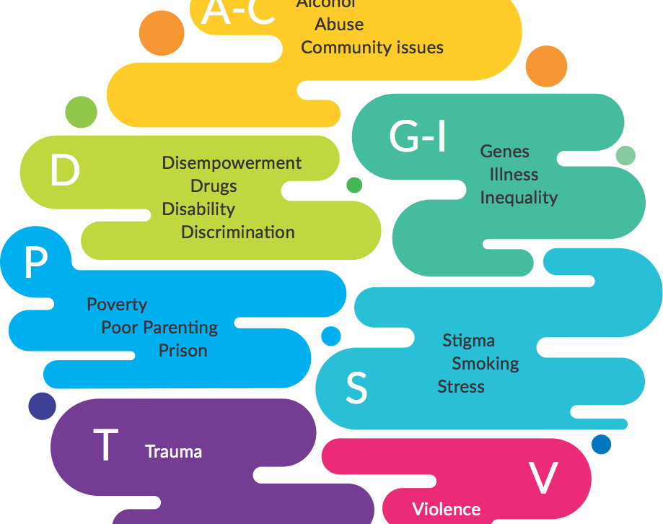
Risk factors for men
Risk factors:
Individual: Alcohol, Drugs, Smoking, Abuse, Stress, Traumatic life events, Prison, Poor parenting, Lack of support, Illness, Disability, Genes
Societal: Poverty, Unemployment, Poor education, Poor housing, Community violence, Disempowering services, Strands of Inequality, Stigma and discrimination

Slide 34
 | Men’s Mental Health

Slide 35
  Talking tools

Slide 36
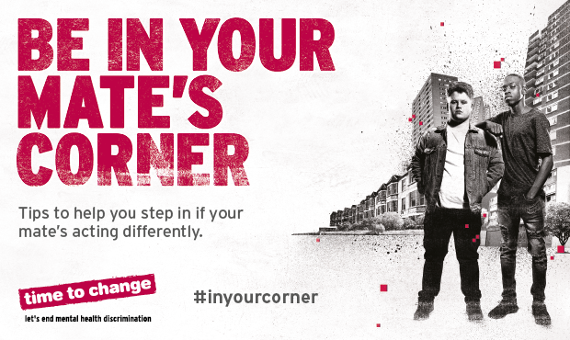
Notes:
We are now going to explore some best practice when it comes to a mental health conversation.
By now means is this the complete authority but it is a blended toolkit using guidance from Mind, MHGA and Shout that focuses on reaching males.
Individually, you will all have your own successes and experience, and we hope you will share these with your table during our breakout exercise.

Slide 37
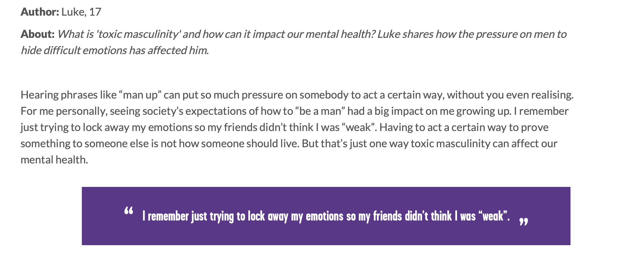
Stigma & Men

Slide 38
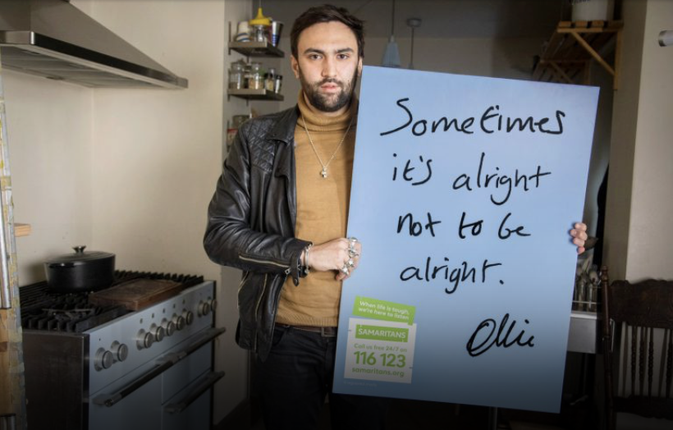
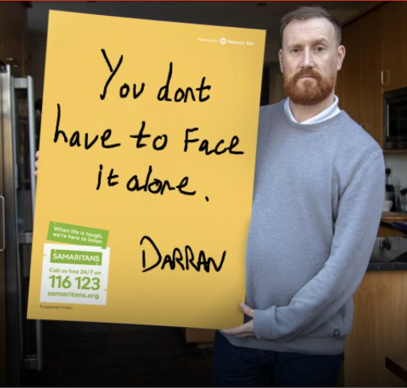
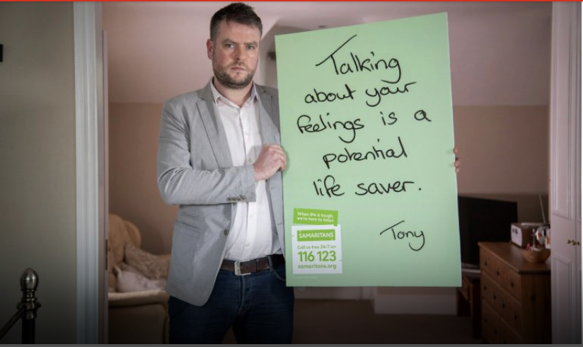
Stigma – Pushing back
Normalise it
Mental health difficulites are part of being human make getting help the norm
Educate people
The more people know the less stigma
Men telling their stories
- sharing helps reaffirm that mental health issues are normal and support helps

Slide 39
Mental health conversation cycle:
Notes:
This toolkit consists of 5 elements and we have adjusted this to focus on male behaviours.
Start- preparation
Asking – h

Slide 40
Start
Create a safe space to have the conversation
Pick the right place: choose somewhere quiet with a relaxed atmosphere where the person will feel comfortable so you can talk without distractions
Walk and talk: some people feel more comfortable talking while doing an activity they enjoy, so the focus doesn’t feel entirely on them
Show you’re ready to listen: have open body language, such as sitting or standing upright, keeping comfortable eye contact and angling your body towards them
How are you feeling? Check in with yourself before the conversation and make sure you’re feeling calm, open and ready to listen

Slide 41
Mental health conversation cycle:
Ask effectively

Slide 42
The four key question types
Feeling
​Focus on feelings, length of time, levels of distress and impact
​Focus on gaining a wider and fuller picture of life. work and home
Exploring
Supporting
What the support might look like ​​
​Check-back on thoughts on support offered and their understanding
Check-back

Slide 43
Mental health conversation cycle:
Opening up the conversation with Men
On a scale of 1 to 10… A simple way to check in with someone and kick off a conversation can be to ask how they are feeling on a scale of 1 to 10
Tell them what you’ve noticed: you could start the conversation by telling the person that you have noticed they don’t seem like themselves and that you’re worried about them, then you can ask what is bothering them:
  You don’t seem yourself lately, what’s going on?
  I’ve noticed you’ve been a bit quiet - how are you?
  What’s happening for you? ­
Check in on a problem they’ve spoken about before: if you know they are struggling with a particular situation, like problems at work, you can use that as a starting point:
  How is work at the moment?

Slide 44
Mental health conversation cycle:
What questions resonate with Men
Ask ‘what’ and ‘how’ questions: to better understand someone's thoughts and feelings, start your question with what, who, when or how:
  When did you start feeling this way?
  What is challenging you at the moment?
  How are you managing/coping?
  Who else can you talk to about this ?
Ask open questions: try not to ask yes/no questions as they can limit how much the other person can share. It helps to show the other person that you're interested in better understanding what they're going through. So instead of asking ‘do you need help?’ you could try asking ‘what help do you need?’
Use reassuring statements: be accepting and compassionate and validate the person’s feelings:
  No wonder you’re feeling anxious, it makes sense to feel…
  It sounds like things have been really tough for you
Try to avoid asking ‘why’ questions: ‘why’ questions can sound judgemental and could put someone on the defensive. Having to defend ourselves creates tension that stops the conversation from progressing forward.

Slide 45
Mental health conversation cycle:
Listen actively

Slide 46
Levels of listening
Social chat
“I think this…”
Statements and views
Me also…
“That happened to me”
Comparing what they say to your viewpoint
I can fix this…
“Have you tried…”
Coming up with solutions
I wonder…
“That sounds interesting, tell me more”
Compassionate curiosity

Slide 47
Mental health conversation cycle:
Respond empathetically

Slide 48

Tips for a positive conversation
Cut out any distractions: stay present during the conversation. Listen to what they’re saying without getting distracted by other things, like checking your phone.
Try not to force it: if the person isn’t engaging with the conversation, then try not to force it.
They’ll be most honest, open and engaged when it feels right for them. You need to trust that they will come to you when that time comes.
Try not to give advice: even when we have good intentions, giving advice can leave us taking ownership of the situation. If someone asks you for advice, first try to better understand their situation. Often, just talking things through will help them find their own way forward. And if you do feel you need to give advice, use words that keep the other person in charge. Let them know that ‘this worked for me, but it may not work for you. If it helps, good. If not, that’s okay, too. It’s your call.’

Slide 49
Mental health conversation cycle:
Act
Notes:
Act – should be the only icon highlighted

Slide 50
Showing empathy
Benefits​ of empathy
Employees are able to perceive their own words with more care​
Employees are more likely to make
clear what they are feeling/thinking ​
Empathy fosters tolerance and understanding​
Examples of empathy
“I can imagine that must be challenging for you”
“I appreciate that must be difficult for you”
“That sounds like it is hard to deal with”
Avoid ‘related case’ statements
“I’ve been in the same situation”​

Slide 51

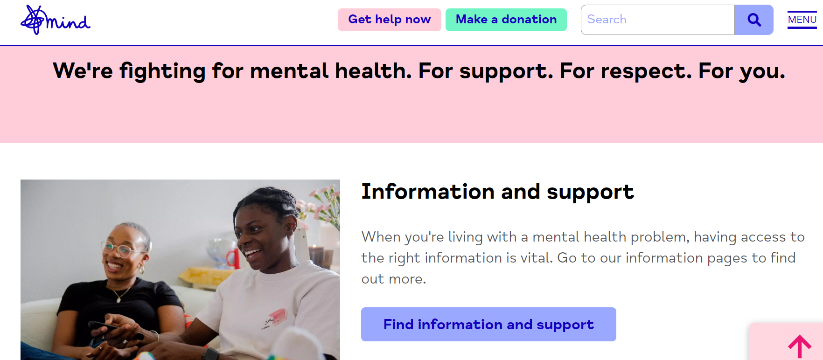
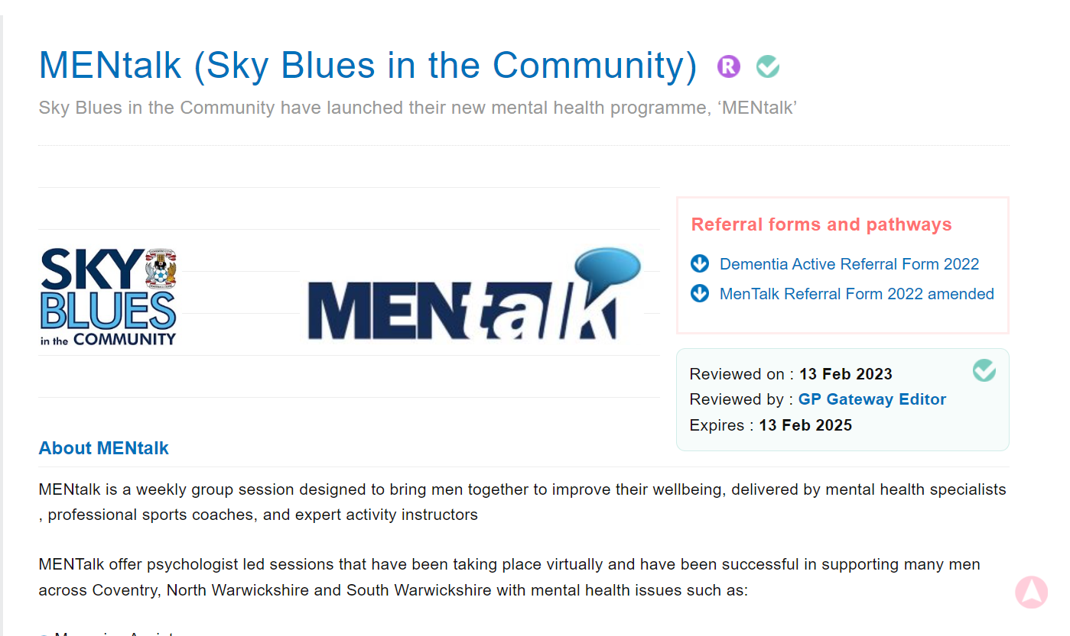
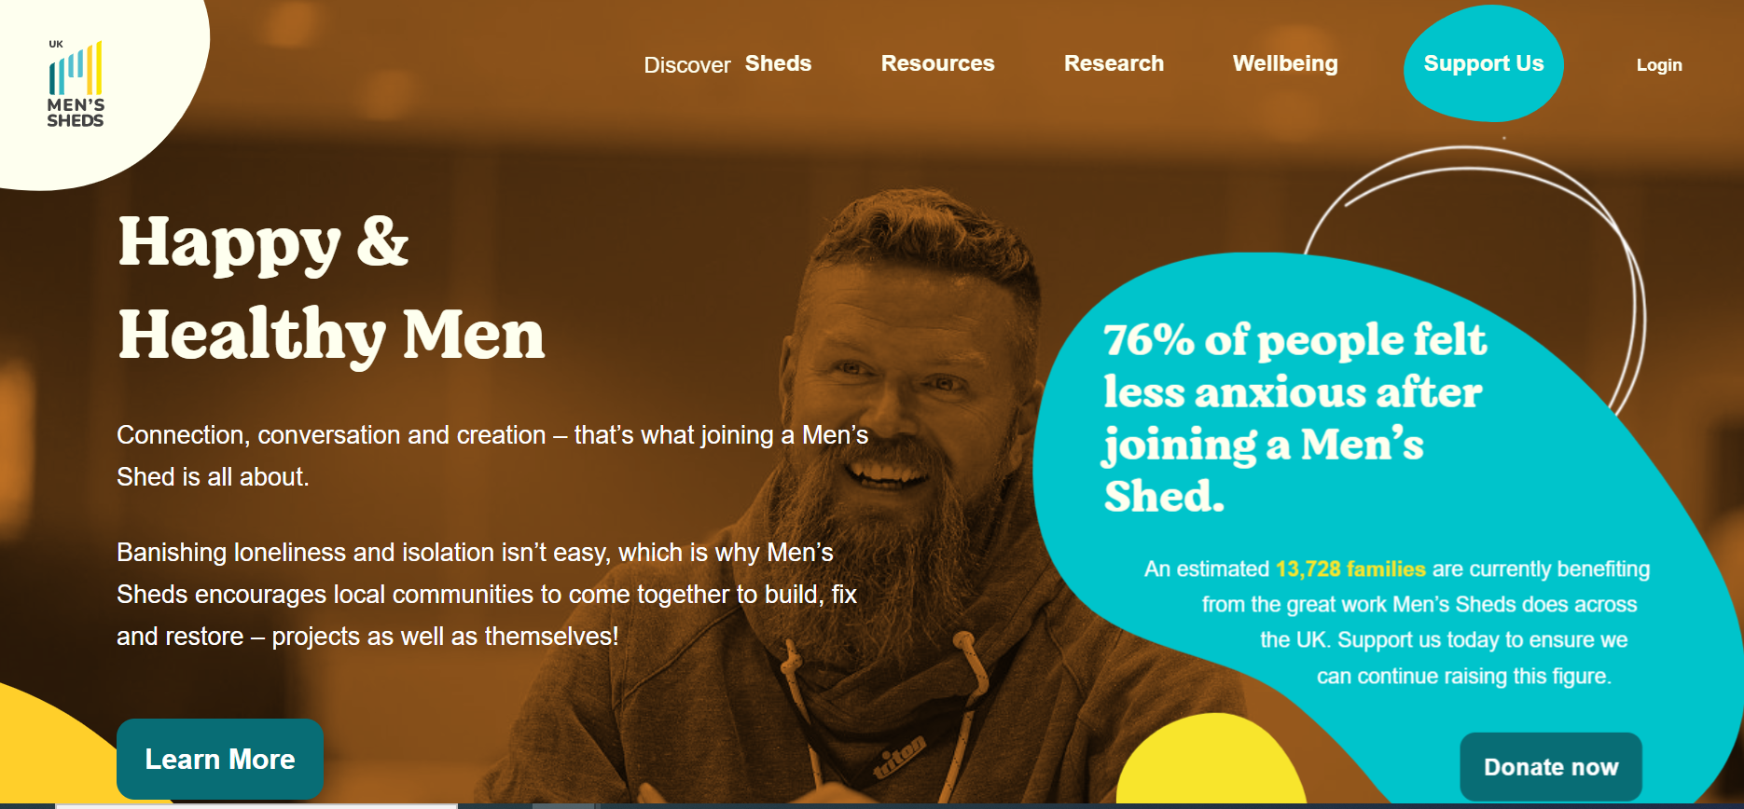

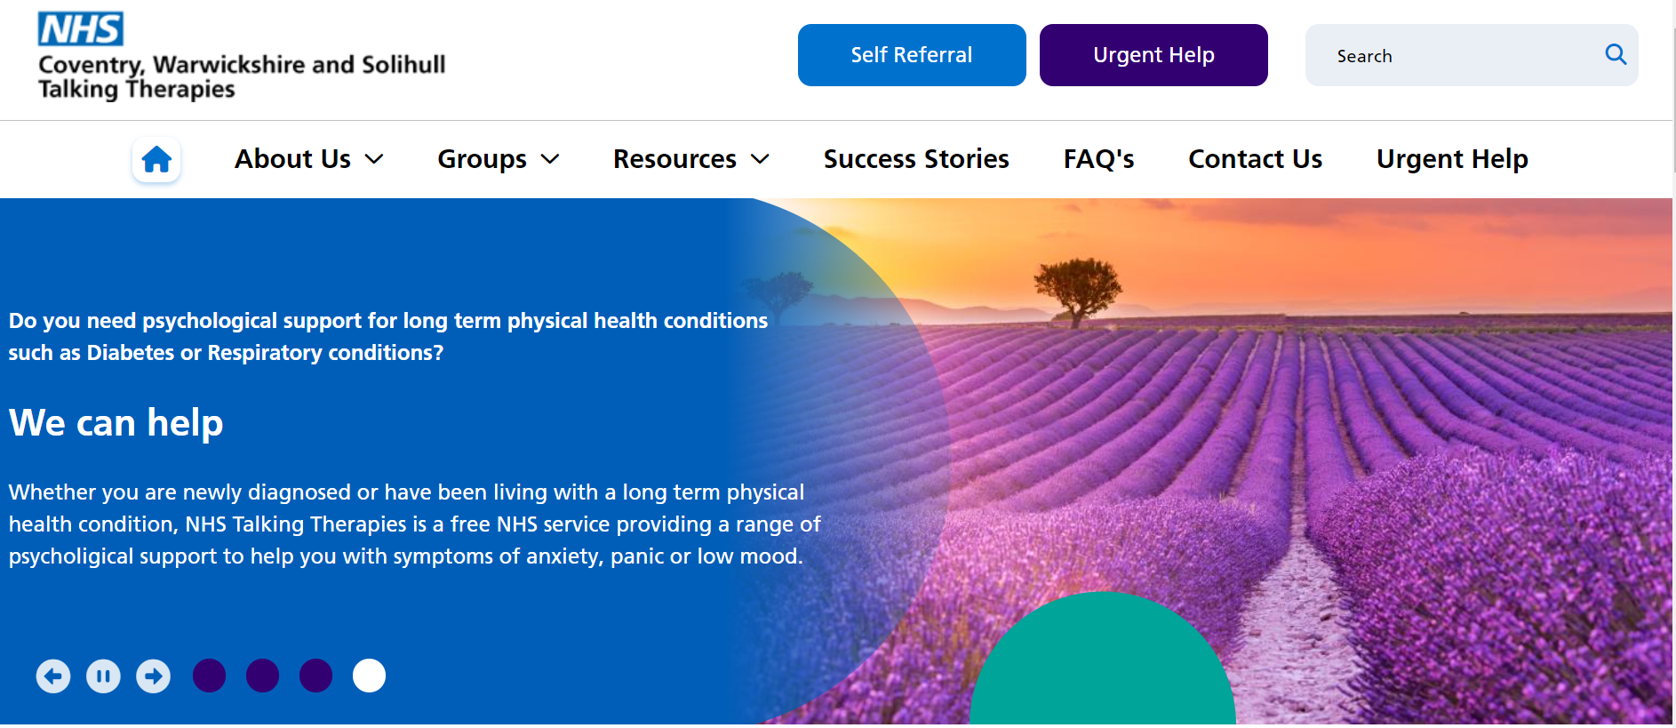
Service Providers

Slide 52
Sharing board activity
Men's mental health board (padlet.com)
Ctrl (click)

Slide 53


Slide 54

Case Study activity

Slide 55

Q&A

Slide 56
Self-care activities
We have several tables /areas set up with activities for you to indulge in:
- Post card painting
-Calm your mind senses and reflection sheets
-Practicing mindfulness/breathing techniques
-Reflection sheets
-Wishing tree
-Outside space -Take a walk, meditate
-Craft -Card /Bauble making
- A cuppa and a chat…
‘Engaging in a self-care routine has been clinically proven to reduce or eliminate anxiety and depression, reduce stress, increase happiness, and more. It can help you adapt to changes, build strong relationships, and recover from setbacks’

Slide 57
Supporting your Health & Wellbeing
Have you met your HWB Champion, and do you know what support they offer?
Find out who your HWB Champion is and how to contact them here.
Have you registered for the monthly work well webinars?
Led by Dr Rachel Morris and team, they deliver 1 hr evening sessions on wellbeing topics. Click here to register for today’s webinar or future sessions.
Have you had a peek at Wellbeing Wednesday and our HWB webpage?
Wellbeing Wednesday can be accessed here.
HWB page on the website is here.
Vivup - Employee Assistance Programme
If you work in general practice, a federation or alliance across C&W – you can access Vivup for free!
You must register using the organisation name ‘Coventry and Warwickshire -General Practice…’ to have access to all the relevant benefits and features.
Vivup offers lifestyle savings for supermarkets, fuel and high street shopping as well as Health and Wellbeing support
Click here to sign up!

Slide 58
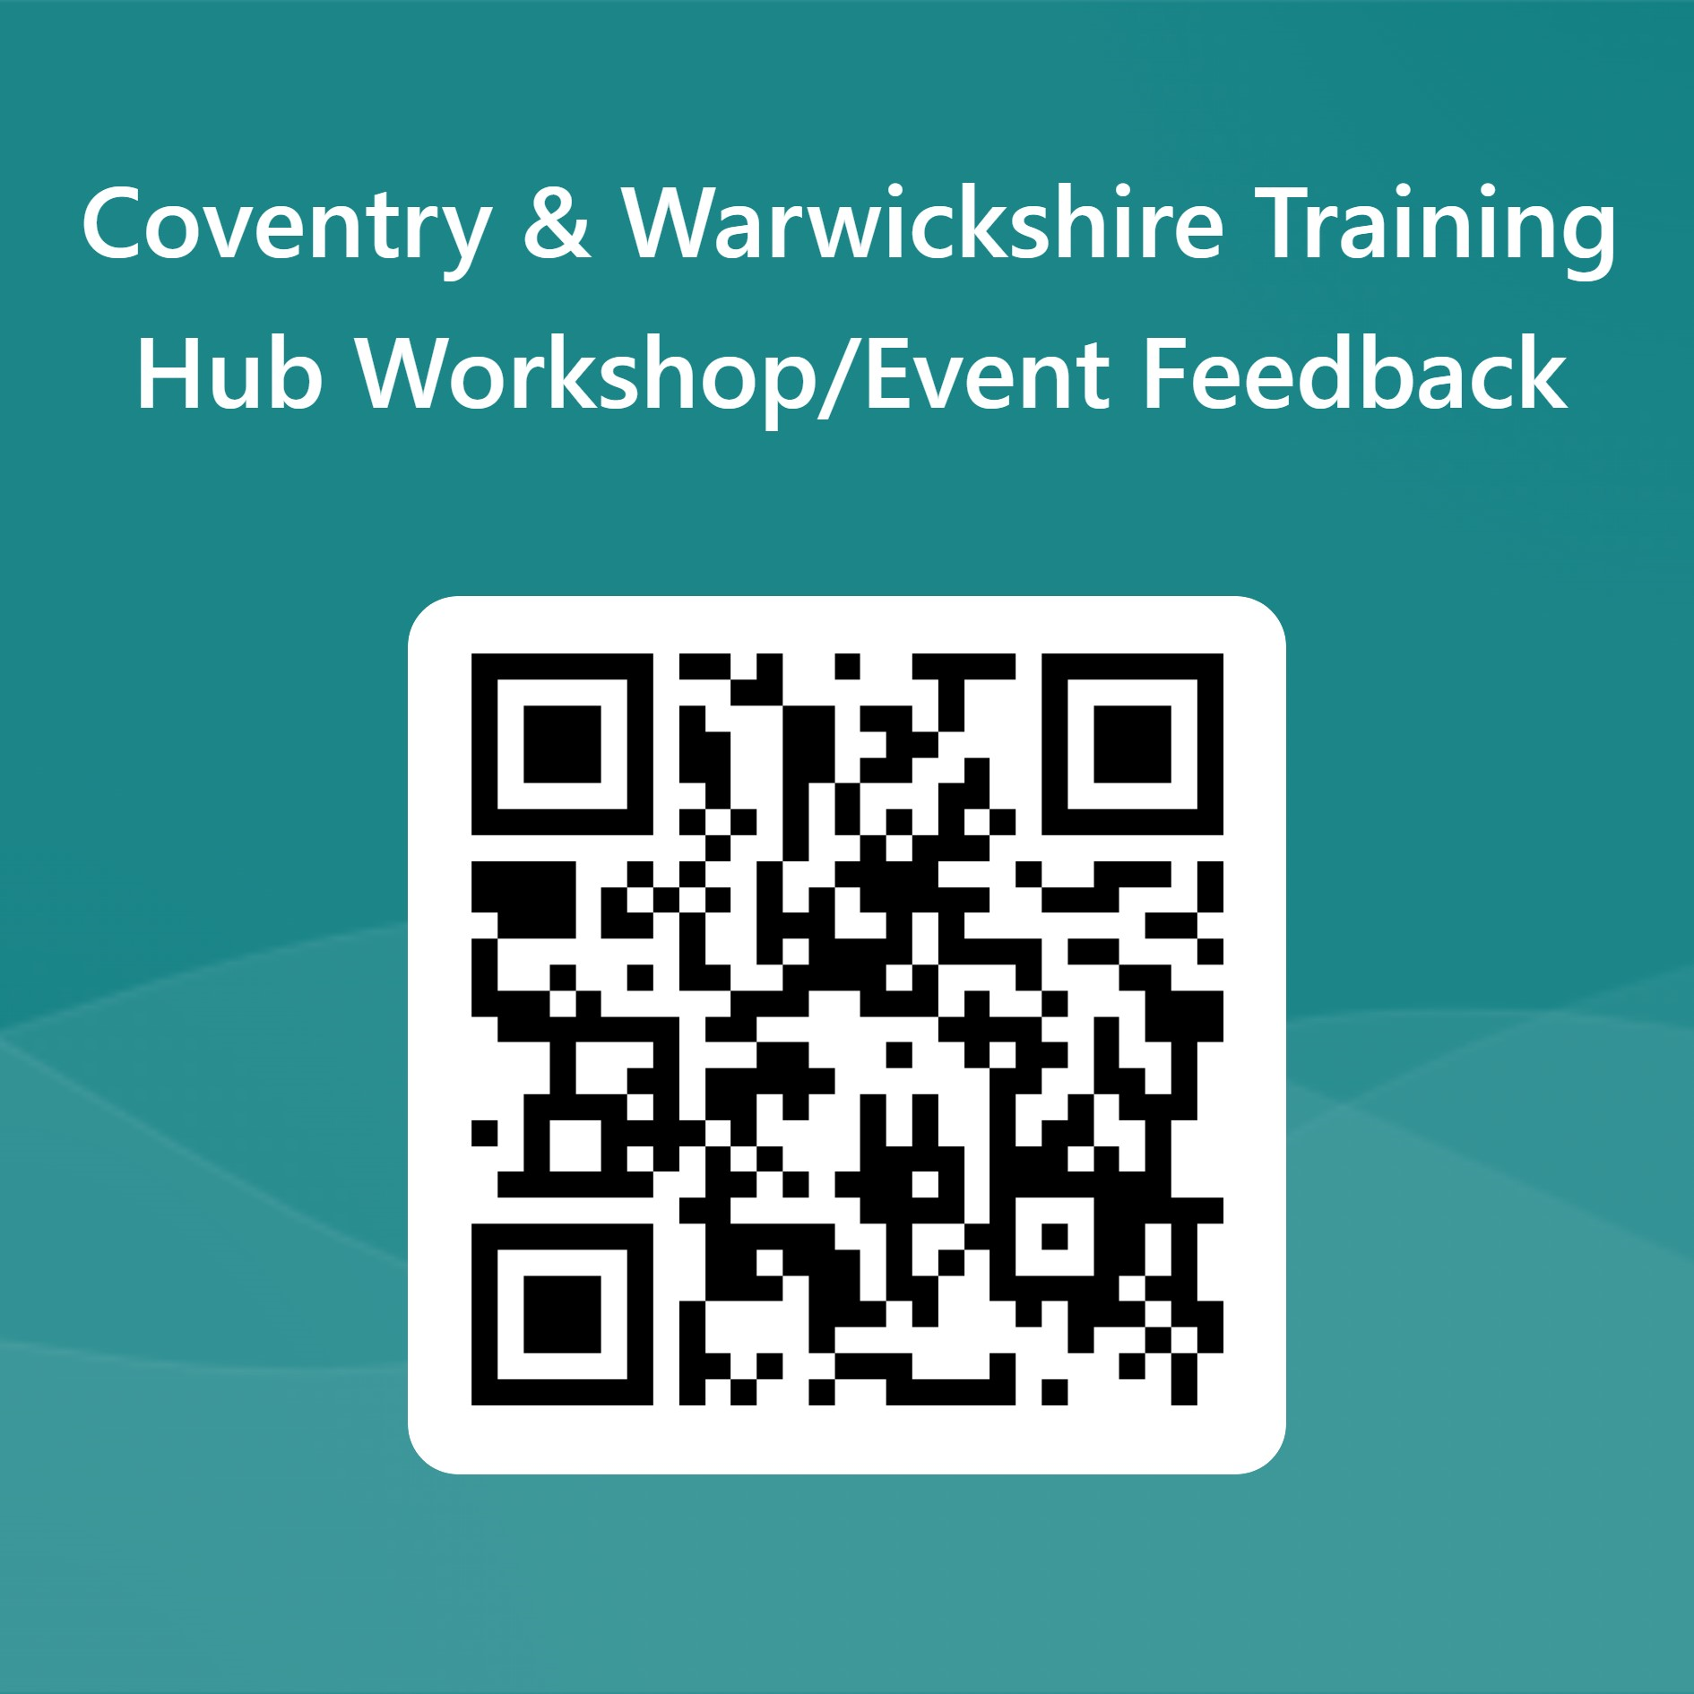
QR Code for Feedback
WORKSHOPFEEDBACK
Notes:
Last page - feedback

Slide 59

Marketplace - Networking

